Slide 1
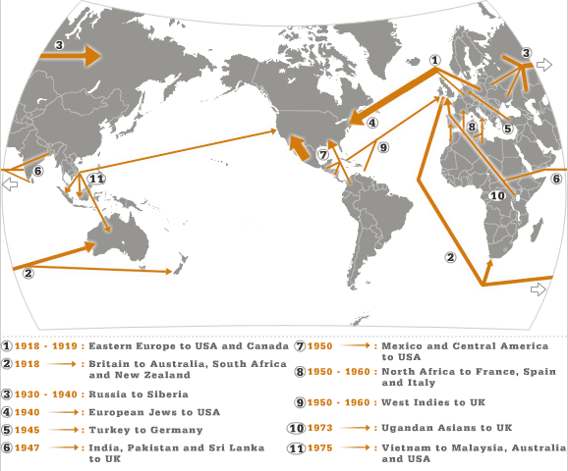
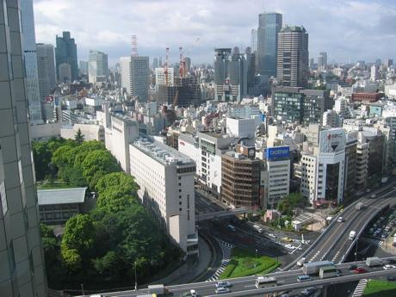
HUMAN GEOGRAPHY 12
In this course you will learn to analyze data, demographic patterns & human patterns of interaction with our planet. You will focus on the human & environmental interaction across the globe and how regions around the world are a combination of the dynamic interaction between humans and their environment.

Slide 2
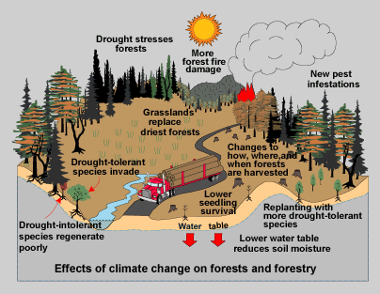
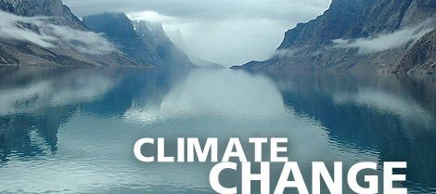
PHYSICAL GEOGRAPHY 12
This Social Science course will introduce you to the awe-inspiring physical diversity of our planet. By investigating the earth, you’ll learn the knowledge & skills needed for a dynamic world. The Big Ideas will look at population patterns and how they are influenced by the environment and human activity and how that, in turn, shapes the landscape in a variety of ways.

Slide 3
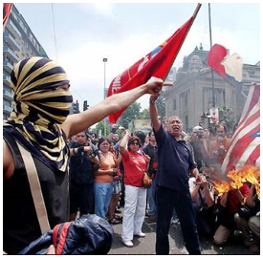
20th CENTURY WORLD HISTORY
In this course, students will use critical thinking skills to analyze documents, images, and pop culture as they explore major events in the last century of human history.
Topics include:
Dictatorships, WWII, the Civil Rights movement, Vietnam, media growth, and the Cold War.
If you've ever wondered how we got here and why, this is the course for you!

Slide 4
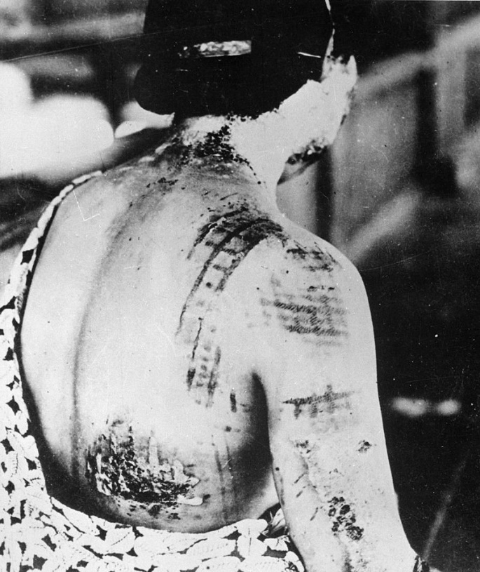
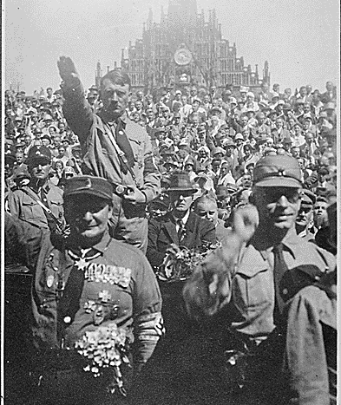
The only thing necessary for the triumph of evil is for good men to do nothing. ~ Edmond Burke

Slide 5
BC First Peoples 12
In this course, you will focus on how the identities, worldviews & languages of the Indigenous Peoples of BC are renewed, sustained and transformed through their connection to the land, the impact of colonialism, rich cultural expressions and self-governance and leadership.

Slide 6
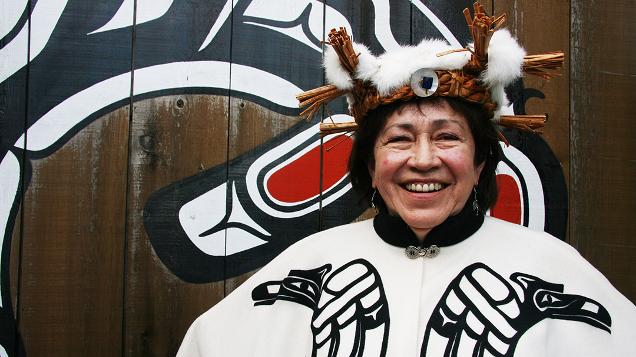
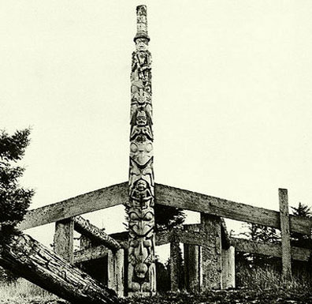
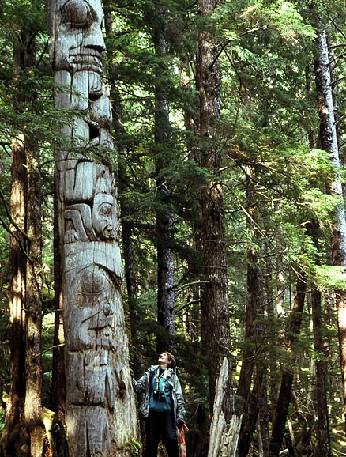
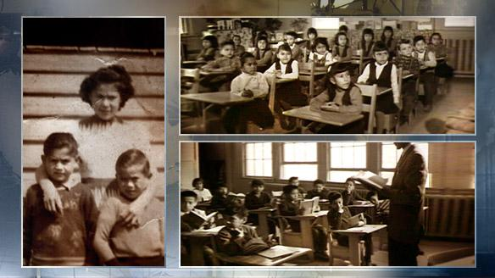
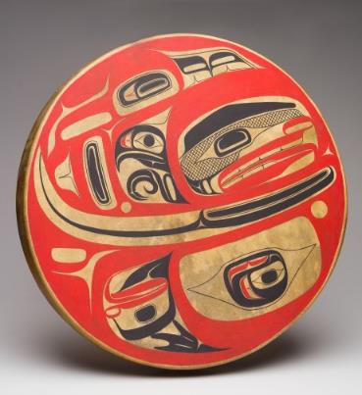
Land Relationships
Cultural Expression
Residential Schools

Slide 7
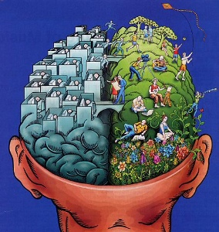
AP PSYCHOLOGY
This course will introduce you to the systematic and scientific study of behavior and mental processes of human beings and animals. You will be exposed to psychological facts, principals, and phenomenon associated with each of the sub fields in psychology. This course offers students the choice of writing the optional AP Exam in May.
“Behavioural psychology is the science of pulling habits out of rats.”
- Douglas Busch

Slide 8
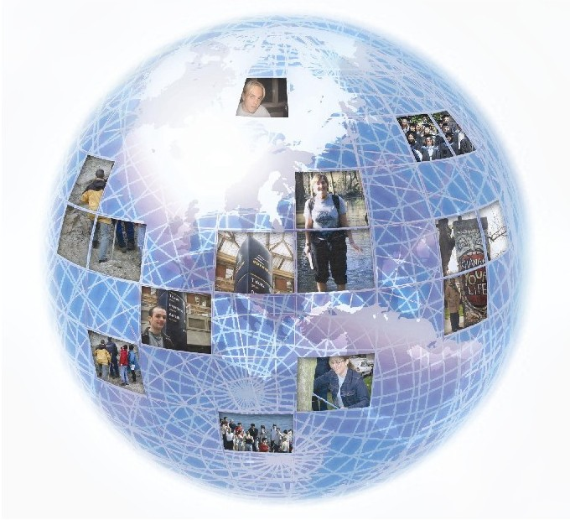
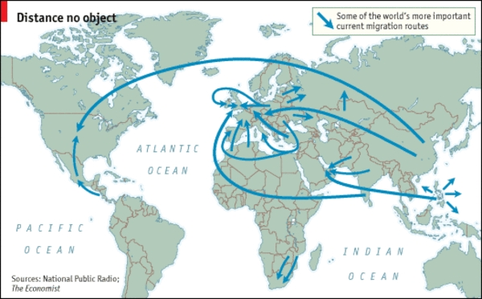
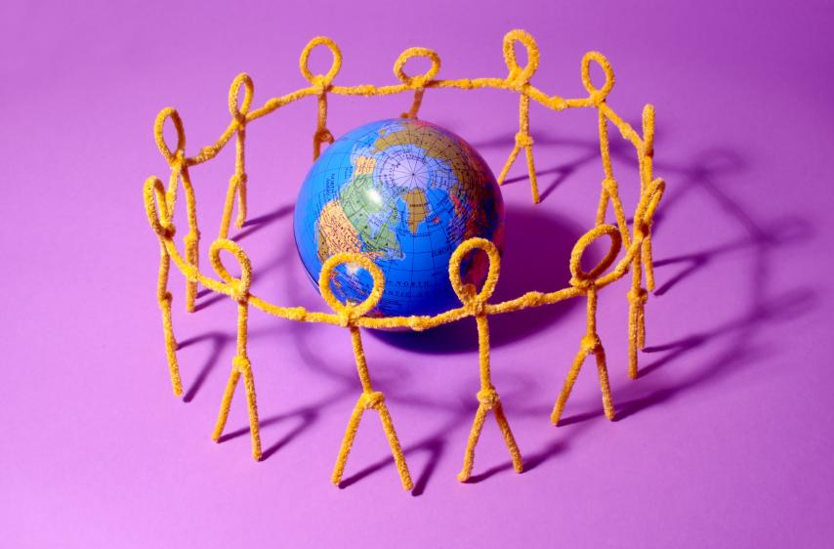
AP HUMAN GEOGRAPHY
The purpose of this course is to introduce the systematic study of patterns and processes that have shaped understanding, use and alteration of Earth’s surface. You’ll use concepts & analysis to examine social organization and its consequences. You will also learn about the methods & tools geographers use in their professional practice. Our study of geography will apply a holistic perspective in examining patterns, places and landscapes, while we find our place in the world.

Slide 9
Talk to your Social Studies Teacher today about the best path for you!
To view this powerpoint in more detail head to our blog at http://blogs.sd41.bc.ca/south-socialstudies/
Follow us on instagram @bbysocialstudies

