Slide 1
SOCIALS 11 EXPLORATIONS
In this course, you may explore and inquire into a range of Social Studies topics including:
Asian Studies Psychology
Politics & Government Genocide Studies
Social Justice Indigenous Studies
Law, and/or Philosophy History
Geography
This might lay the foundation for a more focused pursuit of senior Social Studies subjects.

Slide 2
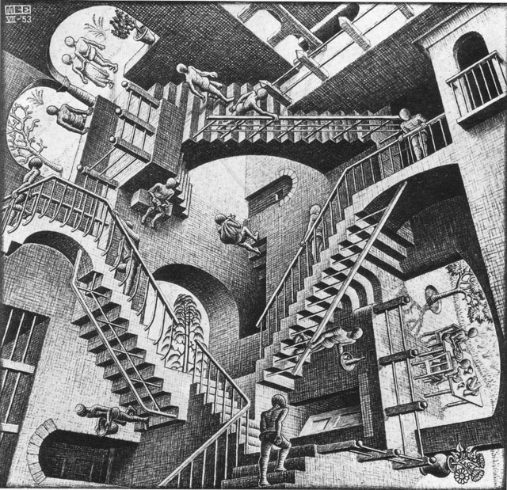
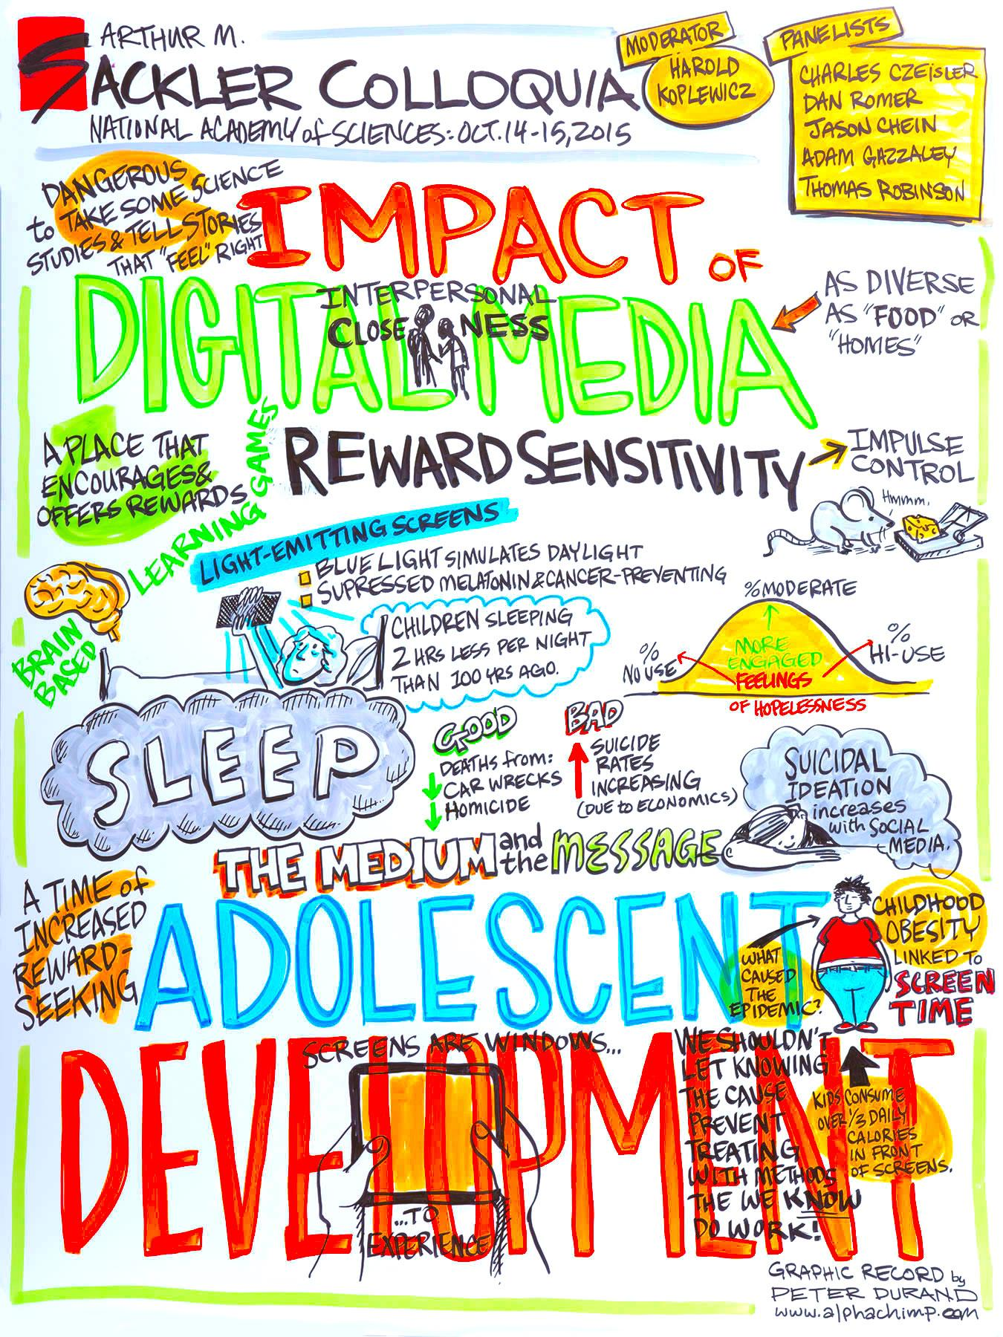
PSYCHOLOGY 11
This is an activities-based, introductory survey course that introduces the study of human behavior & basic concepts in modern psychology. You’ll explore key questions in Psychology & how psychologists answer these questions.
This course covers different topics to Psych 12. Students in grades 10-12 can take this course. (So current grade 9s can apply for it as part of their grade 10 selection).
Psych 11 and 12 over different topics. In Psych 11 students focus on memory, development, psych disorders and sensation/perception.
This course promotes critical thinking in a range of group/individual activities.

Slide 3
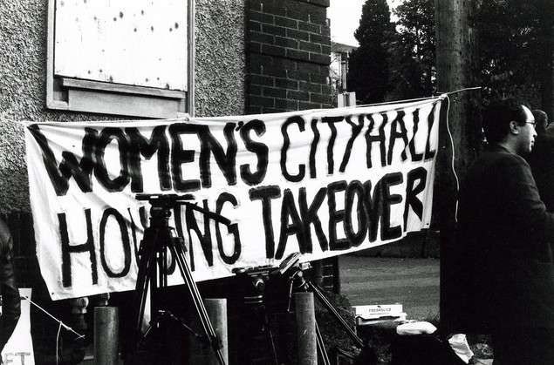
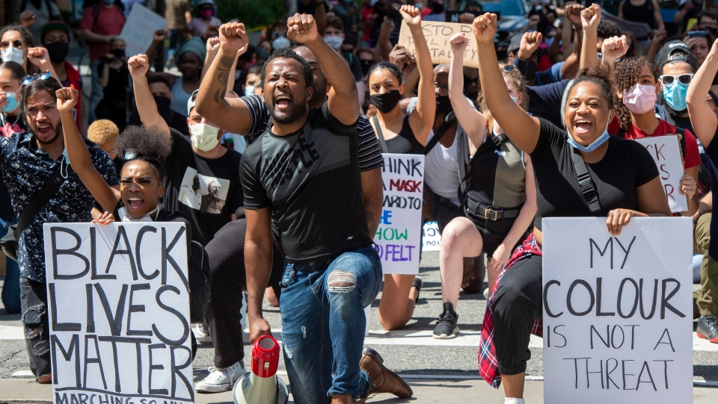
SOCIAL JUSTICE 12
Students will develop ethical & philosophical reasoning skills by exploring issues of injustice in a local and global context. Students will work to invoke change to become ethical and socially responsible global citizens.
Topics include:
Animal rights Child labour RacismEnvironmentalism
Media Homophobia Global issues
SJ “heroes” Consumerism Women’s rights Propaganda Extremism

Slide 4
LAW 12
This course will give you everything you need to know about the Canadian Legal system with a hint of comparison to the American system. This class focuses on statute and case law, the Charter of Rights and Freedoms, and the Criminal and Civil law.
Students will need to be aware of current events and follow cases as they are happening. This is an academic elective with profound focus on debate, discussion, reading and writing.

Slide 5
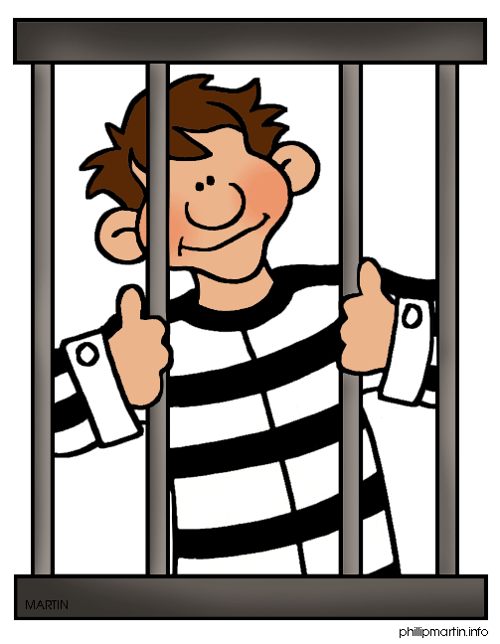

Slide 6
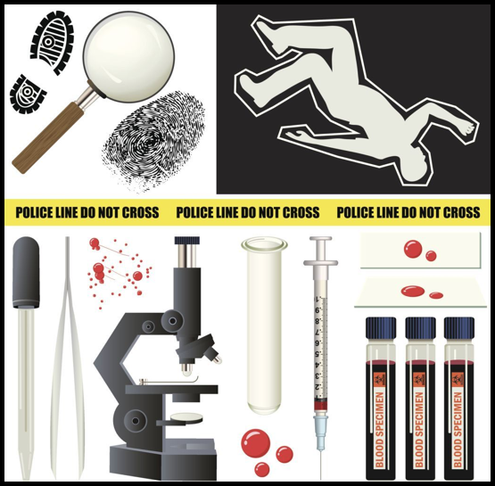
CRIMINOLOGY 12
You will examine the causes and effects of crime as they relate to Canadian society. An analysis of what constitutes a crime (once committed), those who are brought into play & the carried consequences will be examined.
Statistics, theories and the media will be included and debated.
The course will evaluate whether our judicial system is proactive or reactive?

Slide 7
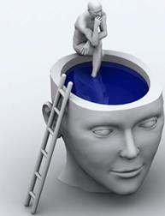
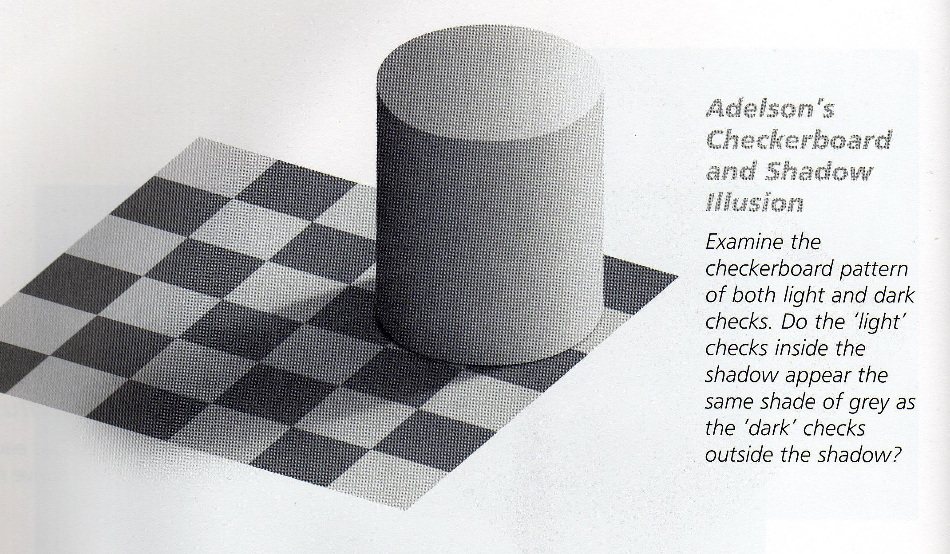
PSYCHOLOGY 12
Students will learn about human behavior and examine the three main debates and research questions Psychologists continue to study. Students will develop critical thinking skills, as well as applying those skills to real life case studies and engaging activities and experiments.

Slide 8
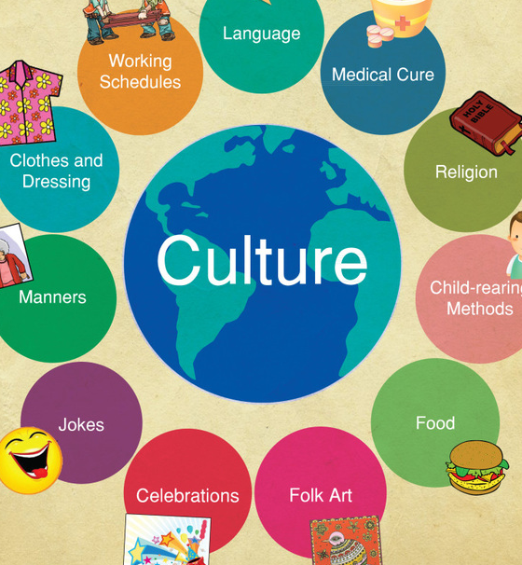
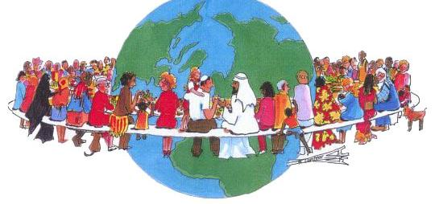
GLOBAL + INTERCULTURAL STUDIES 12
You will explore the concept of culture & how it shapes our thinking, behaviour, family lives & relationships as well as world cultures, current events, writing, art & film from many cultures. We will learn together through dialogue, discussion & projects.
The goal of this class is to help students thrive in a global world, to resist stereotypical thinking & to recognize imbalances of power & inequity.

