Slide 1
Social Studies Department
BURNABY SOUTH SECONDARY SCHOOL AND PROVINCIAL SCHOOL FOR THE DEAF
Course Overviews
5455 Rumble Street
Burnaby, B.C. V5J 2B7
Phone: 604-296-6880

Slide 2
CURRICULAR COMPETENCIES
In Social Studies, you will work to LEARN:
Significance
Assess the significance of different people, places, events, maps, texts, or developments in time
Evidence
Assess the credibility of multiple sources & the adequacy used to justify conclusions
Continuity & Change
Characterize different time periods in history & turning points that marked different periods in time
Cause & Consequence
Determine which causes most influenced decisions & changes & their long- & short-term consequences
Critical thinking in Social Studies

Slide 3
CURRICULAR COMPETENCIES
Perspective
Explain different perspectives of people, places, issues or events over time
Ethical Judgment
Make ethical judgments and assess the limitations of drawing direct lessons from the past

Slide 4
THE HONOURS PROGRAM
The Social Studies Department offers Honours courses in Grades 8-10 as well as an AP Program. Did you know that you can enroll in any Social Studies Honours course? Speak to your Social Studies teacher!
Grade 8-9: Students can sign up for the Honours portfolio where students get enrichment opportunities.
Are you someone who:
Is curious about, or has an obvious interest in Social Studies?
Has good critical thinking skills?
Likes to learn new concepts, skills and strategies quickly?
Is able to express their ideas clearly & effectively in writing and discussions or debates?
Is an active citizen? For example:
Eager to engage in small or large group activities, discussions or debates
Respects diversity
Takes responsibility for their own actions
Is in good academic standing?
If you answered yes then you should think about signing up for honours.
Contact Information:
Tanu Sandhu, Department Head
tanu.sandhu@burnabyschools.ca

Slide 5
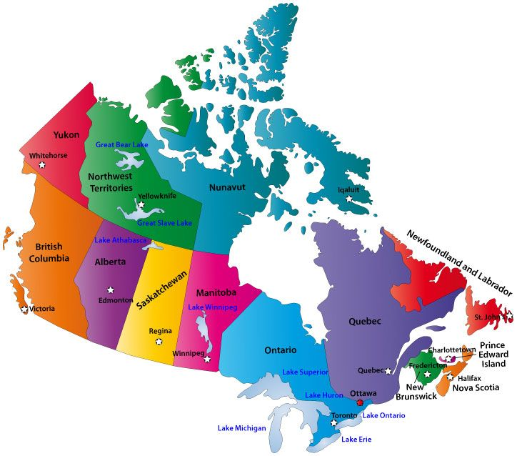
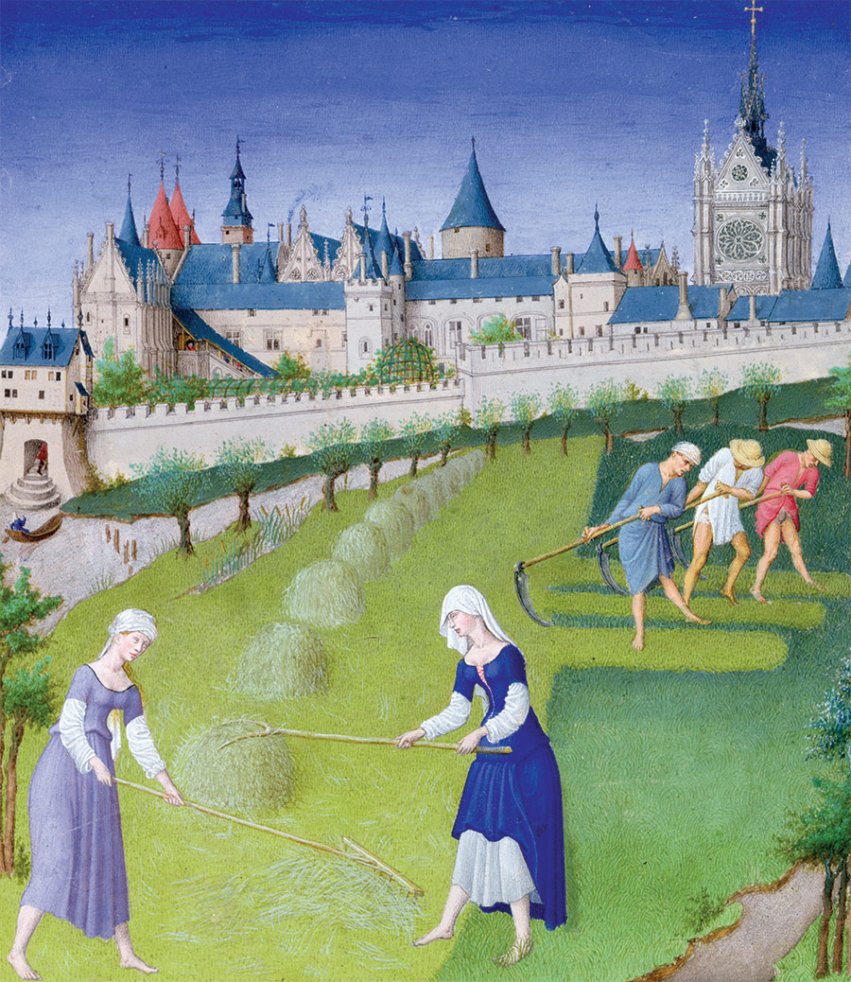
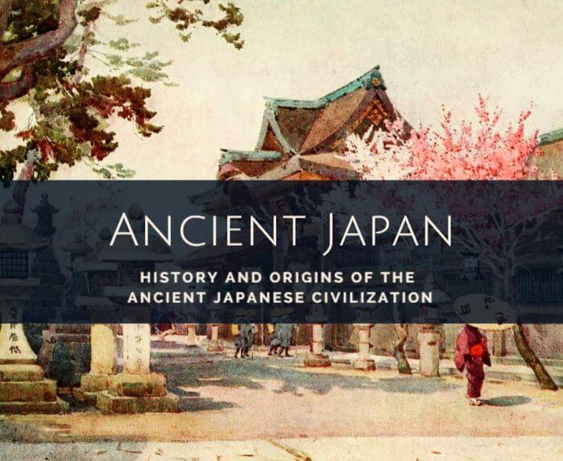
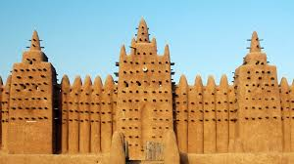
SOCIAL STUDIES 8
Explore the issues, life-changing events & amazing people that helped shape our world between 750-1750.
Socials 8 is organized into 4 big ideas:
Long term change is shaped by cause & conflict;
Human & environmental factors shape changes in population & living standards;
Expansion & exploration led to varying consequences for different groups;
Changing ideas about the world created tension between people wanting to adopt new ideas & wanting to preserve established traditions.

Slide 6
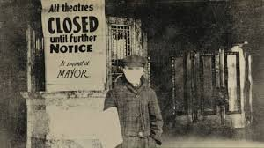
SOCIAL STUDIES 9
You will explore the issues, events & peoples (between 1750-1919) related to 4 big ideas:
Emerging ideas & ideologies profoundly influenced societies & events;
Collective identity was/is “constructed” & can change over time;
The physical environment influences the nature of political, social & economic change;
Disparities in power alter the balance of relationships between individuals & society.

Slide 7
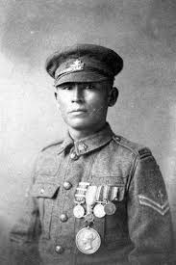
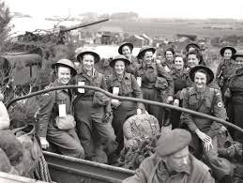
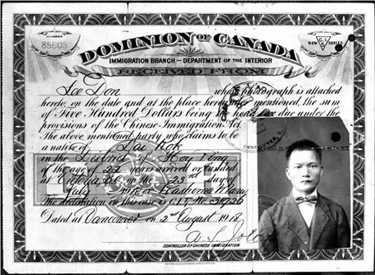
SOCIAL STUDIES 10
Within the time period 1918-present day, you will explore issues, ideas, events & peoples related to 4 big ideas:
Conflicts have been a powerful force in shaping our contemporary world
The development of political institutions is influenced by economic, social, ideological, & geographic factors
Worldviews lead to different perspectives & ideas about developments in Canadian society
Historical and contemporary injustices challenge the narrative and identity of Canada as an inclusive, multicultural society.

Slide 8
Talk to your Social Studies Teacher today about the best path for you!
To view this powerpoint in more detail head to our blog at http://blogs.sd41.bc.ca/south-socialstudies/
Follow us on instagram @bbysocialstudies

