Slide 1
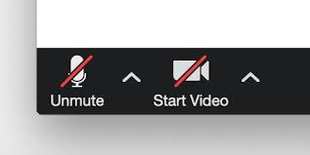
Career Life Connections (CLC) 11
Graduation Project Overview
March 8: Alpha Group M-Z
March 9: Alpha Group A-L
March 10: Make-up meeting
Please mute your microphone and turn off your camera!

Slide 2
For attendance:
please make sure to change your display name to your:
FIRST & LAST Name
How?
Right click on your display and select “Rename”

Slide 3
CLE/CLC Credits
8 Credits are dedicated to Career Education and are required for graduation:
Career-Life Education (CLE) 10
4 credits
Career-Life Connections (CLC) 11
2 credits
Career-Life Connections (CLC) 12
2 credits

Slide 4
Missing/
Didn’t Pass CLE 10?
What are your next steps?
Chat with your counsellor!
Possible options:
Enrollment into CLE10 at South
Take it online with Burnaby Online
Need to complete and pass CLE 10 to meet the graduation requirements

Slide 5
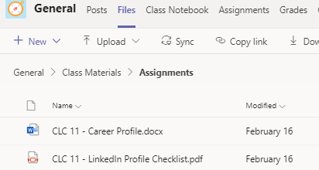
The Q1 & Q2 assignments are now CLOSED.
In order to find the assignments go to “Files” tab at the top of your homepage.
Did not handed in your
Q1 and Q2 assignments?
Submit them with your Q3 assignments.

Slide 6
CLC Graduation Project
What you need to know!

Slide 7
What is the CLC Graduation Project? (Capstone)
The CLC Graduation Project is the cumulative project for CLC 12.
ALL students in BC are required to complete the Graduation Project.

Slide 8
You will plan, design, document, create and present a project on a topic of your choosing.

Slide 9
This project is student-centered, and allows you to personalize their learning in an area you are passionate about

Slide 10
This project should be something you value, care about, or find interest in. Only then will it be meaningful and purposeful.

Slide 11
Time Commitment
Be prepared to invest at least 20-30 hours towards completing your Grad Project.
This is separate from your 30 Hours of Work/Volunteer Experience, or the 80 Hours Work Experience (WEX) course.

Slide 12
Why are we doing this project?
In addition to it being a graduation requirement, the Grad Project is a celebration of your learning.
This project is designed to encourage you to think critically, solve problems and develop existing or new skills.
It will allow you to connect with the world outside of school and to demonstrate that you have the skills to go on to further your education and enter the workforce.
Furthermore, it’s a good project to add to your portfolio.

Slide 13
The Grad Project consists of 4 components:
Proposal
Process
Portfolio
Presentation

Slide 14
1. Proposal

Slide 15
Proposal
Process
Portfolio
Presentation
The Proposal will outline your chosen project.
Your project should focus on developing a skill/skillset in a career area or a passion.

Slide 16
Proposal
Process
Portfolio
Presentation
Q4: You will need to submit a Project Proposal through Teams by April 19.
After submitting your Proposal, you will meet with Mr. Kwan/Ms. Kuang to discuss your plan and receive feedback at an individual meeting in Q4. Meeting dates/times TBA.

Slide 17
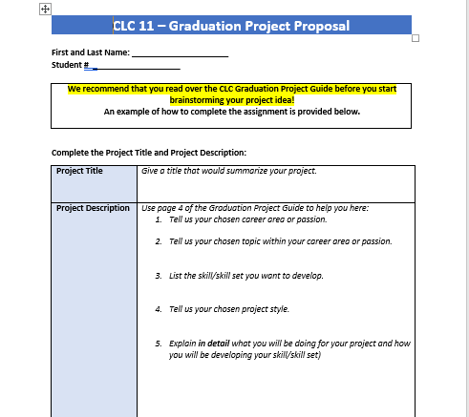
grad project PROPOSAL
Please refer to the example in the assignment as a reference to help you fill out the Proposal
Provide as much detail as you can. Elaborate on your Reponses!

Slide 18
How to Choose A Grad Project Idea???
Step 1: Choose a career area or passion you are interested in exploring.
Step 2: Choose a specific topic within that career or passion.
Step 3: Identify a skill/skill set that you want to expand on within the topic you have selected.
Step 4: Choose a project style to carry out your project.

Slide 19
There are 5 Project Styles:
Project
Event
Entrepreneurial
Service
Research

Slide 20
There are 5 Project Styles:
Project – Focus is to develop, design and build a model of a tangible object
Event – Research, create and host an event
Entrepreneurship – Prepare a business plan. This project will allow you to experience start of a new business.
Service – Research an issue in your community, develop and implement a solution.
Research – Academic research or experiment to develop new arguments or insights

Slide 21
Please read the
Grad Project Student Guide:
more info about the 5 different project styles
step-by-step instructions of how to carry out each project style
Notes:
You are not limited to the 5 project styles, if there is some other format/style in which you like to carryout your project, speak with Mr. Kwan/Ms. Kuang

Slide 22
Proposal
Process
Portfolio
Presentation
After your proposal is approved, you will start your project in Gr 12.
You will dedicate at least 20-30 hours towards the project.
This is a collection of the assignments you need to hand in.
It includes:
-Final Plan
-Action logs
-Resources page
-Self- assessments
Presentation of what you accomplished for your project.

Slide 23
Mentorship
As part of your Grad Project, you will be asked to find a mentor(s) to guide and support you through the completion of your project
Your mentor will play an important role in helping you with career-life development
planning, decision making, exposure to possibilities and finding opportunities

Slide 24
Having a mentor can be a powerful and rewarding experience.

Slide 25
Mentorship
Your mentor should be an adult:
family member
community member
Must have some expertise or knowledge in the area you are exploring for your Grad Project.

Slide 26
Mentorship
The length of time you spend with your mentor is up to you and dependent on your individual needs.
How the mentorship looks will vary from person to person.
E.g. some may meet once for resources/interview, others may meet monthly for project feedback.

Slide 27
Project Examples

Slide 28
Example 1: You are interested in being a program coordinator for a youth centre e.g. Burnaby Neighborhood House.
1. Career Area: Program Coordinator
2. Topic: Educate youth about positive mental health and coping mechanisms for stress and anxiety
3. Skill Development:
Advising
Presentation
Communication
Coordinating
Researching
4. Project Style: Event/Service
5. Project Details: Collaborate with the Burnaby Neighborhood House to host a zoom workshop to educate students about importance of mental health and strategies they can use to cope with stress and anxiety.

Slide 29
Example 2: You are interested in becoming an architect.
1. Career Area: Architect
2. Topic: Learning about drafting.
3. Skill Development:
Drafting and design skills
3D modelling
Learn to use CAD software
4. Project Style: Project
5. Project Details: Will use CAD to design a 2D rendering of a small commercial building and construct a 3D model.

Slide 30
Example 3: You are interested in becoming an entrepreneur.
1. Career Area: Entrepreneur
2. Topic: Owning a small cafe
3. Skill Development:
Strategic thinking and planning skills
Financial skills
Branding and marketing
4. Project Style: Entrepreneurship
5. Project Details: Will work with a mentor knowledgeable in business start-up to draft a business plan for a small café.

Slide 31
Example 4: You are passionate about baking.
1. Passion: Baking
2. Topic: Fondant Cake Making 101
3. Skill Development:
Recipe development
Understanding ingredients
Refining baking techniques
4. Project Style: Project
5. Project Details: Will work with a mentor knowledgeable in baking to learn how to make a two tiered fondant cake.

Slide 32
Example 5: You are interested in science.
1. Career Area/Passion: Science Technology
2. Topic: Running shoe design in relation to performce
3. Skill Development:
Academic research skills
Application of the scientific method
Interpreting and evaluating peer reviewed articles
Communicating information
4. Project Style: Research
5. Project Details: Conduct an experiment on the performance between two running shoes using volunteers. Collect feedback/data. Read research articles and draft a prototype of a shoe that will make a runner perform faster.

Slide 33
Q3 Assignments
Resume
Write an up-to-date resume.
Focus on adding “Accomplishment Statements”.
2. Post Secondary Personal Profile
Questions
DUE APRIL 9th on Teams

Slide 34
Q4 Assignments/Meetings
Graduation Project Proposal
DUE: April 19th on Teams
2. Individual Meeting for Proposal
Starts April 19th. Check for the schedule outside Student Services after Spring Break.
At this meeting you will need to bring:
1. HARDCOPY of your Graduation Project Proposal
2. HARDCOPY of your resume

Slide 35
Contact Us
Ms. Kuang (Last Names A – L)
Email: anna.kuang@burnabyschools.ca
Mr. Kwan (Last Names M – Z)
Email: kenneth.kwan@burnabyschools.ca
Blog: http://blogs.sd41.bc.ca/south-gradtransitions/
Instagram page: clc_burnabysouth
Visit us in person: Career Programs Office at Student Services (C105)

