Slide 1
RESUME 101 How to Write a Strong Resume

Slide 2
Hello!
Please take the time to read over the PowerPoint information to help you write/up-date your resume.

Slide 3
What is a Resume?
A resume is a compilation of your education, work experience, credentials and accomplishments.
Most jobs and professions require a resume as part of the hiring process.
It’s the first thing a recruiter or hiring manager will look at when reviewing job applications.

Slide 4
6 seconds
Is the average time recruiters and hiring managers spend reviewing your resume before they make an initial decision.
Notes:
Make your first impression count!

Slide 5
RESUME STYLES

Slide 6
Resume Styles
There are several basic types of resume styles, each serving a different purpose.
The three most common ones are chronological, functional, combination.

Slide 7
Click here to read more about the different resume styles.
Notes:
Image from The Balance Careers: https://www.thebalancecareers.com/resume-types-chronological-functional-combination-2063235

Slide 8
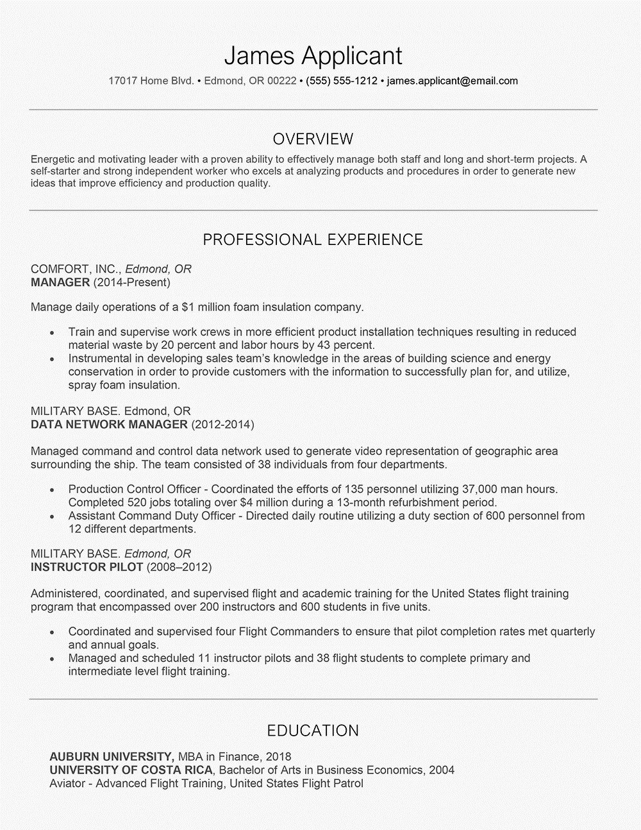
Chronological Resume
The most common resume type.
Lists your work experience in reverse chronological order, from the most to the least recent.
Notes:
Image from The Balance Careers: https://www.thebalancecareers.com/chronological-resume-example-2063152

Slide 9
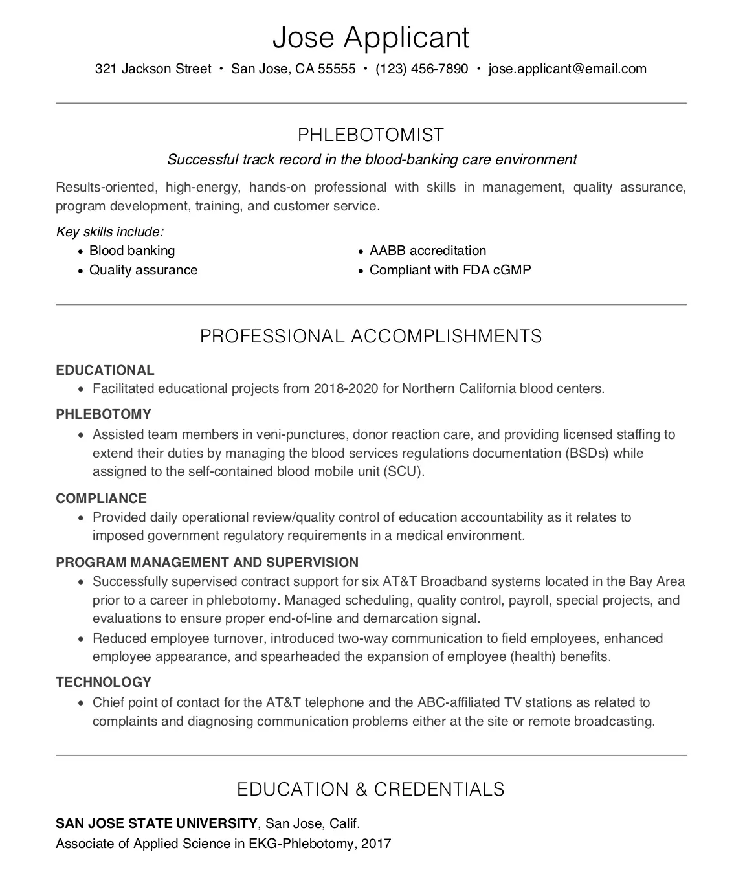
Functional Resume
A functional resume only showcases you skills. No work history.
Used by job seekers who are changing careers or have gaps in their employment history.
Notes:
Image from The Balance Careers: https://www.thebalancecareers.com/what-is-a-functional-resume-2061997

Slide 10
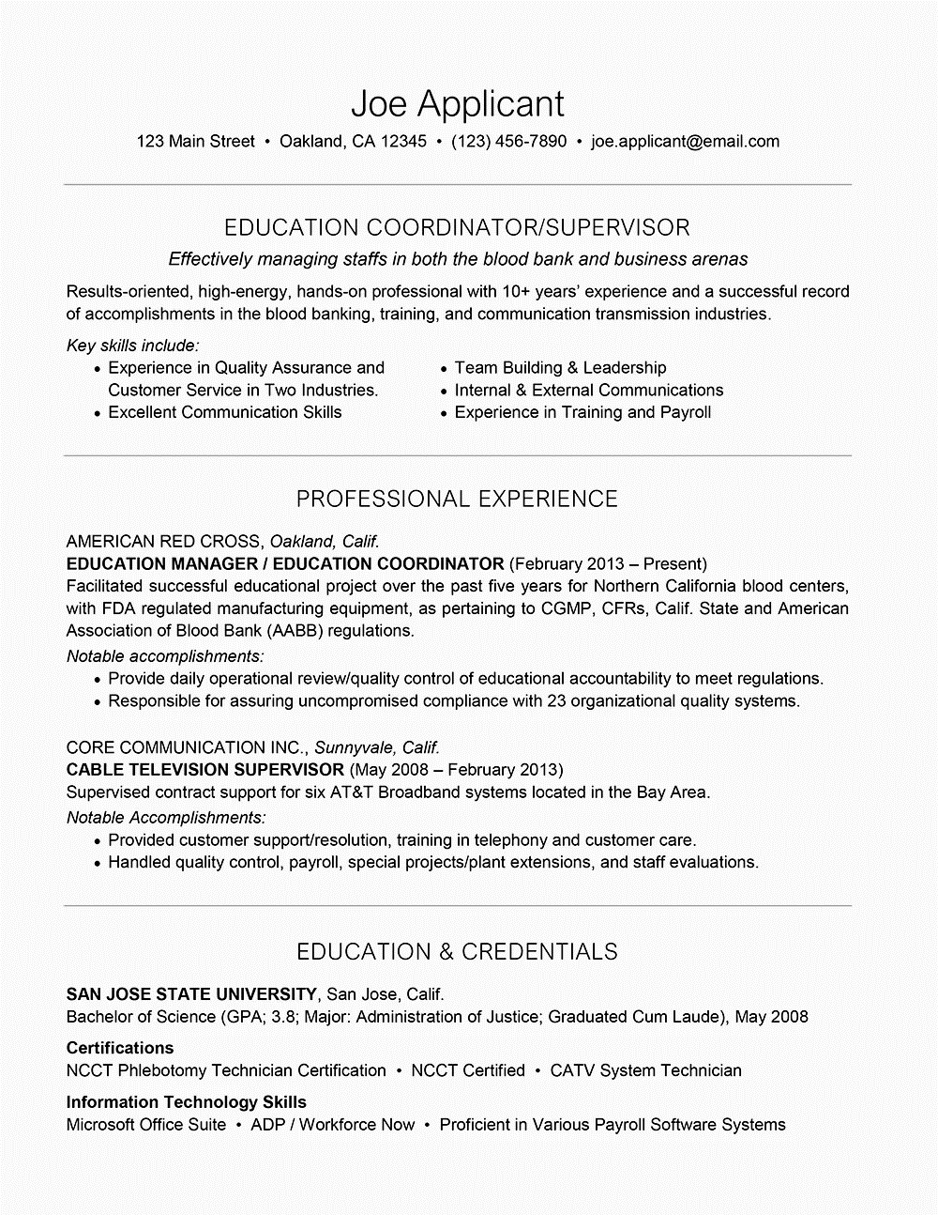
Combination Resume
Lists your skills and experience first, then your employment history.
As a student, a combination resume is deal.
It combines both the chronological and functional resume styles.
It showcases the skills you have that are relevant for the job you are applying for, while also providing your work history.
Notes:
Image from The Balance Careers: https://www.thebalancecareers.com/what-is-a-functional-resume-2061997

Slide 11
Sections to Include on your Resume
13

Slide 12
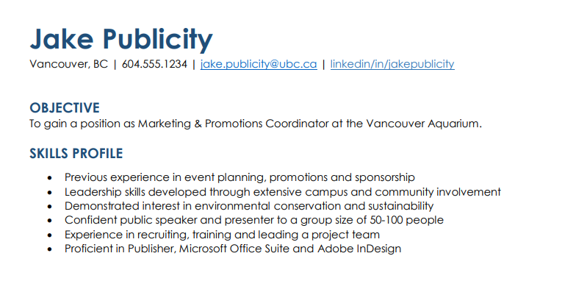
Header & Contact Info
First and Last Name (Use a larger text, but no larger than 20-24 point size)
Mailing address
(Professional email)
Phone Number
Email address
LinkedIn (optional)

Slide 13
Objective (optional)
States your goals for employment.
Listed at the top of your resume.
1-2 sentences long.
Some career experts say resume objectives are outdated and some say it’s still valuable.
Clich here for more info & examples

Slide 14
Profile
Alternate headings you can use: Overview, Summary
This section of your resume lists a brief summary of your skills and experiences that are related to the position you are applying for.
This section is at the top of your resume, under your name/contact info.
Click here for more info and examples

Slide 15
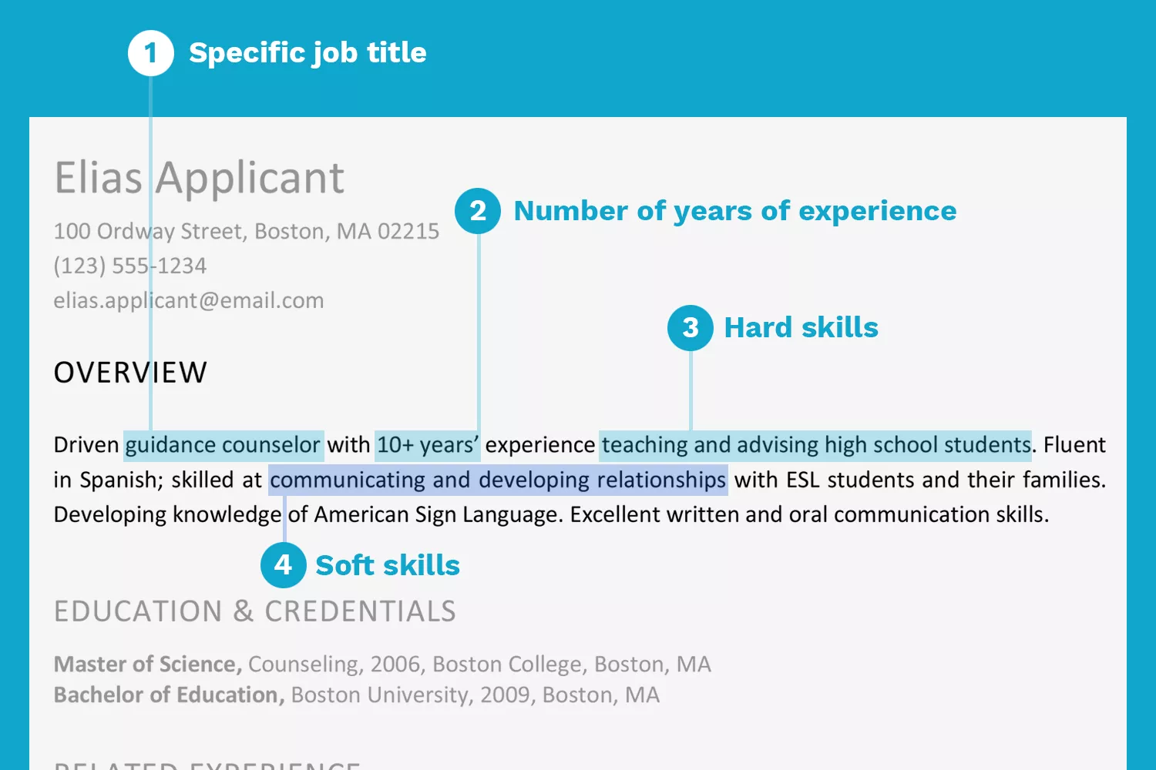
The Profile can be written as a short paragraph like this:
Notes:
Photo from The Balance Careers: https://www.thebalancecareers.com/resume-profile-examples-2062828

Slide 16
Or it can be in bullet points like this:
Notes:
Photo from The Balance Careers: https://www.thebalancecareers.com/resume-profile-examples-2062828

Slide 17
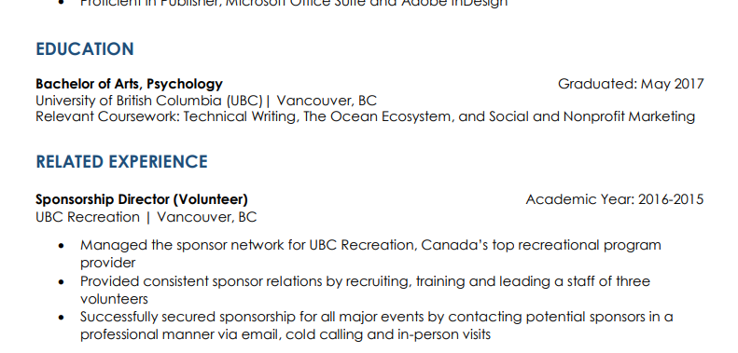
Education
You can add “Expected graduation”
“Relevant coursework” is a list of courses that relate to the position you are applying to, otherwise you can leave out.

Slide 18
Work Experience
19
You can have two sections: one for work experience and one for volunteer/additional experience.
If you have not yet accumulated much work experience, you can combine both work and volunteer experience under one heading – work experience.
In this section you will list your work history.
Must include:
Company #1
City, State Dates Worked
Job Title
Responsibilities / Achievements
Responsibilities / Achievements
Make sure to use accomplishment statements!!!
Notes:
List the companies you worked for, dates of employment, the positions you held, and a bulleted list of responsibilities and achievements.

Slide 19
20

Slide 21
Certifications, Awards and Accomplishments
List any certificates you have.
Mention any awards and achievements you have earned. Remember to include dates of when you received the awards in reverse chronological order.

Slide 22
Personal Interests
If you have personal interests that strongly relate to the position you are applying for, list them.
This is helpful if you are applying for jobs where you don’t have a lot of related work experience, but experience achieved in other ways.

Slide 23
WHAT MAKES A GOOD RESUME
21

Slide 24
1. Use “Accomplishment Statements”
Showcase what you accomplished in each position rather than list your roles and duties.
Providing quantifiable (numerical) achievements help your resume STAND OUT.
Start your accomplishment statement with a action verb, there is no need to say “I managed…”, start with “managed…”
Video on how to write accomplishment statements
Notes:
Video: https://www.youtube.com/watch?v=bOSKynkOgQE&feature=emb_title

Slide 25
Salesperson Example:
Rather than:
Assisted customers with their purchases.
Use:
Exceeded retail sales goal by an average of 10% each month.

Slide 26
2. Take Time to Personalize it
Personalize your resume to each job you apply for.
Refer to the job posting and match what you write on your resume to the criteria the employer is seeking.
Example: If you are applying for a manager role, your job history should reflect leadership roles and skills.

Slide 27
3. Make it Relevant
What you exclude is just as important to what you include:
Your resume should reflect experience that is relevant to the job you are applying to.
Your resume should reflect experiences no more than 10 years in the past.

Slide 28
4. Format your resume
Format: Infographic resumes are trendy in some industries (art/fashion/web design industries), but for most jobs it’s safe to use a traditional format; white page, black text, and legible font.
Spacing: Keep it consistent
Text: Use bullet points, headings, bolding, white spacing, and short, concise sentences. Avoid long sentences and chucks of text.
Margins: even on all sides if possible

Slide 29
4. Format your resume
Fonts: use basic fonts such as Ariel, Times New Roman, Calibri, Helvetica or Georgia.
Font size:
Name should be size no larger than 20-24 pt.
Subheadings should be no larger than 16 pt.
All other text should be no larger than 12 and no smaller than 10.5.
Colour scheme: white background, black for letters and third color to emphasize headings/ highlight important parts.

Slide 30
Common Mistakes on Resumes

Slide 31
Mistake #1: Not Proofreading Your Resume
Have someone proofread your resume for spelling and grammatical errors
Ensure to be consistent with verb tenses
- Past work experience, use past tense verbs
- Current work experience, use present tense verbs

Slide 32
Mistake #2: Too Much Personal Information
Don’t need to include:
profile picture
Gender
date of birth
Nationality
marital status

Slide 33
Mistake #3: Employment Dates Without Months
2009-2010
June 2009 – Dec 2010
Don’t just write down the years, include the months so employers/recruiters don’t have to guess/question your work duration.

Slide 34
Mistake #4: Does Not Show Accomplishments
BAD: listing only your roles and responsibilities.
This does not show employers/recruiters what you have accomplished or how you were successful in that role.
Your resume is not a JOB DESCRIPTION.
Ensure you are writing quantifiable achievements.

Slide 35
Mistake #5: Including Irrelevant Work History
Do not need to include all of your work history, especially when it’s not relevant to the job you are applying for.
Keep your resume concise and to the point – they won’t want to read a 4 page resume.

Slide 36
Video Recommendations
Videos about common resume mistakes from job recruiters:
Video 1
Video 2

Slide 37
To succeed in today’s job market, think of your resume as an advertisement targeted towards your future employer.

Slide 38
Q3 Assignment:
Please use the resume template provided to you in Teams to write an up-to-date resume.
Use the information and additional links in the slide to guide you.
Goal is to write some awesome accomplishment statements under each work experience position you have held!

