Slide 1
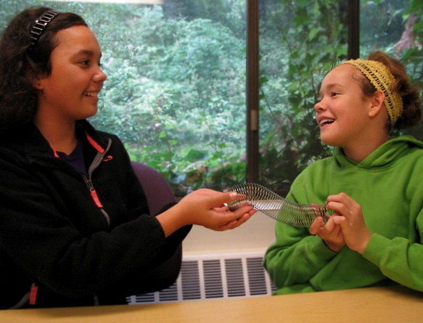
Taking Turns
Notes:
Please see the How to Use Personalized Stories document for more information on how to edit and display this PowerPoint presentation for your child.
Please customize this template to best help your child by:
Modifying the template to use your child’s name
Using language that is familiar to your child
Including items that are of great interest to your child
Adding photos of your child or family to all of the blue frames in this template.
Adding photos and new slides from your own child’s life to this template.
Changing any of the text, photos, or images in this template with photos or images that are more meaningful to your child

Slide 2
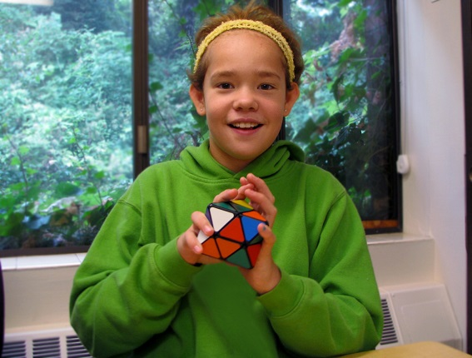
I love playing with toys!

Slide 3
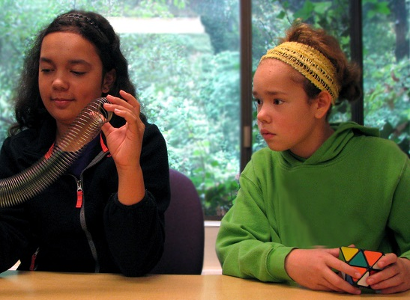
Sometimes when I play with toys I want to grab a toy that someone else has.
This is not the best choice and can make us both unhappy.

Slide 4
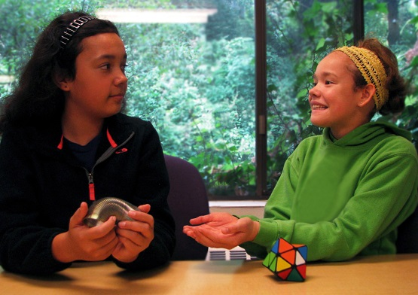
I can ask for turns when I want a toy. I say, “Can I have a turn please?”

Slide 5
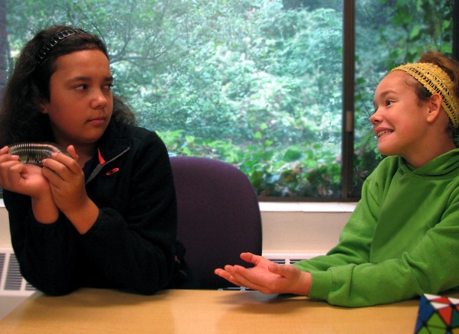
Asking for a turn does not always mean I will get a turn. That’s okay! I can make other choices.

Slide 6
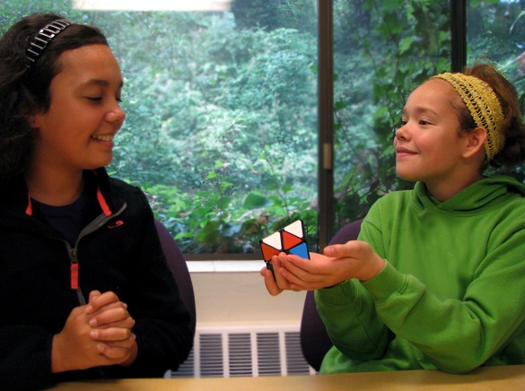
I can offer to trade toys with my friend if I want what he/she is playing with.
If I really want to play with that toy, I need to make a good choice about what to trade… something cool!

Slide 7
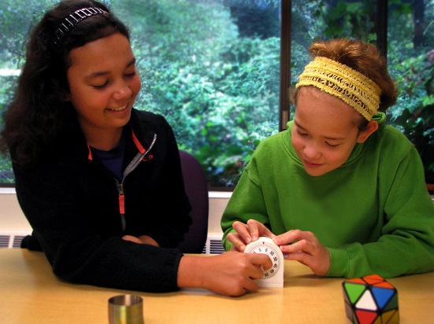
We can try setting a timer so that we both have equal turns with the toy.

Slide 8
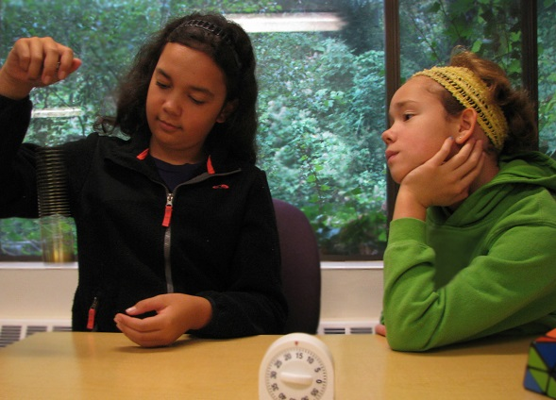
I can ask my friend to tell me when he/she is done with the toy I want. I can make a new choice while I wait!

Slide 9
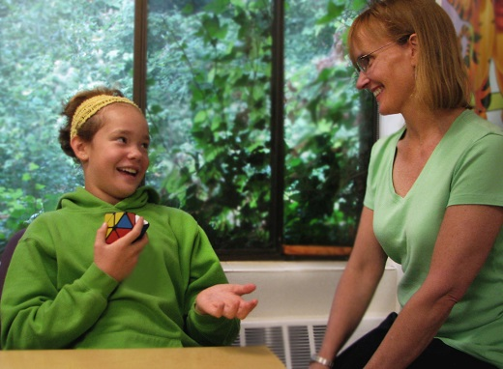
If none of these choices works, I can ask an adult to help us take turns. Adults know all about how to take turns!

Slide 10
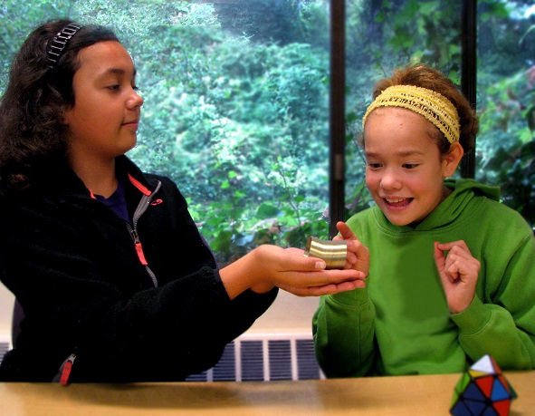
I love playing with my friends and making good choices to help me take turns!

Slide 11
Things to Try
When I am having trouble taking turns or waiting for friend to give me a turn, I will:
Ask for a turn
Offer to trade
Set a timer
Make a new choice while waiting
Ask an adult to help
….Please add your own ideas or modify the above

