Slide 1
Sharing
What have you been thinking or trying in your context related to our focus on SEL/SRL?
    Where is your inquiry focusing?
    What have you been seeing in practice?
    What have you tried or are you thinking of trying?

Slide 2

Bringing SRL to Life in the Classroom
Notes:
Deb

Slide 3
Talking about “self-regulated learning” in "kid friendly" terms
Kelsey Keller
Coquitlam School District

Slide 4
Applying These Ideas to Classroom Routines: Jennifer Ross
Getting Ready to Go Outside

Slide 5
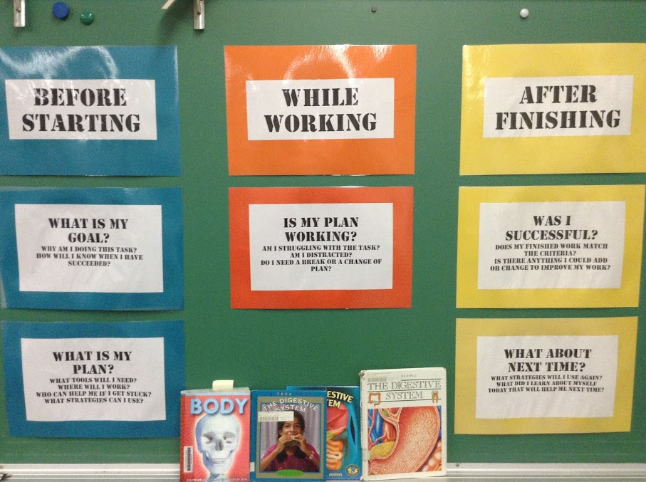
Fostering Strategic Action
Julie Tye (Delta School District)
Notes:
Deb

Slide 6
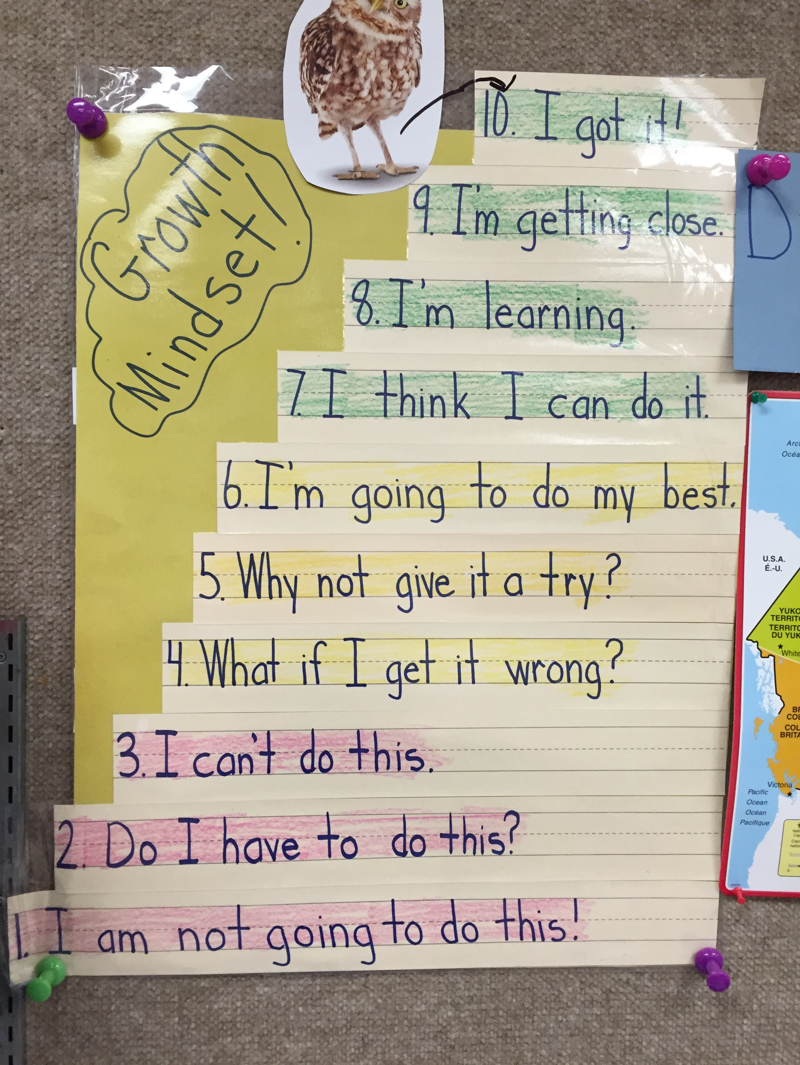
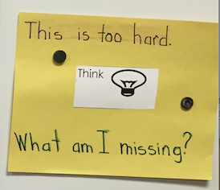
Brigitte Sebulsky's Class (Delta): Fostering Growth Mindsets

Slide 7
Reflection
What do you see in these examples, in relation to:
  Supports for SEL?
  Supports for SRL?
Could you take up some of this in your context?
  What are you doing?
  What could you try?

Slide 8
Inspirational Example
Research and Create a Book
Notes:
Deb

Slide 9

Research and Create a Book
Courtesy of K. Ondrik in It’s All About Thinking: Middle Years, 2015

Slide 10
Research and Create a Book
Courtesy of K. Ondrik in It’s All About Thinking: Middle Years, 2015

Slide 11
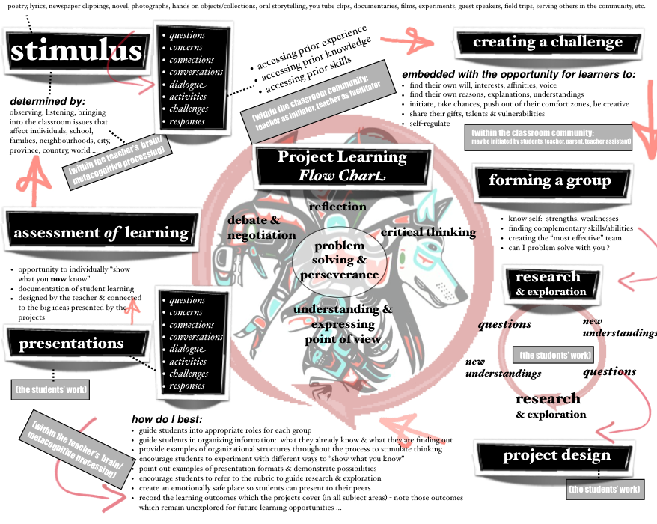
See It’s All About Thinking: Building Pathways in the Middle Years, Schnellert, Watson & Widdess, 2015

Slide 12
Stimulus
Creating a challenge
Forming groups
Research & exploration
Synthesizing learning
Presentations
Assessment of learning
Flow chart
Student problem solving & perseverance
Reflection
Critical thinking
Understanding & expressing point of view
Debate and negotiation

Slide 13
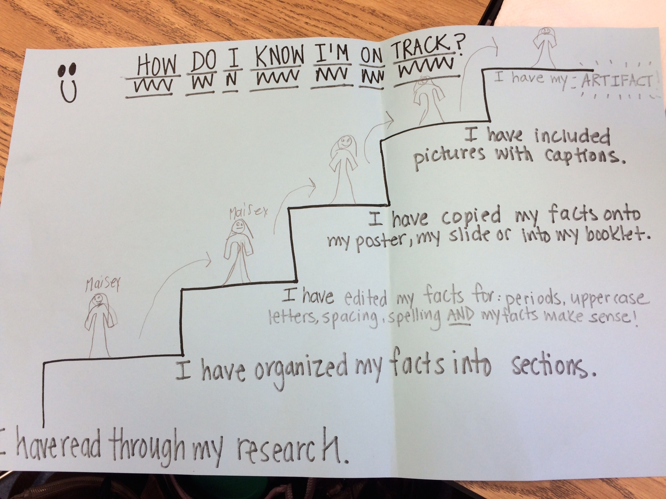

Slide 14
K. Ondrik, In It’s All About Thinking: Building Pathways in the Middle Years,
Schnellert, Watson & Widdess, 2015

Slide 15

Reflection
What do you see in this example, in relation to:
  Supports for SEL?
  Supports for SRL?
Could you take up some of this in your context?
  What are you doing?
  What could you try?

Slide 16

Your Collaborative Inquiry
Notes:
Deb

Slide 17
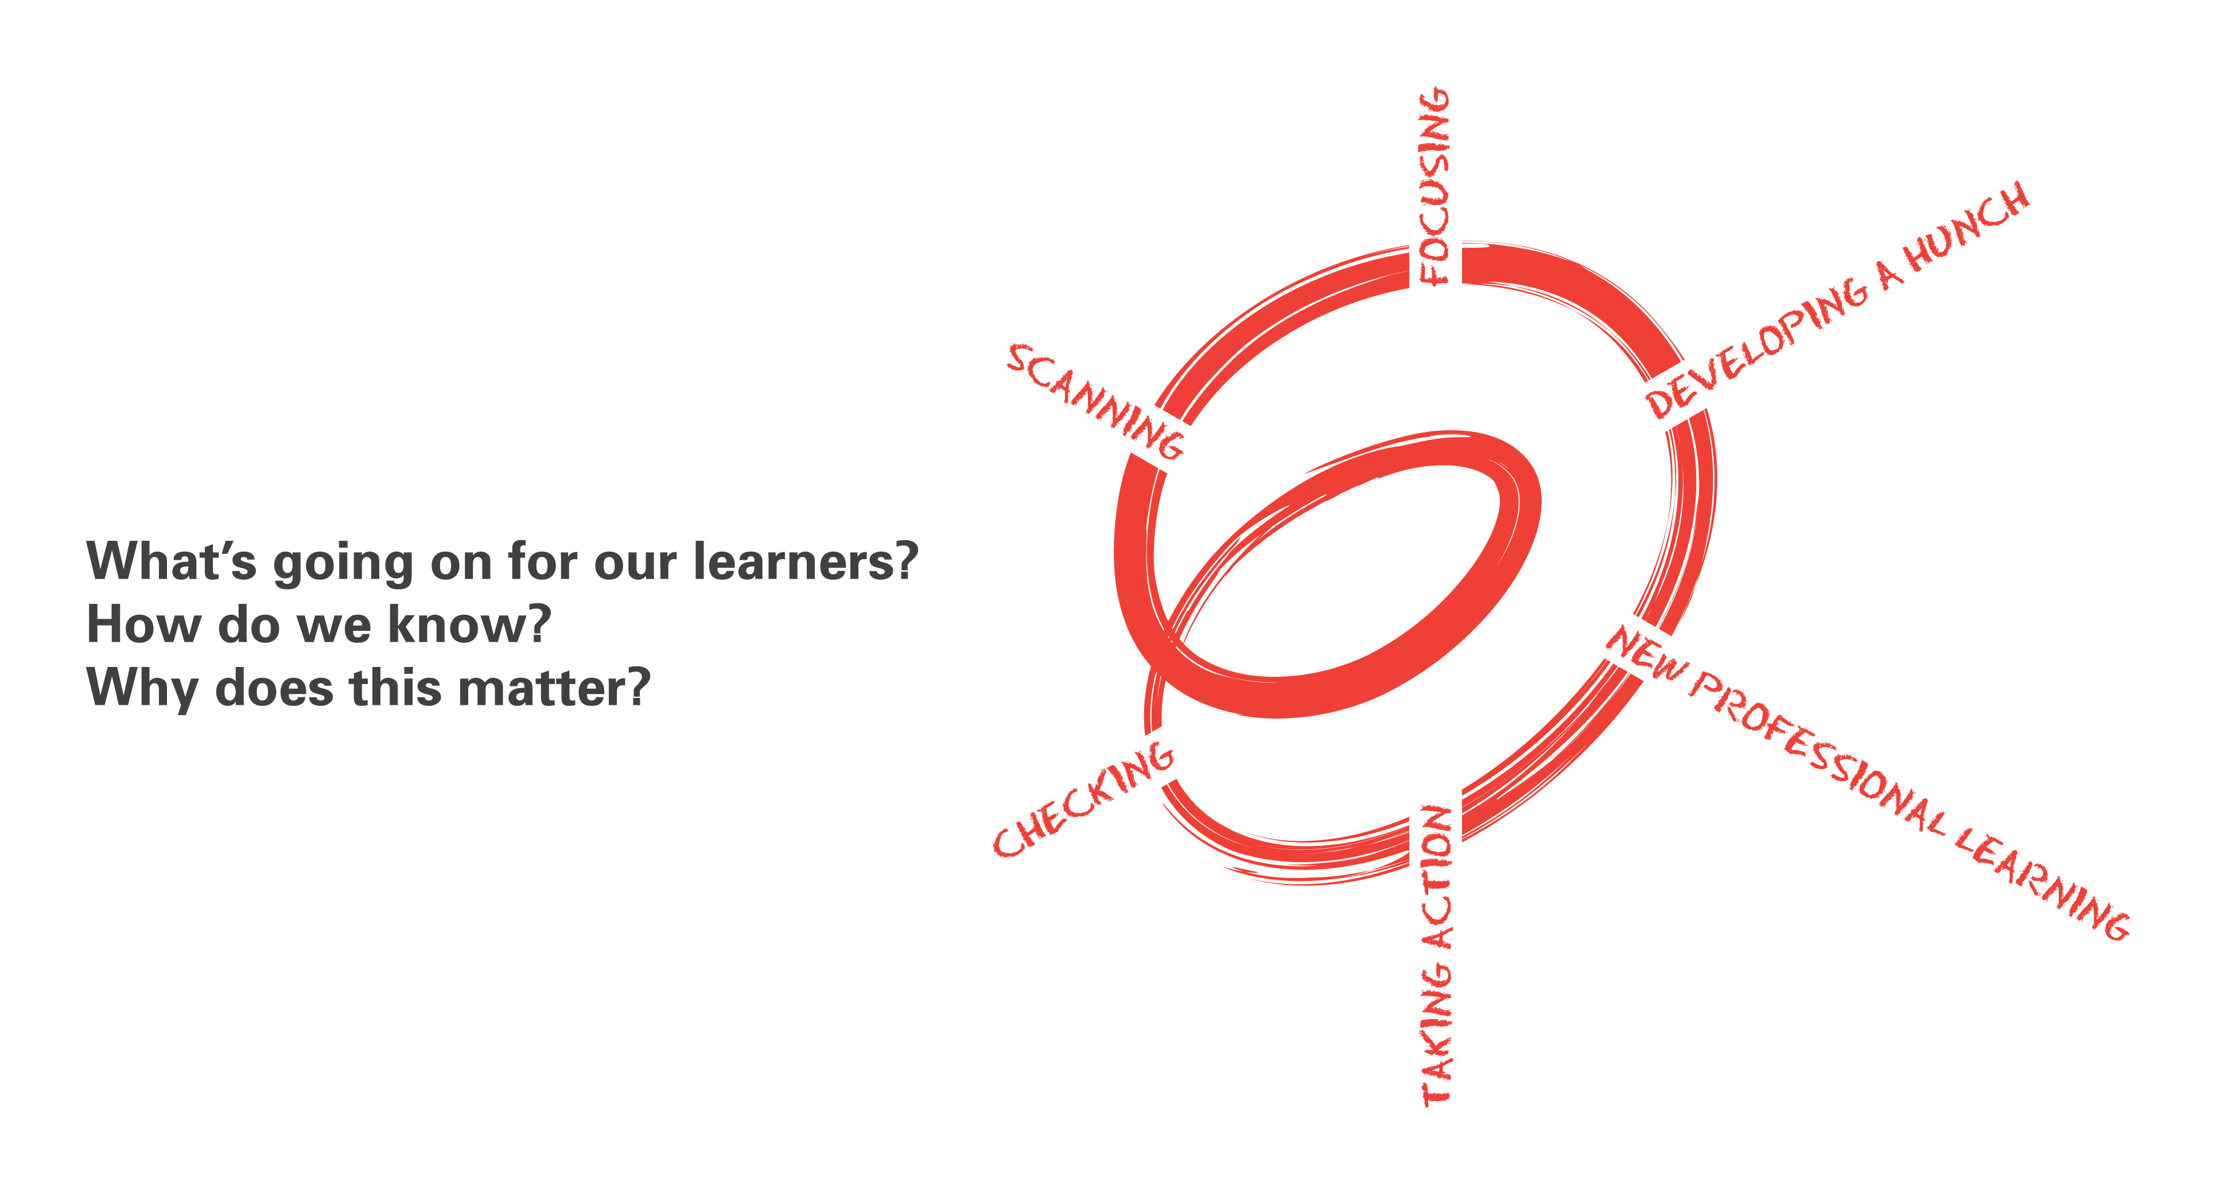
Spirals of Inquiry
(Halbert & Kaser, 2013)
What is happening in your context?
What do you need to focus on?
What do you think is going on?
How is it going? What’s next?
What do you need to learn about?
What will you do?
Notes:
An inquiry cycle- Halbert & Kaser

Slide 18
Work Time
What will you learn about or try in your context related to our focus on SEL/SRL?
    Where will you focus your inquiry?
    What will you look for in practice?
    What will you try?
Notes:
Deb, I’m imagining you will orchestrate this activity.
Nancy... I like the idea of including Leyton a bit more in the afternoon. But we can talk about it with him too.
Also imagining that these first discussions will focus on the first question from the “Beginning Reflections” slide; then Leyton might take up the other two questions in introducing the “Wonder Book” activity.

Slide 19

Plan for Our January Meeting
Sharing
    What are you trying?
    How is it going?
Resources
    A Focus on Core Competencies
    Shared Readings: Discussion
Work Time
    What will you do?

Slide 20
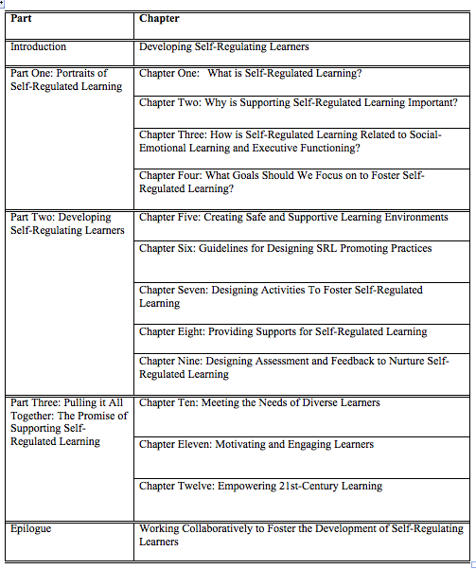
Shared Readings For Next Time
All Read:
Chapter Five
Choose One of: Chapter Six
Chapter Seven
Chapter Eight
Chapter Nine

