Slide 1
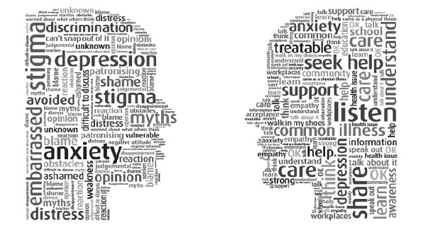
Addressing Mental Health Concerns at School

Slide 2
The Importance of School Support
Half of all lifetime cases of Mental Health disorders begin by 14 years of age.
Three quarters have begun by age 24.
Early Intervention
Recognizing signs early enables one to take action to prevent problems from getting worse
Early Intervention can change prognosis and prevent progression of mental health disorders
Notes:
Half of all mental disorders begin by age 14, 75% begin by age 24 Teachers/School Counsellors and others who interact with youth are key in the early identification of MH problems. Professional Help is not always on hand. People often do not know how to respond. Not everyone needs “conventional”treatment.
Half of all mental disorders begin by age 14, 75% begin by age 24
MHalf of all mental disorders begin by age 14, 75% begin by age 24
H problems often begin to surface in the teen and young adult years.
Being able to recognize signs early enables one to take action to prevent problems from escalating.
When issues are identified early, there are actions people can take to prevent things from getting worse.
Easy to recognize a cold.
Addressing issues early is key to prevent escalation of problems
Hard to distinguish normal problems that are experienced from time to time and feelings/emotions/behavior indicative of a Mental Health problem
Check up at mindcheck
2

Slide 6
Levels of Support
BC Children's Hospital –
Surrey Memorial – APU
Youth Day Treatment
Forensic Services
Maples Programs
Intensive
Interventions
Supportive Interventions
Preventative supports for all students
Child and Youth Mental Health
Youth Crisis Response
EPI
Odyssey
Burnaby Addiction Services
Cameray
HUB – Youth Clinic Counsellor
FORCE
Connect Group
Friends for Life
Staff support – youth workers and counsellors
Crisis lines and website support
Group – kids in the know
Speak –Up Presentations
MindUP; Emotional Literacy – programs
Staff training
Policy, practices and procedures
Critical Incident Response Team

Slide 7
Preventative Supports for all Students
Speak – up
SEL – programs such as: MindUP and
Emotional Literacy (RULER Approach)
Staff training and procedure development
Preventative Supports for All Students

Slide 8
District Practice and Policies for Managing Disclosures, What & When to Report
Harm to Self
Harm to Other
Confidentiality

Slide 9
Speak Up School Presentations
Increase Mental Health Awareness
Increase Mental Health Understanding
Address Stigma
Skills and Strategies for Emotional Wellbeing

Slide 10


MindUP!
www.thehawnfoundation.org
I love MindUP! It is a way to focus your mind, calm down and reflect on a situation when you need to make a choice.
- Tyler G., Seventh Grade Student
SEL Programs
Social and emotional learning is a framework for promoting mental health and reducing risk behavior in children and youth. SEL programming may reduce the number of students who require early intervention, because participation in SEL programs fosters in children the skill they will need to cope with life’s challenges. www.casel.org

Slide 11
Supportive Interventions
Child and Youth Mental Health
Youth Crisis Response
EPI – Early Psychosis Program
Odyssey
Burnaby Addictions Services
Cameray
HUB – Clinic Counsellor
FORCE
Connect Parent Group
Friends for Life
Staff support – youth workers and counsellors
Crisis lines and website support
Kids in the Know Group
Supportive Interventions

Slide 12
Supportive Interventions
For Students
For Parents and Staff
www.mindcheck.ca
www.heretohelp.bc.ca
www.youthinbc.com
E.P.I. www.psychosissucks.ca
Telephone Helpline(s)
School Counsellor
Youth Worker
Youth Clinic
Family Doctor
Community Mental Health
Community Counselling
Youth Crisis Response
FORCE www.forcesociety.com
Institute of Families
www.instituteoffamilies.ca
Connect Parenting Group
www.heretohelp.bc.ca
www.keltymentalhelath.ca
www.teenmentalhealth.org
Community Counselling Agencies

Slide 13
Fraser South EPI Program - for youth with early symptoms of psychosis, or any of the symptoms associated mental health mood disorders . A clinician will ask screening questions about the need to call now, what problems the youth are experiencing, what help the youth may have sought in the past and what type of help may be of assistance now. They will assess and refer to appropriate services for ongoing follow up and support.
Youth Crisis Response - provides mental health assessment, same day crisis intervention, stabilization, short-term brief intervention, resource and referral coordination, and up to six follow-up sessions for children and youth who are in acute crisis. Also provides child crisis assessments on a limited, non-urgent basis
Child and Youth Mental Health (CYMH) - provides direct and contracted community-based services to children, youth under the age of 19 and their families on a voluntary basis. Referrals of a child or youth can be made to CYMH by the child or youth themselves, and individuals who are directly involved with the child and youth such as family members and other agencies or service providers. The child/youth or parent/guardian must have knowledge of the referral and agree prior to referral by an agency or service provider. Clients who are suicidal or experiencing extreme impaired functioning due to acute mental illness have the highest priority.

Slide 14
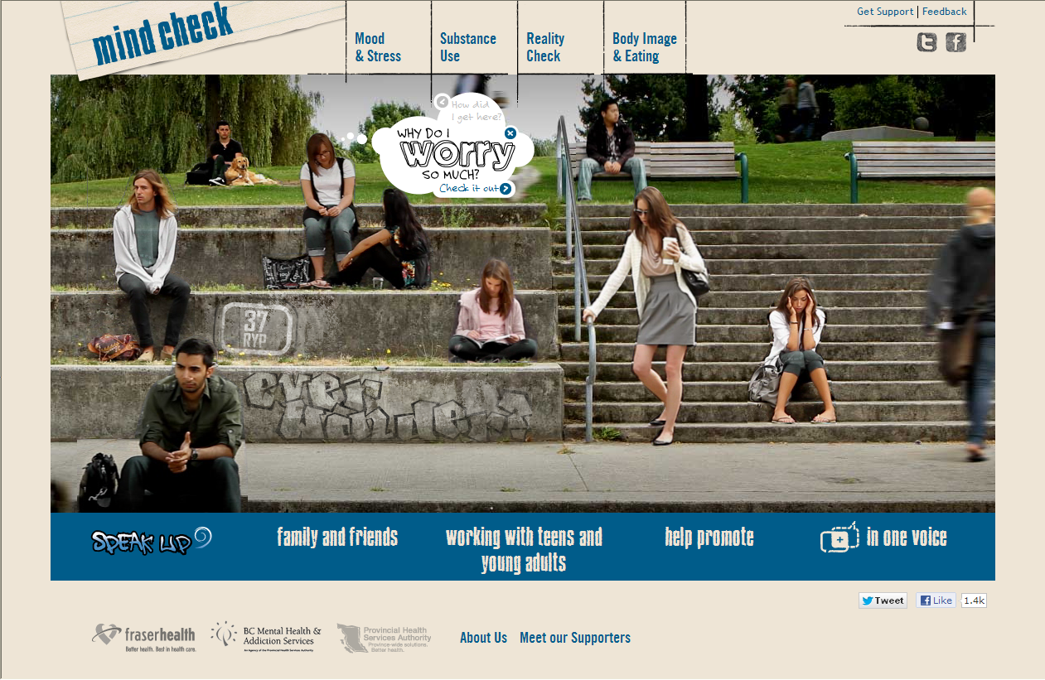
Mental Health
Improve Understanding
Increase Awareness
Check Up!
Speak Up!
What Stigma?
Notes:
Goals/Hopes for today’s presentation
Check Up! Starting thinking about your own mental health and “mental health check ups” – touch base with yourself, how I doing, how am I coping? Get you to start thinking about how to take care of your mental heatlh
Where/What Stigma – we want you to start thinking about stigma – what are the personal beliefs you hold about people with Mental Health issues?

Slide 15
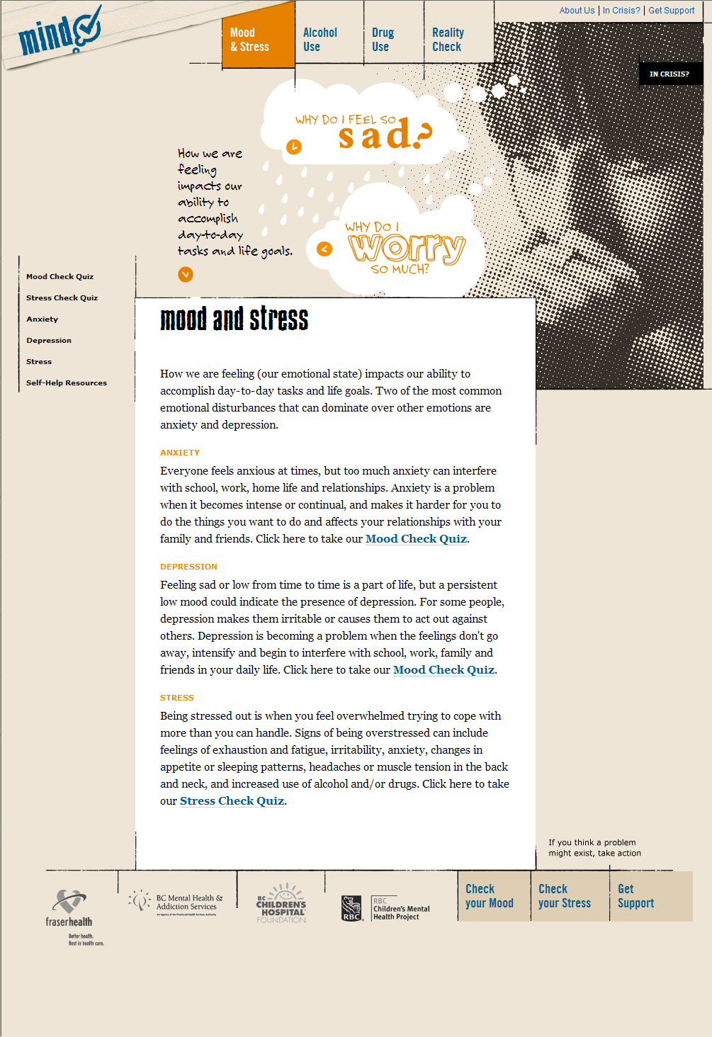

Slide 16
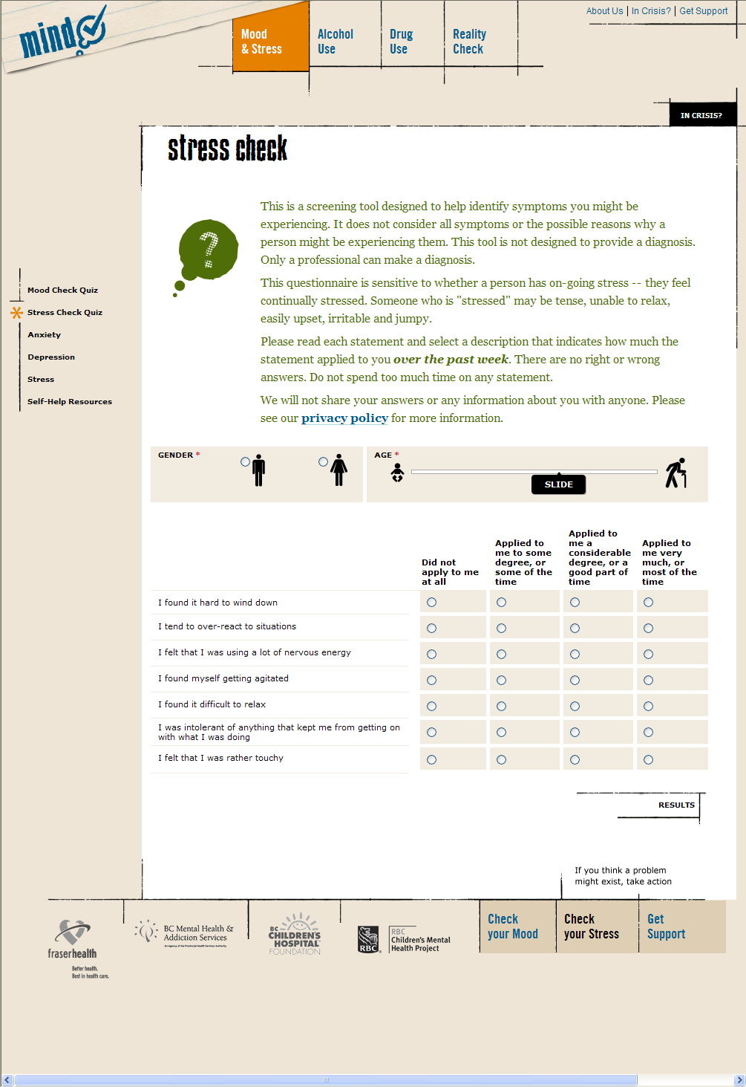

Slide 17
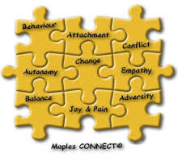

Parent Support

Slide 18


For Teachers

Slide 19
Intensive Supports
BC Children’s Hospital –
Surrey Memorial – APU
Youth Day Treatment
Forensic Services
Maples Programs
Intensive Supports

Slide 20
Intensive Supports
The Child and Adolescent Psychiatric Emergency Unit (CAPE) provides a short stay in inpatient care for children and youth (through age 17) experiencing acute psychiatric problems. Placement is by referral only – patients must first go to their community hospital emergency department for initial assessment (in Vancouver, children 16 and under should go to the BC Children’s Hospital Emergency Department).
CAPE is a 6- bed unit staffed by registered nurses, child psychiatrists and social workers.
Surry Adolescent Psychiatric Unit - This 10-bed psychiatric unit serves youth between 12 and 18 years of age who live in Burnaby, Delta, Langley, Surrey and White Rock. The unit provides assessment, stabilization and initial treatment .
Youth Forensic Psychiatric Services - This provincial program of the Ministry of Children and Family Development that provides court-ordered and court-related assessment and treatment services for troubled youth. Services are provided to:
Young persons in conflict with the law pursuant to the Youth Criminal Justice Act
Young persons found unfit to stand trial or not criminally responsible due to mental disorder.

Slide 21
Maples Adolescent Treatment Centre – This program is one part of the provincial Child and Youth Mental Health service network that provides an array of direct residential and community services for youth and their families. The Maples is designated under the Mental Health Act as a provincial mental health facility. Through its programs and services it supports communities in caring for and treating troubled 12 to 17 year-old youth with significant psychiatric and behavioural difficulties.
Youth Day Treatment Program - Offers comprehensive psychiatric treatment and educational programming to youth and their families living in the communities of Coquitlam, Port Coquitlam, Port Moody, Belcarra, Anmore, Pitt Meadows, Maple Ridge, Burnaby and New Westminster. Youth referred to the program receive intensive structured psychiatric and educational programming. The program includes individual and family therapy, group therapy, educational programming and medical management. Referral required. Offered in partnership with the Ministry of Education and Fraser Health.

Slide 22

Helping Students and Families
Accessing Community Supports and referrals to services requires voluntary participation of families children/youth
When families are ready for service there are often lengthy waitlists.
In the mean time school staff can be important support for children and youth struggling with mental health concerns.

Slide 23
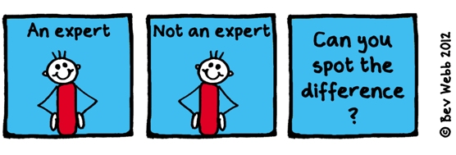
What we all can do.
Know the signs and symptoms of mental health concerns
When you see signs and symptoms, suspend judgment and ask the student what is going on.
Try to see the perspective of the student
Respond with empathy to their emotional concerns
Connect by listening, validating what you hear and encouraging connections with school counsellor,
youth workers and other natural supports.
Let them know you are there for them but expand their circle of support.
Change is often a long and difficult process look for the small improvements and steps in right direction
Consult discreetly with a trusted colleague, counsellor or administrator. It is natural to want process these situations with others and to ensure that we have responded in an appropriate way

