Slide 1
RETHINKING LETTER GRADES
Keeping the Focus on the Learner
Notes:
Jeannette - Welcome

Slide 2
Inquiry
What is the value of standards-based assessment as compared to letter grades and percentages?
How does one implement standards-based assessment and reporting to further engage students in their learning?

Slide 3
Conversation Cards

Slide 4
Does what we report accurately reflect our students’ true level of understanding?
“How confident am I that the grades students get in my classroom/school/district are accurate, meaningful, and consistent, and that they support learning?” Ken O’Connor 2007
Do our assessment practices contribute to student confidence, or do they raise anxiety?
“Confidence is about real optimism that develops from a sense that success is possible, even if it’s not immediate.” Tom Schimmer
Notes:
In the metaphorical sense, establishing a true north for grading provides a guide for the ideal conditions. Establishing a true north increases the likelihood that grading practices remain consistent and aligned. It prevents everyone from losing sight of the big ideas that align assessment, instruction, and grading paradigms.

Slide 5
Unwavering Focus on Student Success
Learning Modernization
Framework for Enhancing Student Learning
Uses Aboriginal Principles of Learning
Communicating Student Learning
Standards Based Pedagogy
Focus on competencies not content
Standards (i.e. targets) clearly defined
Progress determined by teacher, not algorithm
Enhanced Feedback → communication about learning frequent and clear
Standards Based Assessment
More focused
More detailed
More fair
Standards Based Gradebook

Slide 6
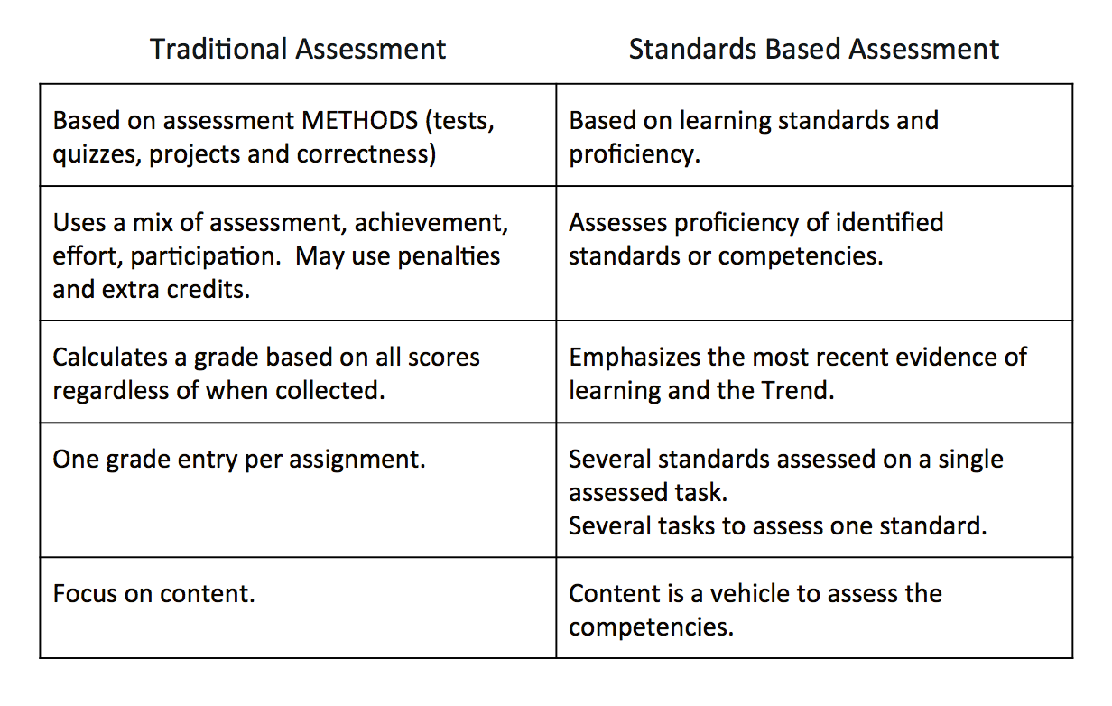

Slide 7
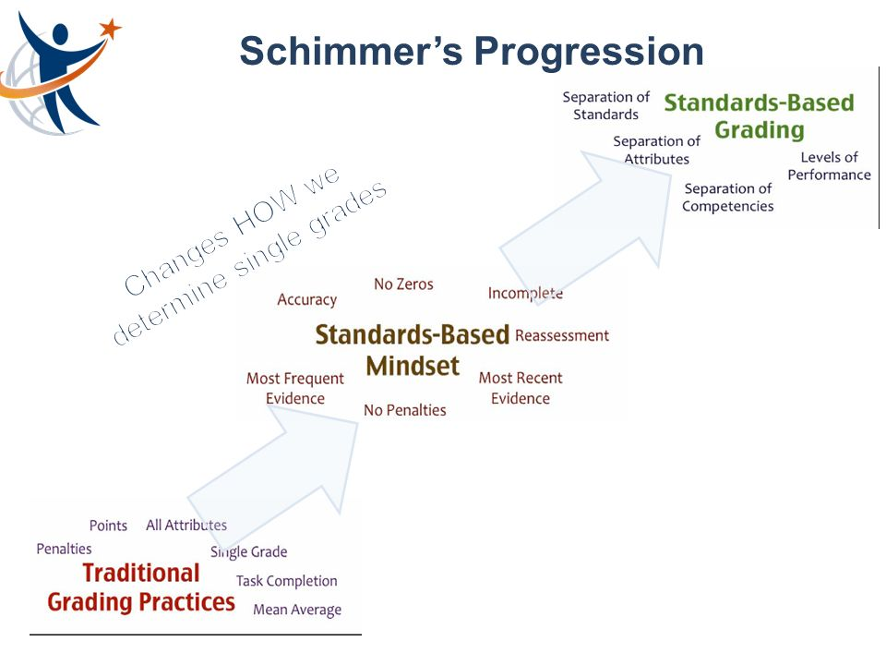
Notes:
Traditional Grading Practices – evidence of learning is organized by tasks (such as quizzes, tests, and projects) that overlap the same standards, and achievement levels are often the result of the mean averaging of these weighted tasks. Traditional levels of achievement (A through F) include non-achievement factors (such as late work and extra credit) in the grade determination, which artificially increases or decreases the grade. It is what we are most familiar with.
Standards-based Grading – evidence is organized by standards and factor out all non-achievement attributes, which are assessed separately from proficiency grades, against their own standards of achievement. Rather than using traditional letter grades and percentages, standards-based grading involves levels of proficiency that illustrate a natural progression of quality.

Slide 8
Considering the Standards-based Mindset:
What resonates with you the most?
What are you wondering about and why?
Notes:
Traditional Grading Practices – evidence of learning is organized by tasks (such as quizzes, tests, and projects) that overlap the same standards, and achievement levels are often the result of the mean averaging of these weighted tasks. Traditional levels of achievement (A through F) include non-achievement factors (such as late work and extra credit) in the grade determination, which artificially increases or decreases the grade. It is what we are most familiar with.
Standards-based Grading – evidence is organized by standards and factor out all non-achievement attributes, which are assessed separately from proficiency grades, against their own standards of achievement. Rather than using traditional letter grades and percentages, standards-based grading involves levels of proficiency that illustrate a natural progression of quality.

Slide 9
https://curriculum.gov.bc.ca/classroom-assessment-and-reporting
NEW ASSESSMENT DOCUMENTS

Slide 11
Notes:
The criteria categories, criteria, and sample applications included on the curriculum website are available to use when developing one’s own criteria-based classroom assessment applications to inform their teaching and learning.

Slide 12
Criteria Categories
Criteria categories reflect the key competencies within an area of learning and are the same from Kindergarten through Grade 9. They can facilitate cross-curricular assessment.
Notes:
Teachers may choose the categories that are relevant to particular tasks or contexts. In some cases, they may focus on one category. In more extensive tasks and inquiries, they may use all of the categories.
These categories have been developed by teachers for teachers. They are not required and are intended only to support teachers in their assessments.

Slide 13
Criteria Categories and Criteria for Science K-9

Slide 16
Applications
Criteria categories and criteria can be used to develop tasks, create assessment tools, and/or communicate student progress. They support ways to design and facilitate whole-class, group, and individual assessments.

Slide 18
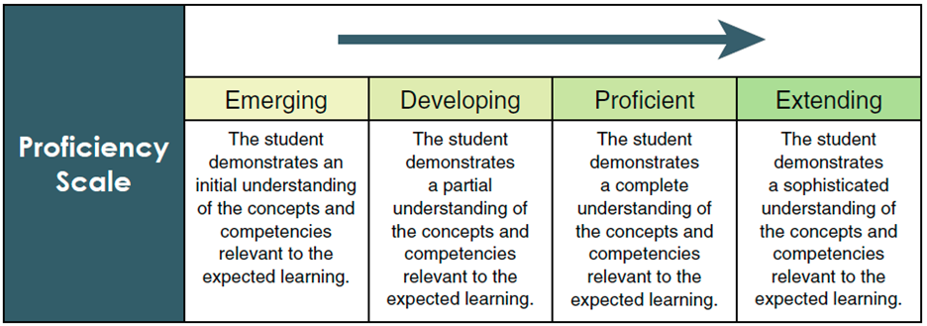
Notes:
Teachers use the four-point provincial proficiency scale and descriptive, strength-based feedback to communicate progress in all areas of learning in K-9.
In Grades 4-9, letter grades are provided to parents on request and a proficiency scale/letter grade comparison table has been drafted comparing letter grades to the proficiency ratings
During the 2018/19 school year, piloting districts will test the four-point provincial proficiency scale and provide feedback to the Ministry.

Slide 19
Sample Application – Science 7/8

Slide 20
Questioning and Predicting (Criteria Category) | Emerging | Developing | Proficient | Extending
Demonstrate a sustained intellectual curiosity about a scientific topic or problem of personal interest
Make observations aimed at identifying their own questions, increasingly complex ones, about the natural world
Formulate multiple hypotheis and predict multiple outcomes | * Structures a hypothesis that is appropriate to the specified format in a limited way. * Constructs a hypothesis that is testable and is based on previous observations in a limited way. * Develops a hypothesis that suggests how one could prove it in a limited way. | * Structures a hypothesis that is somewhat appropriate to the specified format. * Constructs a hypothesis that is satisfactorily testable and is somewhat appropriately based on previous observations. * Develops a hypothesis that somewhat accurately suggests how one could prove it. | * Structures a hypothesis that is mostly appropriate to the specified format. * Constructs a hypothesis that is accurately testable and is mostly appropriately based on previous observations. * Develops a hypothesis that mostly accurately suggests how one could prove it. | * Structures a hypothesis that is completely appropriate to the specified format. * Constructs a hypothesis that is effectively and accurately testable and is appropriately based on previous observations. * Develops a hypothesis that accurately suggests how one could prove it.
* Creates a question or 2 that are not based on observations about the natural world
* Makes a couple of observations and uses those observations to create a question about the natural world
* Makes some observations and uses those observations to create some questions about the natural world
* Makes many observations and uses those observations to create several questions about the natural world
https://curriculum.gov.bc.c.a/curriculum/science/8
Notes:
Jennifer
We thought we would try it out and provided two strands
The words that are placed in the boxes can become the comments that you place on report cards to indicated their progress in acquiring various skills for example.

Slide 21
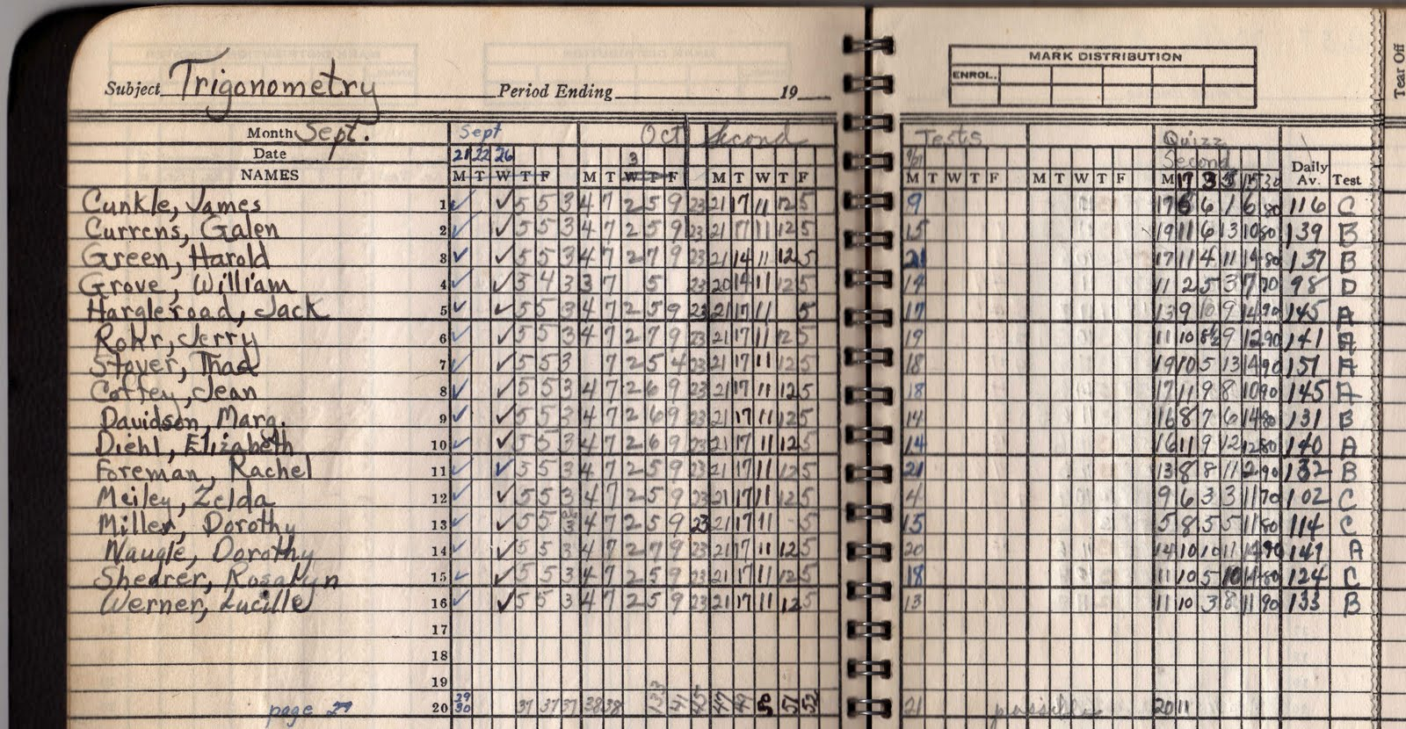

Slide 22
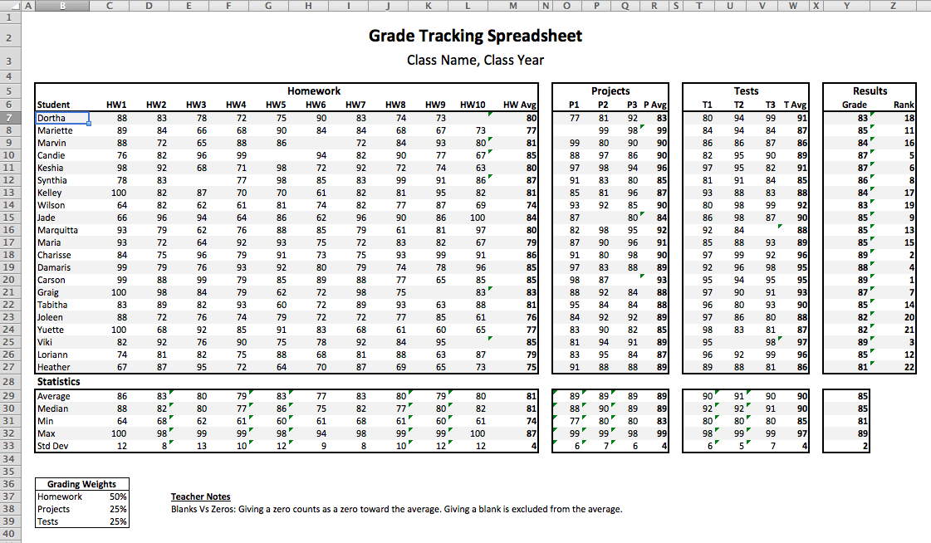

Slide 23
Gathering Assessment Information
Notes:
Jeannette

Slide 24
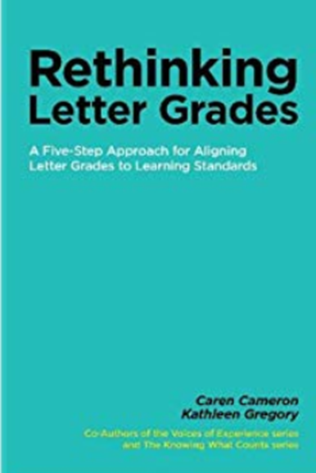
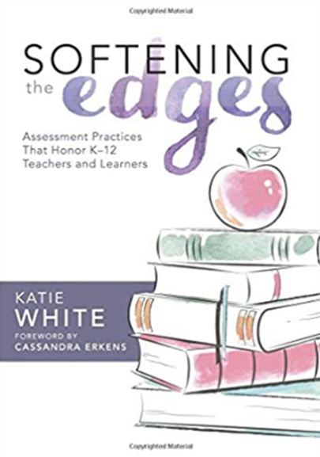
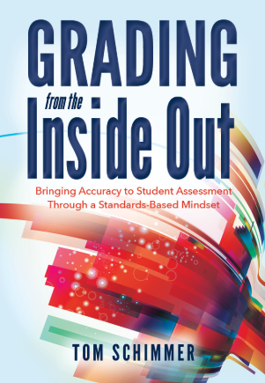
Assessment Resources

Slide 25
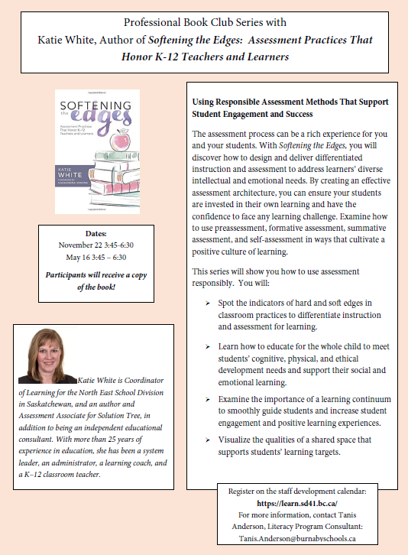

Slide 26
“Changes should be made out of hope for a better tomorrow instead of fear of losing yesterday or today.”
Yong Zhao, Catching Up or Leading the Way: American Education in the Age of Globalization (Alexandria, VA, ASCD, 2009), 182

Slide 27
Share …
  How have you used standards-based assessment?
  What are you thinking about trying?
  What questions do you have?
  What would you like to learn more about?

