Slide 1
HEAT
Introduction
This powerpoint is available on-line at
http://blogs.sd41.bc.ca/science/new-curriculum-support/dlrc/thermal-energy/

Slide 2
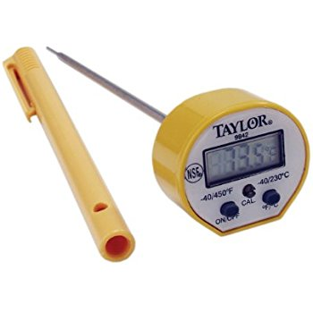
GOALS
I can explain the difference between
heat and temperature.
I can explain how heat moves by conduction,
convection and radiation
I can record information on a table
I can read a digital thermometer
I can make predictions
I can ask questions

Slide 3
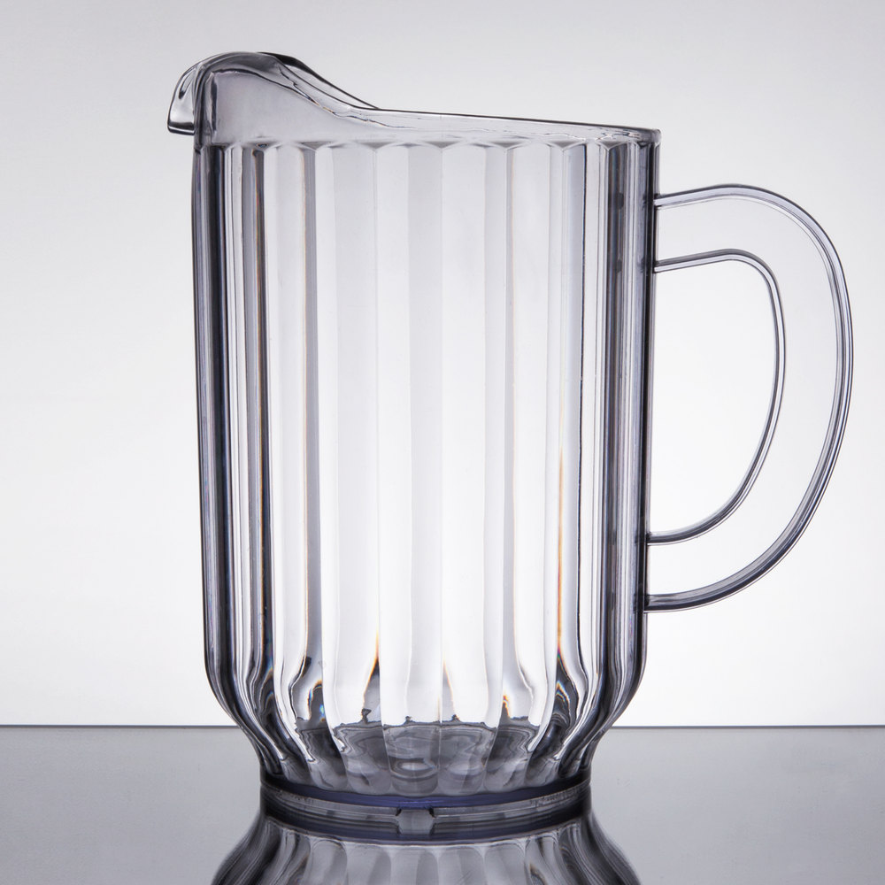
Predict, Observe, Explain
Let’s use the thermometer to measure the temperature of the jug and cup.
PREDICT which one will cool more quickly
Vote on the whiteboard

Slide 4
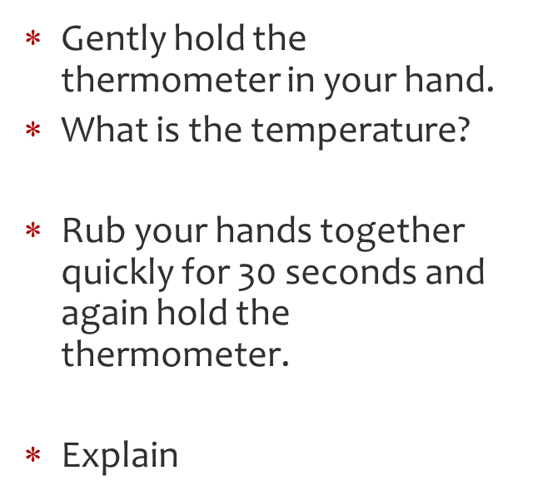
Sources of Heat

Slide 5
How does heat travel?

Slide 6
What will happen if you put a book between the bulb and the radiometer?

Slide 7
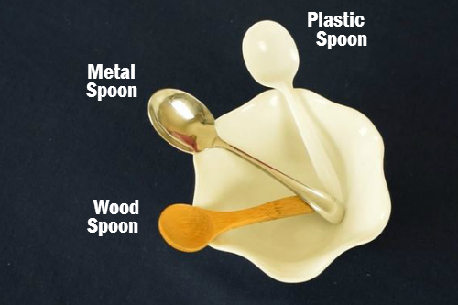
Which spoon will heat up first?

Slide 8
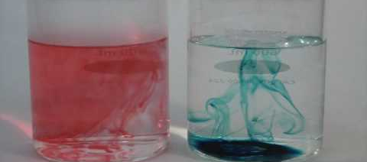
Which cup—HOT OR COLD-- will the food colouring spread fastest in?

Slide 9
Predict, Observe, Explain
Let’s use the thermometer to measure the temperature of the jug and cup.
PREDICT which one will cool more quickly
Vote on the whiteboard

