Slide 1
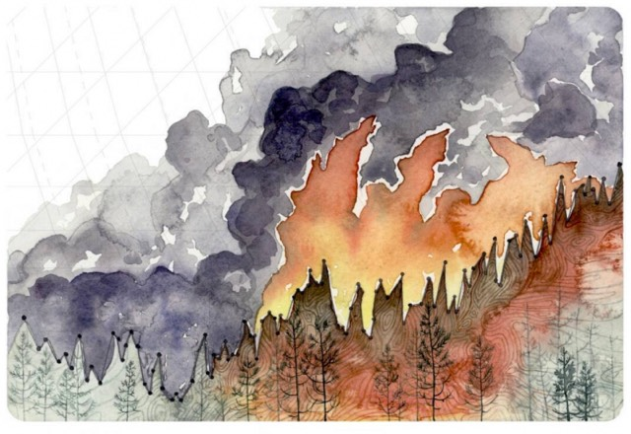
Sci 10 Working Group
Artist Jill Pelto turns climate change data into art: http://www.jillpelto.com/gallery/

Slide 2
AGENDA
Acknowledgement
Introductions
Goal of Group
Resources Share
Templates/Planning Time

Slide 3
ACKNOWLEDGEMENT
We acknowledge the territory of the Coast Salish nations, Tsleil-Waututh, Musqueam and Squamish, on whose unceded traditional lands we teach, learn and live.
Sky stories (image at right) available from the Planetarium)
http://www3.sd73.bc.ca/sites/default/files/users/npankewich/Astronomy%20Sky_Stories_A_First_Nations_Journey_Teacher%27s_Resource-1.pdf

Slide 4
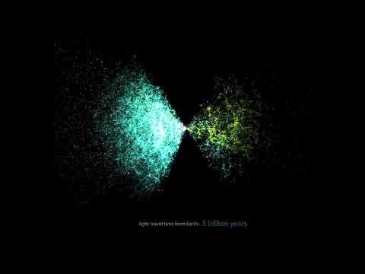

Slide 5
Big bang calendar
With a partner, see if you can fill in the dates on this timeline if Jan 1 was the big bang and Dec 31 was today. (14.7 BILLION years = one year)
Adapted from: https://astrosociety.org/edu/astro/act2/H2_Cosmic_Calendar.pdf

Slide 6
The Big Bang Theory
No experts, so we are learning together!
Considering doing this course…https://www.futurelearn.com/courses/gravity
A few ideas—
Good videos: https://ed.ted.com/on/Duu3Zj3b
https://www.stem.org.uk/resources/elibrary/resource/26892/big-bang-evidence
Cosmic Calendar: http://www.faradayschools.com/re-topics/science-year-10-11/the-cosmic-calendar/
Lesson/Unit Plan Ideas
http://www.faradayschools.com/teacherspages/science-teachers/
https://www.cfa.harvard.edu/seuforum/download/CQEdGuide.pdf
http://www.lpi.usra.edu/education/pre_service_edu/OriginsActivities.shtml
https://www.sciencelearn.org.nz/resources/1814-big-bang-theory
http://www.nuffieldfoundation.org/science-society/activities-universe
Http://www.cpalms.org/Public/PreviewResourceLesson/Preview/152376
http://www.amnh.org/our-research/hayden-planetarium/digital-universe/about

Slide 7
Resource share
What have you already got/done on these two topics?

Slide 8
Planning Time
See template and outline on the district science blog:
http://blogs.sd41.bc.ca/science/workshop-material/science-10-working-group/

