Slide 1
Earth and Water—through an inquiry lens
Donna Morgan
Math/Science Consultant

Slide 2
We acknowledge the traditional, unceded territories of the Coast Salish peoples, the Musqueam, Squamish and Tsleil-Waututh Nations on whose land we live, learn and work.
Notes:
10 minute mark for Lilian Dyck segemnt

Slide 3
Agenda
Acknowledgement
Introductions
What’s about us? (Padlet share)
Intro to Earth Sciences (20+ min)
Assessment of Inquiry using Curricular Competencies (20 minutes)
SUPPER BREAK: 5:00 (30 min)
Hands On Experiments learn different experiments and how they can be used for inquiry (25 minutes)
Tying it together—finding resources(10 min)
Feedback/Prizes

Slide 4
This is a series of videos—water and ocean are good too

Slide 5
Session Objectives
Develop an overview of EARTH and WATER CONCEPTS as they build through the K-7 curriculum
Learn some lab invitations, hands on inquiry and some demonstrations to stimulate thinking.
Develop tools to assess inquiry
Weave Indigenous perspectives into the teaching of these topics
Make cross curricular connections with EARTH and WATER topics

Slide 6
OUR BIG IDEAS TODAY
K: Daily and seasonal changes affect all living things.
Gr 1: Observable patterns and cycles occur in the local sky and landscape.
Gr 2: Water is essential to all living things, and it cycles through the environment.
Gr 3: Wind, water, and ice change the shape of the land
Gr 4: The motions of Earth and the moon cause observable patterns that affect living and non-living systems.
Gr 5: Earth materials change as they move through the rock cycle and can be used as natural resources.
Gr 6: The solar system is part of the Milky Way, which is one of billions of galaxies.
Gr. 7: Earth and its climate have changed over geological time.

Slide 8
Let’s use our places
https://padlet.com/donnamorgan8/asygab4org7l
(that is the letter
l at the end)

Slide 10
Water cycle game…

Slide 13
Some inquiry starting points for minerals… This poster available as PDF from http://www.nr.gov.nl.ca/nr/mines/outreach/know.pdf

Slide 14
The Rock Cycle
https://www.learner.org/interactives/rockcycle/rockdiagram/

Slide 15
Geological Time Scale
Can you put these events in order?

Slide 16
Climate Science
SCIENTIFIC CONSENSUS:
CO₂ is now at 408 ppm
Global Temperatures have risen 1 degrees C since 1880
Sea level has risen about 7 cm in the last 23 years
https://www.youtube.com/watch?v=3v-w8Cyfoq8

Slide 17
Jill Pelto…

Slide 18
This picture changed us? Or did it?

Slide 19
Assessing Inquiry
Types of Evidence We can Collect
Formal and informal observations
Discussions, learning conversations, questioning, conferences
Tasks done in groups
Demonstrations, performances
Projects, portfolios
Peer and self-assessments
Self-reflections

Slide 20
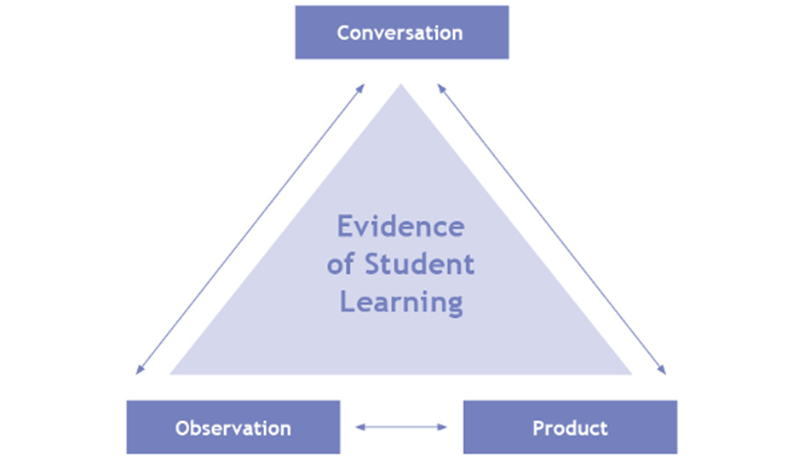

Slide 21
Key Steps in Planning Assessment
Plan the assessment at the same time as you plan the unit
Have clear criteria—and where possible, co-construct the criteria with students
Plan assessment to be on-going, have multiple points where students get feedback, and vary WHO gives the feedback (teacher, peer, self, audience)

Slide 22
DINNER BREAK

Slide 23
Now explore:
Read through the four-pager on your topic area
Explore the activities in the Superlab
Come back to share how you might assess students on these inquiries

Slide 24
Reminders
Science Blog
Science and Children
Series Repeat in the fall, but starting with Space Science, then cycling through the topics again.

Slide 25
On The Back of your Name Tag

