Slide 1
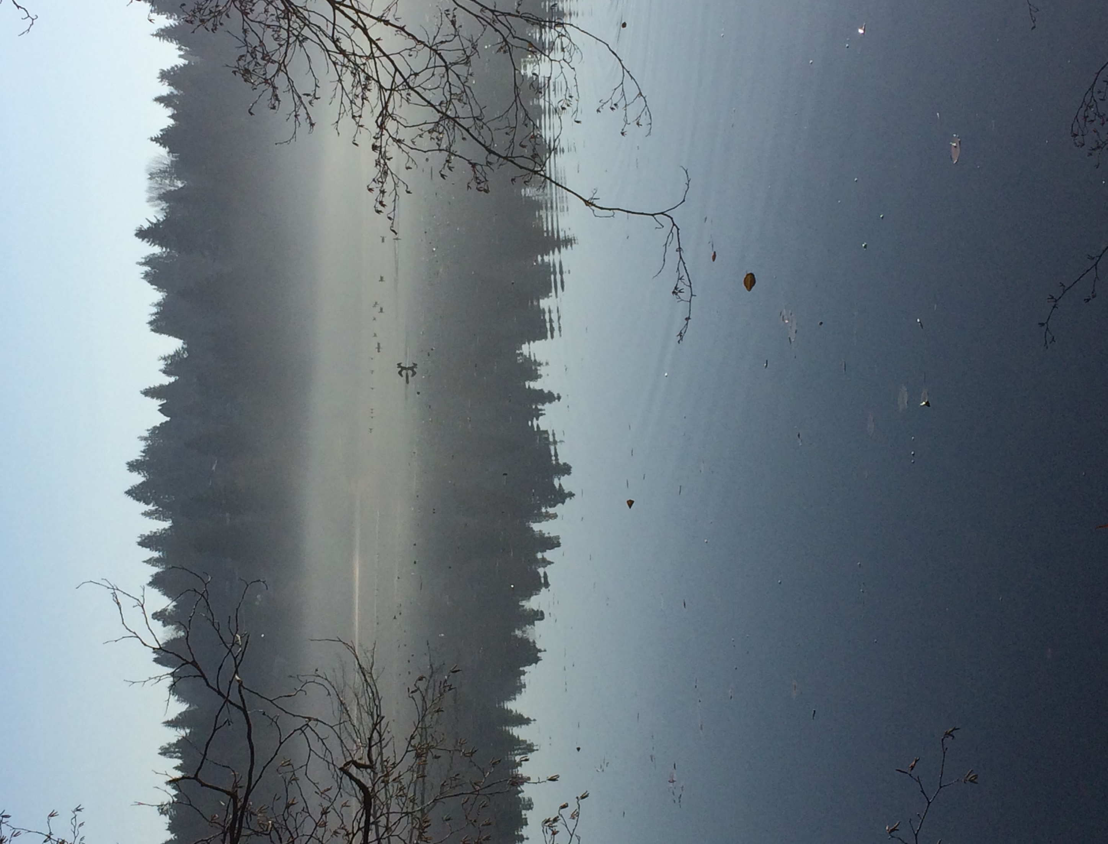
Connecting students to the flora and fauna of Deer Lake
Burnaby Central Secondary
Dec 19, 2017

Slide 2
Agenda
Introductions (5 min)
“Hook” (10)
Your goals of the day
Indigenous knowledge (10)
Curricular Connections (10)
Possible Projects (examples from North and Byrne)
Resources to take outside (10)
Walk in the park—what can we identify? (45 min)
Debrief—and next steps (15)

Slide 3
What are your goals for today?

Slide 5
How are these principles reflected in your classrooms? Which principles relate to getting outdoors?

Slide 6
Can story be science?
“When each Elder spoke they were conscious that other Elders would serve as ‘peer reviewer’ [and so] they did not delve into subject matter that would be questionable. They did joke with each other and they told stories, some true and some a bit exaggerated but in the end the result was a collective memory. This is the part which is exciting because when each Elder arrived they brought with them a piece of the knowledge puzzle. They had to reach back to the teachings of their parents, grandparents and even great-grandparents. These teachings were shared in the circle and these constituted a reconnaissance of collective memory and knowledge. In the end the Elders left with a knowledge that was built by the collectivity."
Stephen J. Augustine, Hereditary Chief and Keptin of the Mi’kmaq Grand Council

Slide 7
What is hard about getting outside?
Write/Pair/
Share

Slide 8
Make a VENN diagram to compare/contrast: -Traditional Ecological Knowledge
-Western Science
-School science

Slide 9
Ideas for Projects
Byrne Creek Bio 11—Website
Burnaby North Science 9—in depth study of plant/animal
Even more sophisticated…Leigh Joseph—estuary gardens/diabetes conection/can plants hear?

Slide 10
Leigh Joseph/plants can hear
: http://www.cbc.ca/radio/quirks/hearing-plants-awkward-bees-arctic-gems-farting-fish-and-chicken-bones-1.4234437/indigenous-stories-lead-scientist-to-discover-plants-can-hear-1.4234449 (start at 1:30)

Slide 11
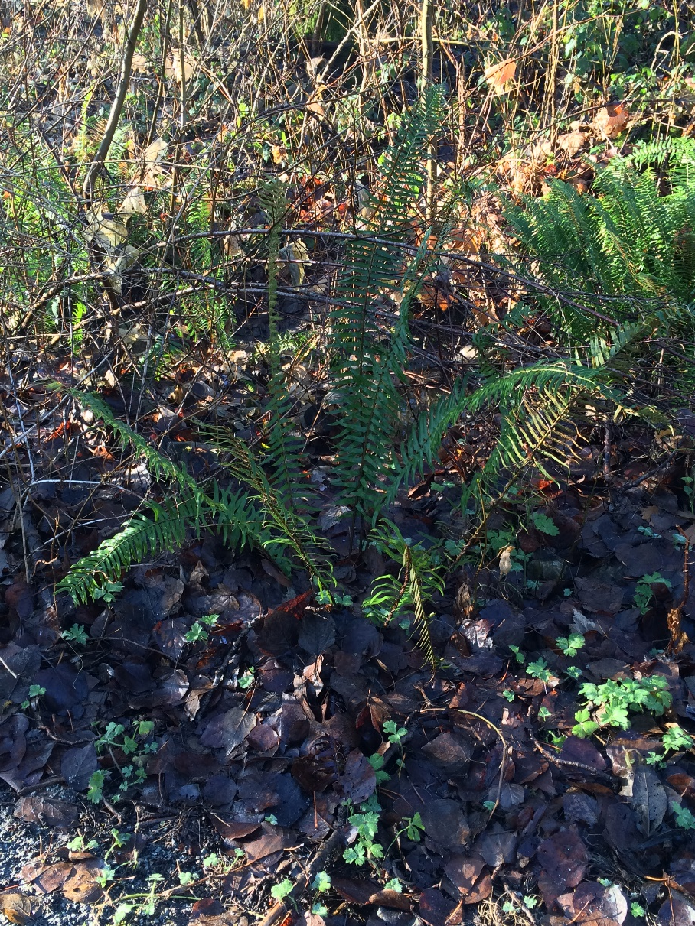
Plantain
Ferns—Bracken, Sword, Licorice ++

Slide 12
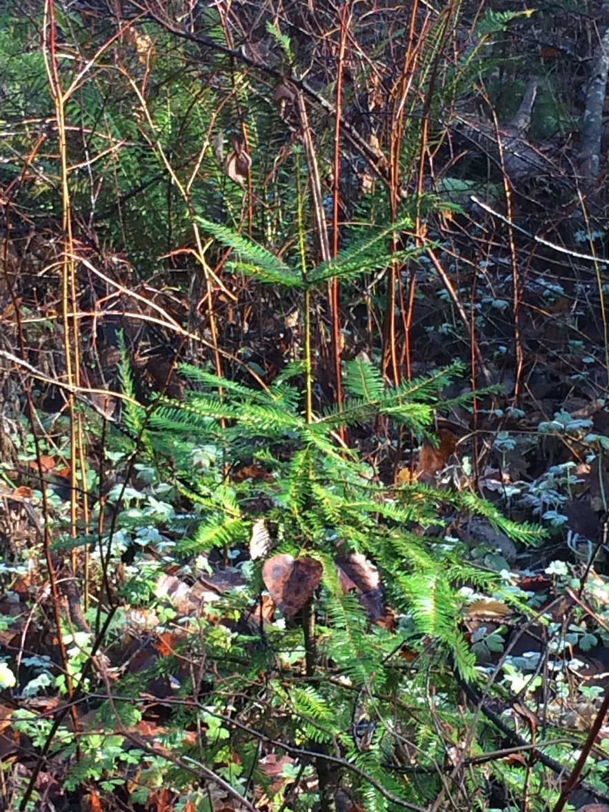
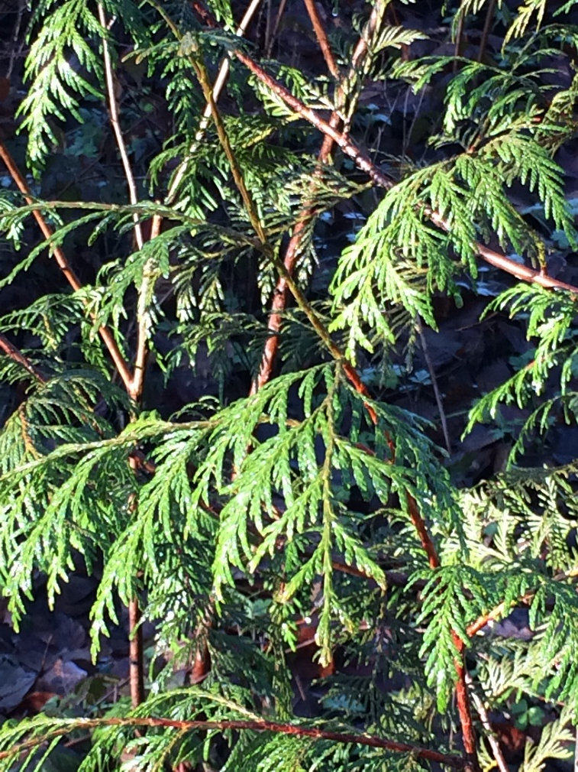
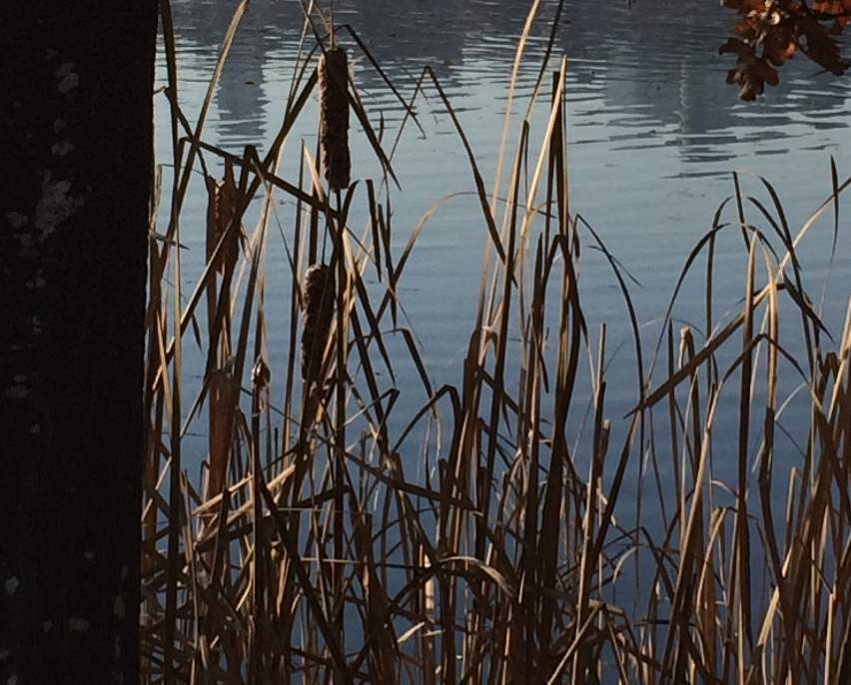
Cedar
Hemlock
Cattails

Slide 13
Let’s go out for a walk
Try to identify the plant you have been given.
Also, think about what you might see and what connections there are to your curriculum

Slide 14
Some resources
Resources:
SFU based on-line museum of a traditional Sto:Lo Village
http://www.sfu.museum/time/en/panoramas/beach/plants-and-berries/
Science Lesson using Indigenous Plants (a bit elementary, but useful)
https://www.scientistinresidence.ca/pdf/life-science/Temperate%20Forest/SRP_Temperate%20Forest_Lesson%2020.pdf
Legend about Douglas Fir Trees
https://heartofthewestcoast.com/2012/01/26/douglas-fir-trees/
http://www.wnps.org/education/resources/documents/K-5_Q&E/2nd_grade/2-2b.pdf
Leigh Joseph studies traditional diets and how they might help combat diabetes. This includes reviving the “rice root” plant (chocolate lily) that was cultivated along the Squamish estuary.
http://www.squamishchief.com/community/getting-back-to-her-roots-1.1104968
http://www.indigenousreporting.com/2012/story-1/
BC Indigenous Plant List
http://www.bcnature.ca/wp-content/uploads/2015/03/Appendix2.pdf
Tree Book
https://www.for.gov.bc.ca/hfd/library/documents/treebook/trees.htm
http://www.firstvoices.com/en/home​

