Slide 1
Healthy relationships

Slide 2
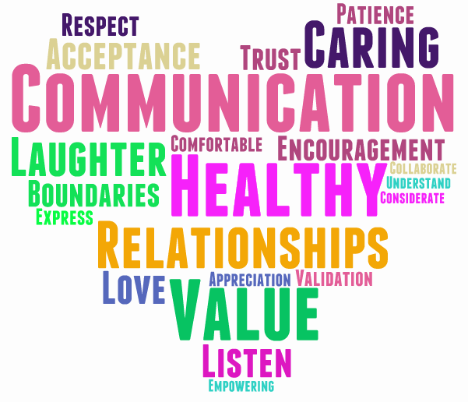

Slide 3
What is a healthy relationship?
In healthy relationships, people can feel safe, respected and accepted for who they are. In unhealthy relationships, people may feel anxious, confused, uncertain and even unsafe. Knowing these differences can help you make choices about who you date and for how long.

Slide 4
Signs of a healthy relationship
Being yourself
Honesty
Good communication
Respect
Feeling safe
Trust
Equality
Support
Boundaries (respected)
https://kidshelpphone.ca/get-info/healthy-relationships-vs-unhealthy-relationships

Slide 6
Communication
Healthy Communication:
you discuss things that are important to you or your relationship. You ask each other what you’re thinking and feeling and you listen to each other.
…includes:
Tone/Volume
Body language
Eye contact
Active listening
Notes:
Eye contact: in some cultures, eye contact may be disrespectful.

Slide 7
Dealing with arguments
It’s healthy to argue from time to time. Disagreeing gives you a chance to explore different perspectives and helps you express your feelings. It’s a problem if you’re fighting all of the time or if you say cruel things. It’s important to remember that physical fighting (punching, hitting, etc.) is never OK.
Here are some tips for fighting fair:
Stay calm
Don’t accuse
Address the problem
Step back

Slide 8
Boundaries
Good boundaries help you feel secure and worthwhile. When someone crosses the boundaries you have set, your mind and body tell you that the person has gone too far, and you start to feel uncomfortable.
Each person should express to their partner what they are and are not comfortable with, when it comes to sex life, finances, family and friends, personal space and time.

Slide 9
Healthy boundaries…
Allow for open conversations
Have trust
Help you feel safe and secure
Respect your personal limits
Use appropriate language and touch
Allow for personal space and time apart
Have balance and ‘give and take’

Slide 11
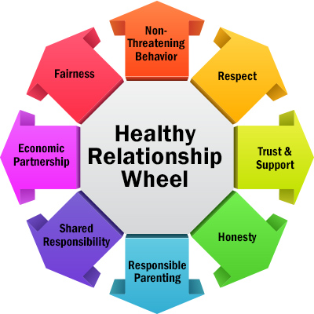

Slide 12
Resources
Videos
https://www.youtube.com/watch?v=yjzGxLq1Dqs
Teen Friendships & Boundaries (5 mins)
https://www.youtube.com/watch?v=hmJyWreER7A
Friendtimacy Ted Talk (16 mins)
https://www.youtube.com/watch?v=iPSH7PDEqA8
12 Signs You’re in a healthy relationship (11 mins)
https://www.youtube.com/watch?v=fGoWLWS4-kU
Tea Consent (2 mins)
Activity
We’re Not Really Strangers Quarantine Edition (sent as a pdf)
Instagram:
Gottmanninstitute
WNRS (We’re Not Really Strangers)
Quizzes:
“Is My Relationship Healthy?”
https://www.ydesfemmesmtl.org/en/is-my-relationship-healthy-quiz/
“What is your love language?”
https://www.5lovelanguages.com/

