Slide 1
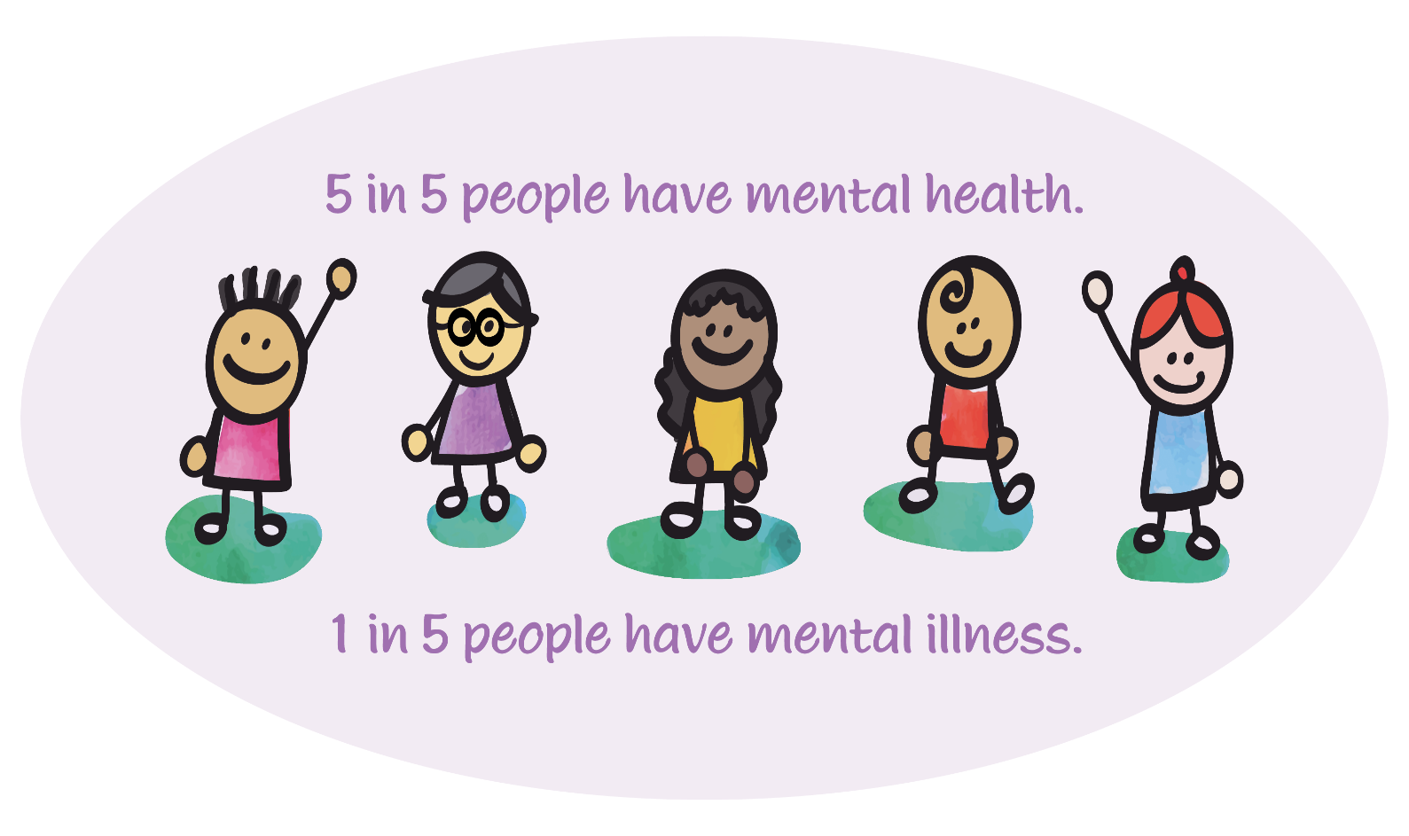
Mental Health Literacy

Slide 2
MENTAL HEALTH LITERACY IS…
A component of health literacy-and has been shown to have a strong positive correlation to healthy outcomes of populations and people.
Able to be taught (to teachers and students alike)
Ideally taught in schools (that’s what schools do)
Life-long knowledge that can be used for self, family, friends and others

Slide 3
MENTAL HEALTH LITERACY GOALS
Understand how to obtain and maintain good mental health
Understand and identify mental disorders and their treatments
Decrease stigma
Enhance help-seeking efficacy:
know where to go
know when to go
know what to expect when you get there
know how to increase likelihood of “best available care” (skills and tools)

Slide 4
What do these words mean?
Mental Disorder/ Illness
Mental Health Problem
Mental Distress
No Distress, Problem or Disorder
Notes:
Mental Distress: THe expected and usual emotional cognitive behavioural perceptual and somatic response of an individual to external or internal stress. It is a signal that adaptation is required and it attenuates once sufficient adaptation or removal of the stressor has occurred. Mental distress doesn't require medical
Mental Health Problem: a substantial and persistent mental distress leading to functional impairment but not meeting diagnostic criteria for a mental disorder. It is a signal that adaption is failing and that extraordinary assistance may be required. Medical treatments are sometimes applied if other methods of amelioration are not proving to be successful.
Mental Illness: Caused by a perturbation in usual brain function. It can often occur regardless of the social environment

Slide 5
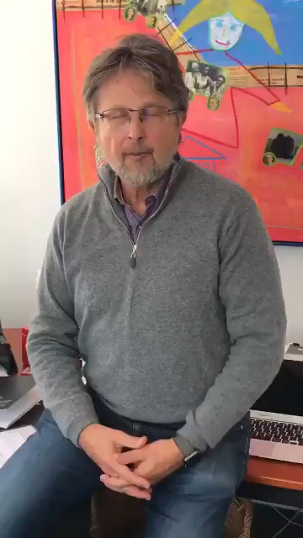

Slide 6

USE THE RIGHT WORDS
Pyramid Position | Event | Word
Distress | Lost my keys | Agitated
Distress | Did not make the team | Disappointed
Distress | Going on a first date | Nervous
Problem | Parent dies | Grief
Problem | Lost my Job | Demoralization
Problem | Romantic Breakup | Devastated
Disorder | None necessary | DEPRESSION
Notes:
Using the right word is really important. Many times we hear teens (and adults) say “I’m so depressed.” This indicates that depression is a feeling or emotion, when it is actually an illness. Using the appropriate words for feelings and improving social-emotional literacy can help. If the feeling is nervous, use the word nervous! If the feeling is devastation, say that feeling is devastation.
When everyone says the word “depressed” it conveys that mandy people have illness, when they actually do not. This same is true for saying “I’m so OCD”. A person may be particular about details, or like things a certain way – express the need for organization, but don’t say “I’m so OCD”.

Slide 7

Clarity is essential: “Depression”
Depression
Mental Disorder/ Illness
Demoralized, Disengaged, Disenfranchised
Mental Health Problem
Mental Distress
Unhappy, Disappointed,
Disgruntled
Notes:
Watch out for pathologizing clinical words

