Slide 1
Mental Health Literacy
Staff Discussion
Understanding the Stress Response

Slide 2
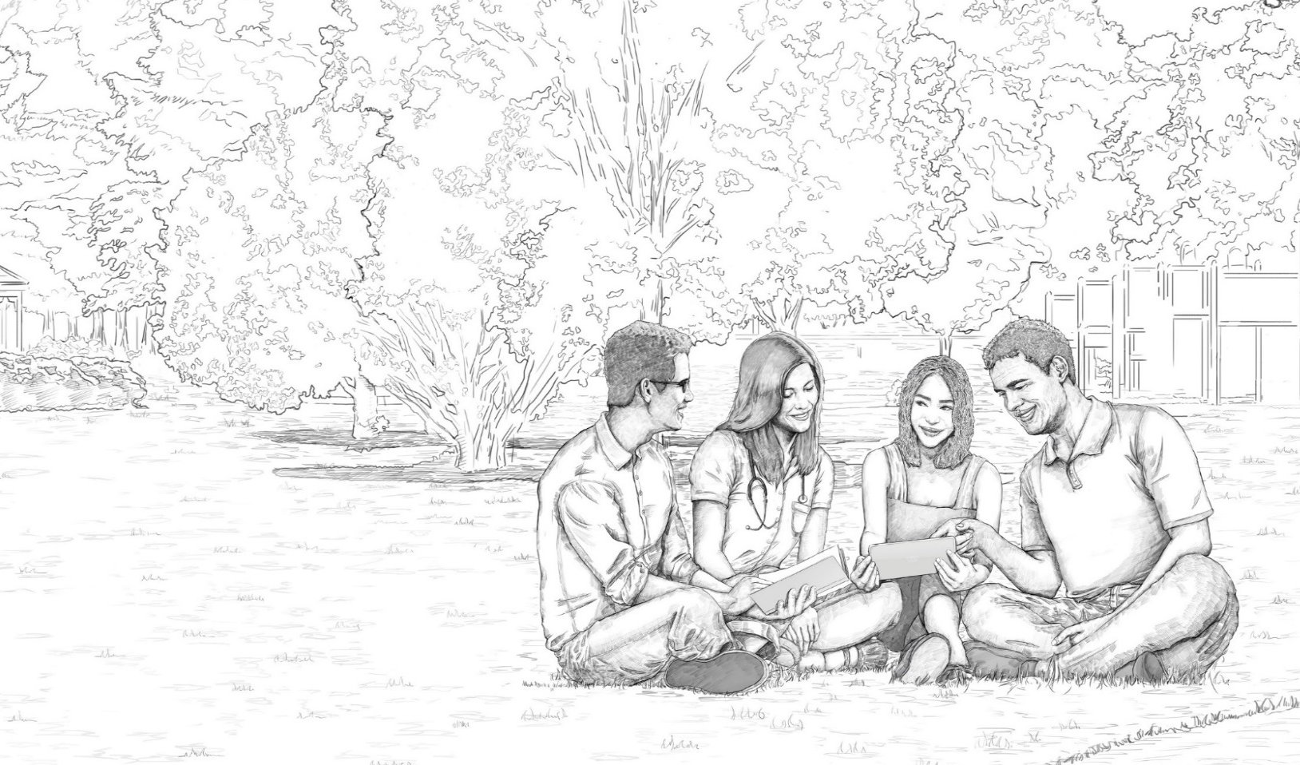
STRESS: WHAT DOES THE WORD MEAN?
The enemy of a healthy life
We now get stressed about stress
“Most people view the stress response as a toxic state to be minimized, but the reality is not bleak. In many ways, the stress response is your best ally during the difficult moments – a resource to rely on rather than an enemy to vanquish.” (K. McGonigal, The Upside of Stress, 2015)
Notes:
Stress doesn’t have to be all bad. In fact, it isn’t. We can frame things in “growth mindset” and look at stress as a stimulus to change, like motiviation.
The stress response drives learning. We don’t always get things correct the first few times we attempt - stress is a necessary biological component to help us focus and overcome difficulties.
Stress can be an ally.
Many people are familiar with the stress response “fight or flight” – less discussed is another stress response: excite and delight. Our response to stress helps us solve problems, leading to adaptive solutions.

Slide 3
How To Make Stress Your Friend: Kelly McGonigal
https://www.ted.com/talks/kelly_mcgonigal_how_to_make_stress_your_friend?language=en

