Slide 1
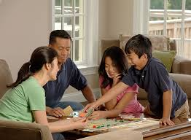
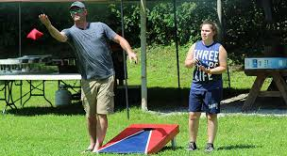
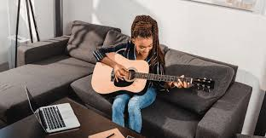
The Importance of Fun and Play

Slide 2
VIDEO: Explaining the Pandemic to My Past Self
https://www.youtube.com/watch?v=Ms7capx4Cb8

Slide 3
Stress is a normal reaction to uncertainty and things that may harm us. Many of us are currently worrying about our own health and the health of our loved ones, losses we may be experiencing, and what the future will bring. Fun and play can bring a lightness to those stresses and worries

Slide 4
Incorporating more fun and play into your daily life can improve the quality of your relationships, as well as your mood and outlook. Even in the most difficult of times, taking time away from your troubles to play or laugh can go a long way toward making you feel better.
Laughter makes you feel good. And the positive feeling that comes from laughter and having fun remains with you even after the giggles subside. Play and laughter help you retain a positive, optimistic outlook through difficult situations, disappointments, and loss

Slide 5
Benefits of fun and play for mental health
Relieves stress : Play is fun and can trigger the release of endorphins (the body’s feel good chemical) that contributes to a feeling of well-being
Improves relationships and connection to others: Sharing laughter and fun can foster empathy, compassion, trust, and intimacy with others.
Keep you feeling young and energetic: In the words of George Bernard Shaw, “We don’t stop playing because we grow old; we grow old because we stop playing.” Play can boost your energy and vitality and even improve your resistance to disease, helping you function at your best.
Helpguide.org – The Benefits of Play for Adults Lawrence Robinson, Melinda Smith, M.A., Jeanne Segal, Ph.D., and Jennifer Shubin

Slide 6
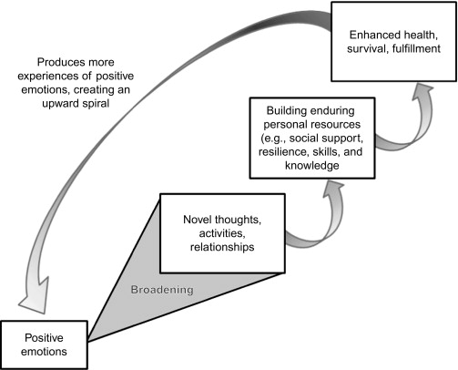
The Broaden-and-Build theory in Psychology
Beyond merely bringing positive feelings to your life, doing things that get you into a better mood can actually make you more resilient toward stress. Activities that raise our level of positive affect, or increase our good mood, can lead us to be more aware of resources in our lives that can help us to remain strong in the face of stress. When we're more aware of these potential resources, we tend to take advantage of them more. This builds resilience and leads to a further increase in positive affect—what's often referred to as an "upward spiral of positivity," which can really help relieve stress that you currently face, as well as future stress.
The Broaden and Build Theory of Positive Emotions, Barbara L. Fredrickson, 2008

Slide 7
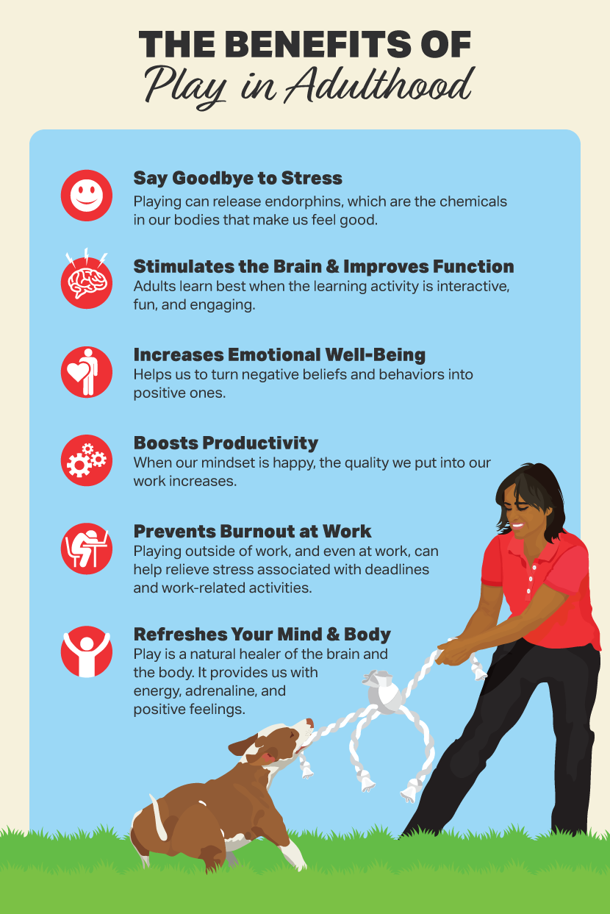

Slide 8
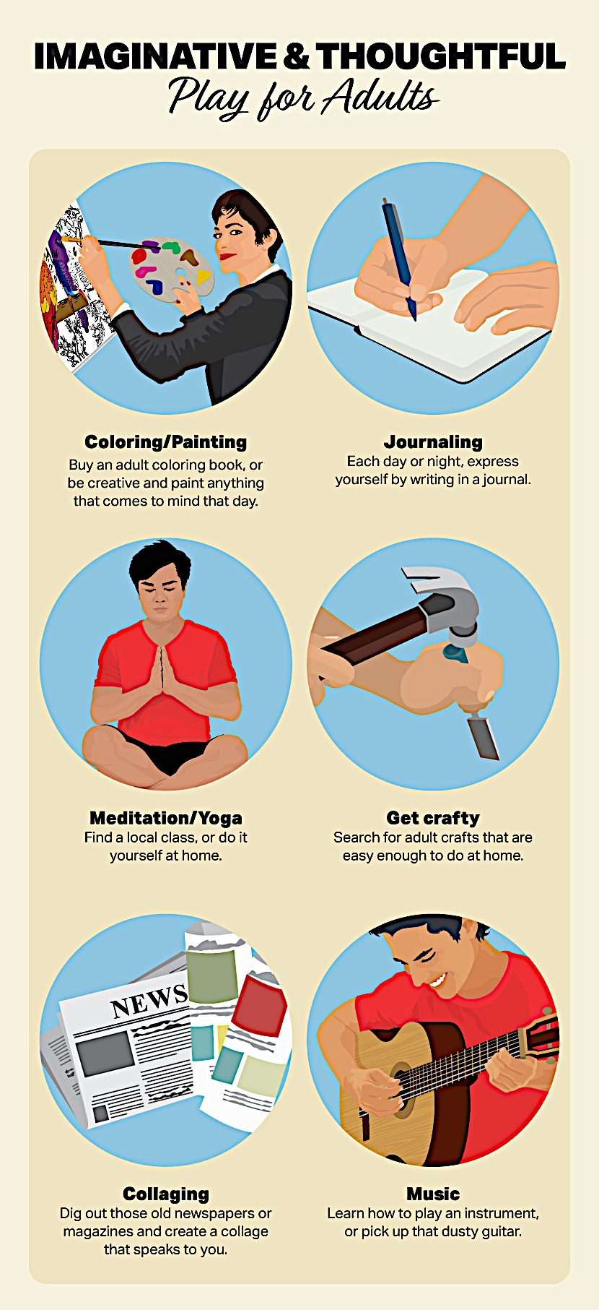
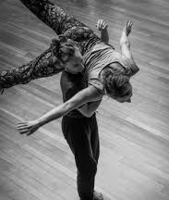
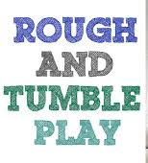
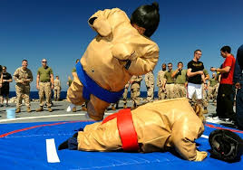
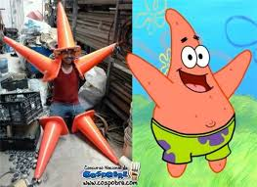
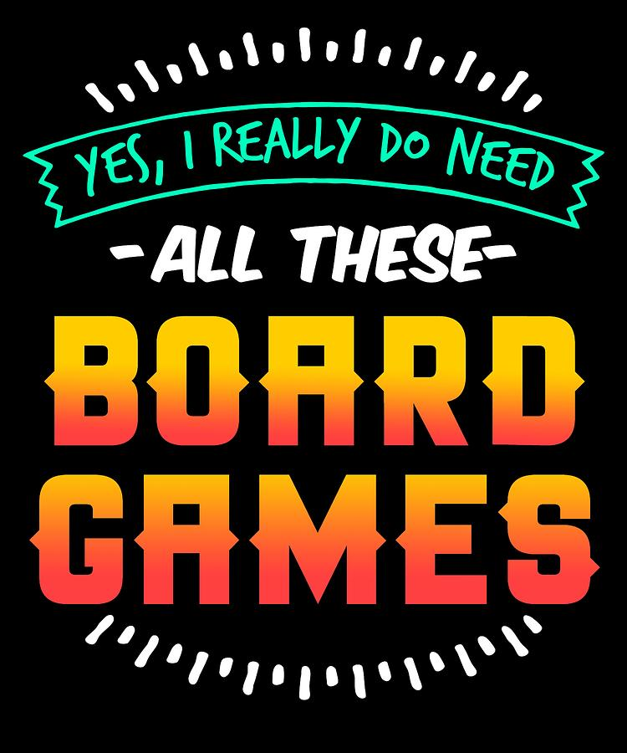
How do we play?
Play exists in so many forms!
There are numerous lists of the “types of play”
It can be messy, silly, energetic, quiet and gentle.
“Play is more than just fun”
Body Play
Ritual Play
Notes:
(Smilansky, 1968)
Functional Play – exploratory, experiemental (functions and properties of objects)
Constructive Play – Building structures/ creations
Dramatic Play – Socio-dramatic – sets goals and tasks through narrative structure – exploring roles and scenerios – helps to expand beliefs, desires and intentions.
Games with rules – table games and physical/movement games
Physically active play – creativity, self-control and discipline (executive functioning) – Outdoor play, big-body play

Slide 9
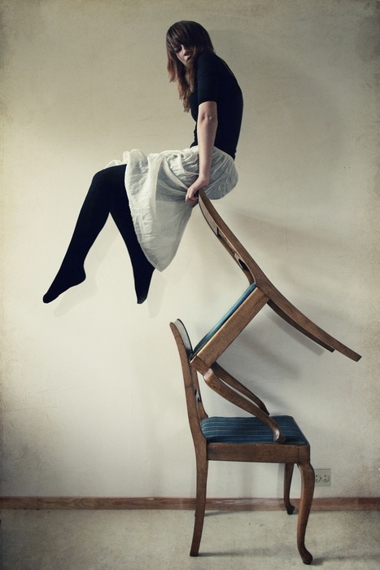
Finding Balance
Recent reports indicate that physically active play is decreasing across Canada, while screen time and obesity are increasing (Tremblay, 2018).
Some contributing factors pointed out by researchers are: poor play environments, schedules, screen time, and an increase in structured activities.
Variety of play is important, and finding a balance between time spent on and off screens is important for children and adults.

Slide 10
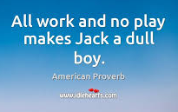
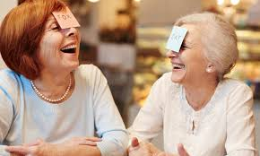
Play is important for Everyone
Research demonstrates that play in all its forms serves a crucial role in every aspect of child development (Ministry of Education BC. Handbook, Play Today, p.71).
Unfortunately, as adults, play is often replaced with more serious pursuits.
It is important to remember that play is important for adults too! Especially in stressful times.

Slide 11
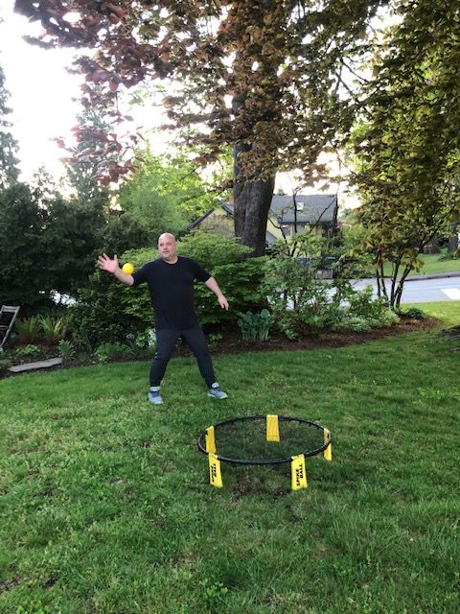
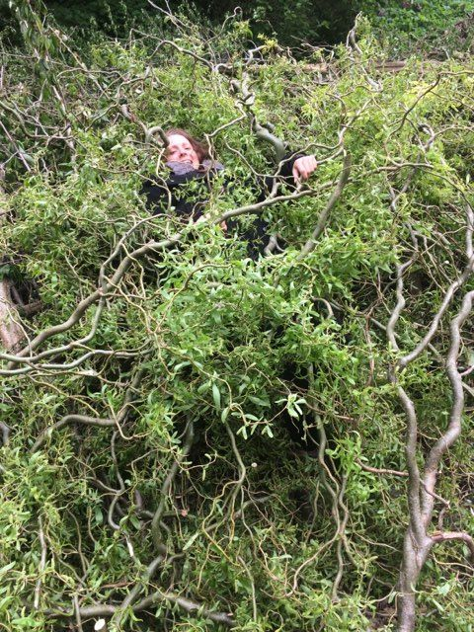
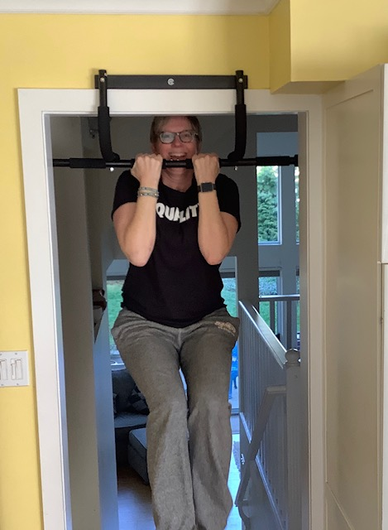
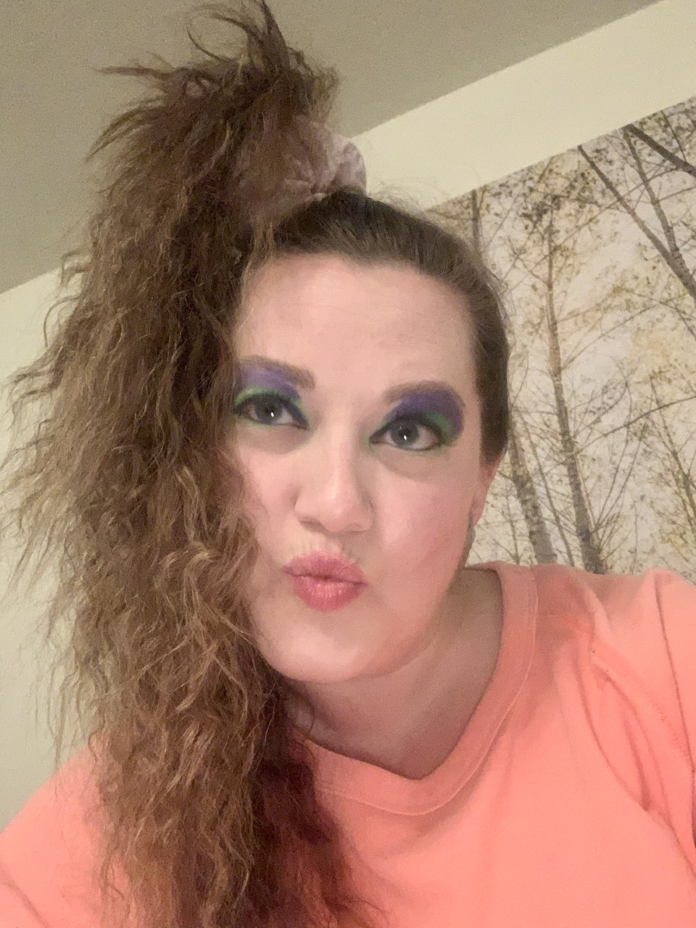
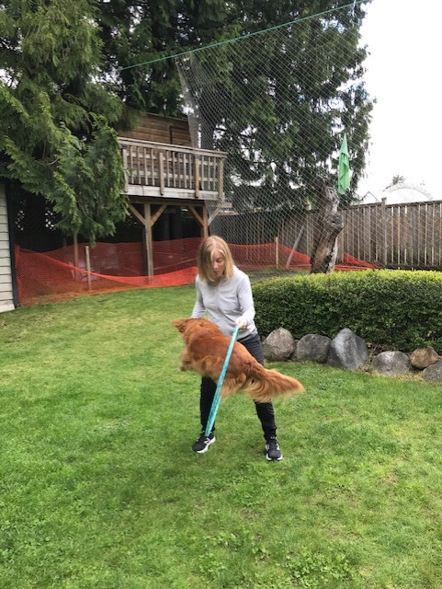
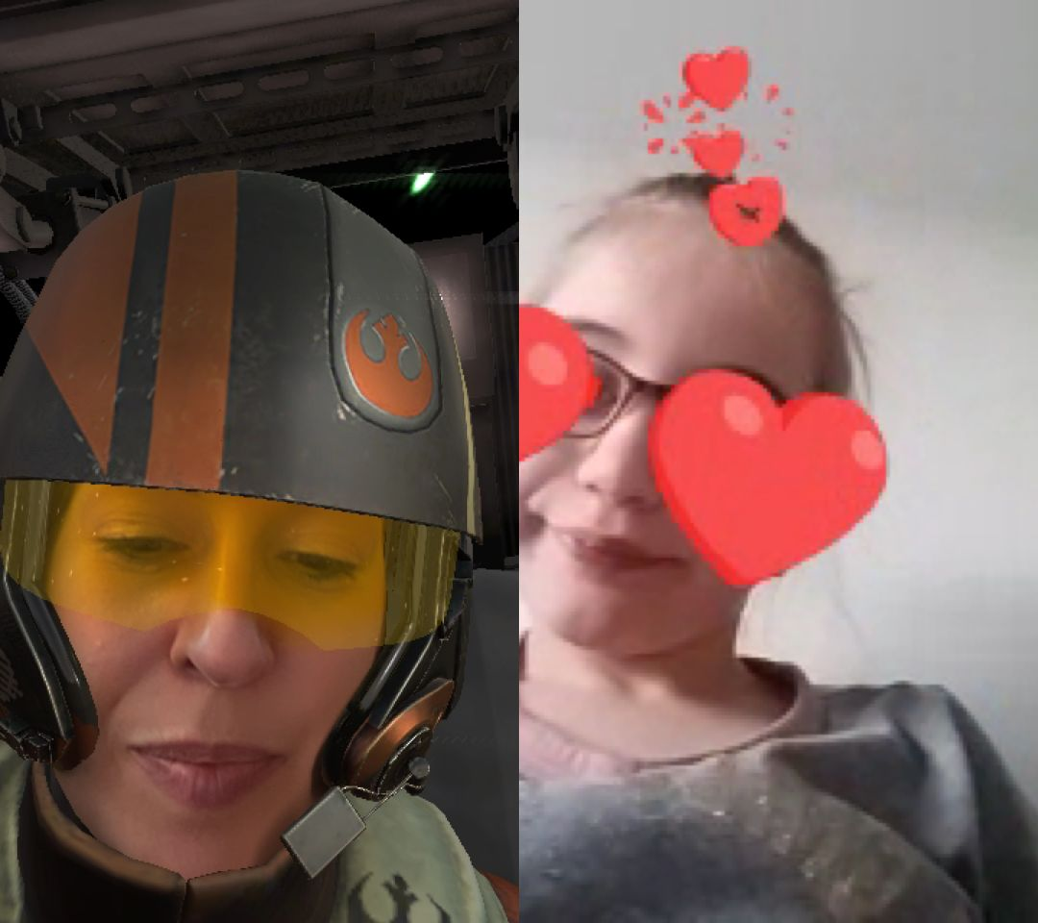
How do We play?

Slide 12
How do YOU Play?

Slide 13
References:
https://www2.gov.bc.ca/assets/gov/education/early-learning/teach/earlylearning/play-today-handbook.pdf
https://www.helpguide.org/articles/mental-health/benefits-of-play-for-adults.htm Authors: Lawrence Robinson, Melinda Smith, M.A., Jeanne Segal, Ph.D., and Jennifer Shubin. Last updated: June 2019.
https://www.fix.com/blog/adults-playing/ Caleigh Flannigan, M.A. October, 2018.(Graphic Slide 7)

