Slide 1
Well-Being For ALL: Supporting Each Other and Our Communities

Slide 2
Definition of Well-being
Resources
Psychological
Social
Physical
Challenges
Psychological
Social
Physical
Well Being
Dodge, R., Daly, A., Huyton, J., & Sanders, L. (2012). The challenge of defining wellbeing.
Stable well-being is when individuals have psychological, social and physical resources they need to meet a particular psychological, social or physical challenge.
Notes:
SV- In essence, stable wellbeing is when individuals have the psychological, social and physical resources they need to meet a particular psychological, social and/or physical challenge. When individuals have more challenges than resources, the see-saw dips, along with their wellbeing, and vice-versa.

Slide 3
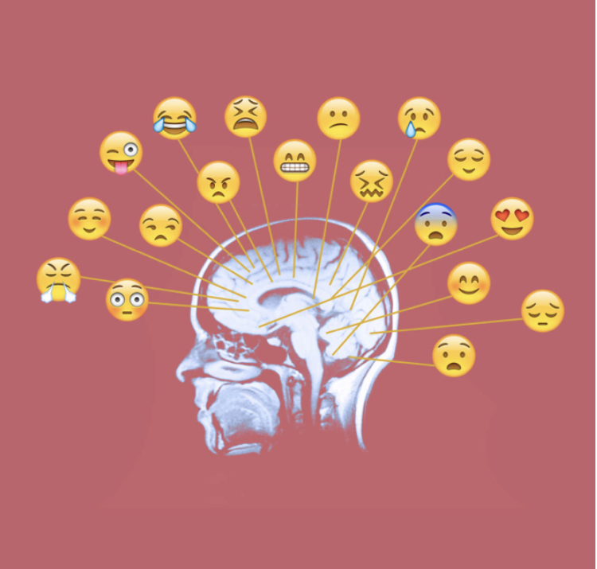
Well-Being & Resilience
Well-being is NOT being happy all the time
It is understanding emotion and developing skills to cope with the big emotions and adversity.
Our school environment, building a caring community and our personal capacity to respond has a huge role to play.
Focus on resilience. How do we balance the challenges with the resources in our lives.
Looking for positive influences and not letting the negative influences dominate our inner self talk, or the story we tell ourselves.
How are we building our resilience as educators?

Slide 4
A Conceptual Model of Well-being and Flourishing in Schools
What if you imagine that your primary role as an educator is to learn how to thrive in your work, and in doing so encourage all others around you (including your students) to do the same?
What does it look like to flourish in your job ?
“Teacher Wellbeing: Noticing, Nurturing, Sustaining and Flourishing in Schools”
Sabre Cherkowski

Slide 5
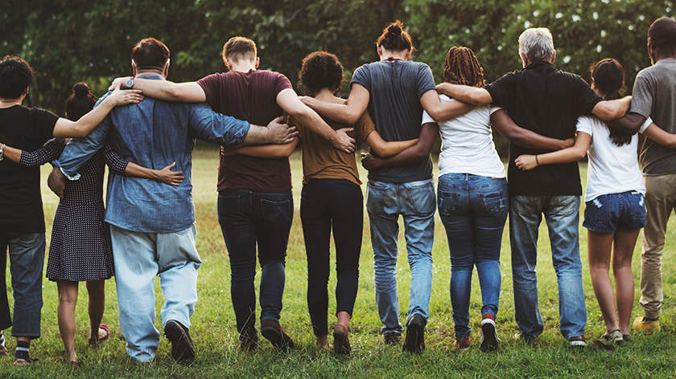
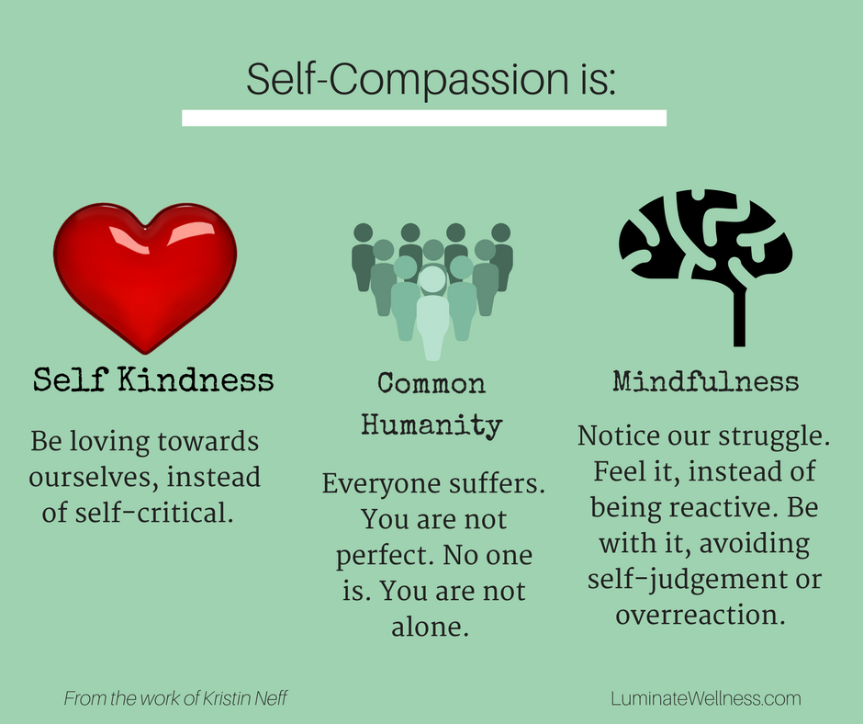
Compassionate communities start with self-compassion
How are we fostering well-being through compassionate community building ?
What are our next steps to enhance our goal of ensuring schools are compassionate communities ?

Slide 6
Schools that Focus on Well-being – Flourish
Resources for Staff…. to help you flourish
https://www.mindwellu.com
“Teacher Wellbeing : Noticing, Nurturing, Sustaining and Flourishing in Schools”
Sabre Cherkowski and Keith Walker
Resources for Schools:
https://www.healthyschoolsbc.ca/
https://www.we.org/our-work/we-schools/well-being/
https://dashbc.ca/
https://casel.org/
https://www.wellbeingbc.ca
Resources for Students
https://mindup.org/
https://ggsc.berkeley.edu/images/uploads/GGSC_Gratitude_Curriculum_MS_HS.pdf
https://www.randomactsofkindness.org/for-educators
https://www.uvic.ca/research/centres/cisur/publications/helping-schools/iminds/index.php

