Slide 1
Healthy Bodies, Healthy Minds
Connecting Health Lessons to Mental Health Literacy

Slide 2
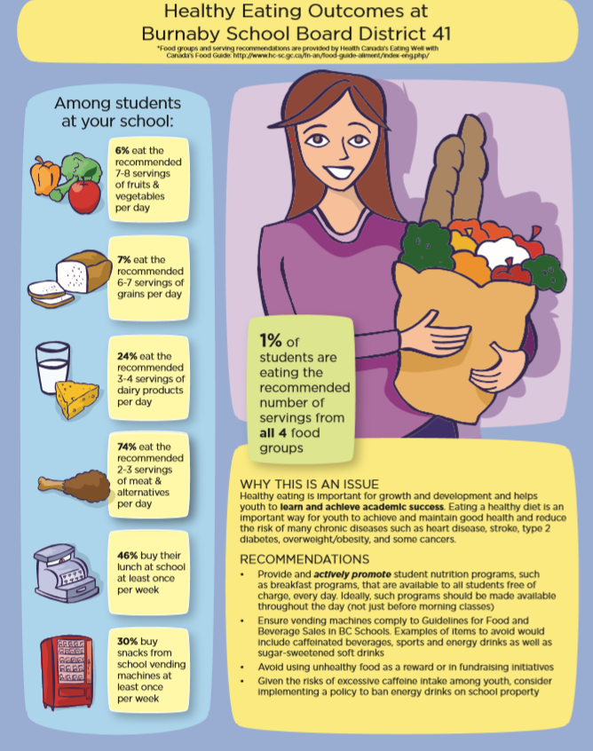
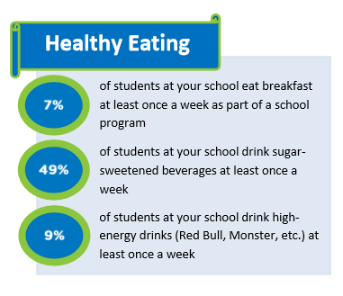
Nutrition and Student Eating Habits Compass Survey results 2017/2018 – students 9-12 What are our students eating habits? How does that impact their physical and mental health? How can we as educators respond?

Slide 3
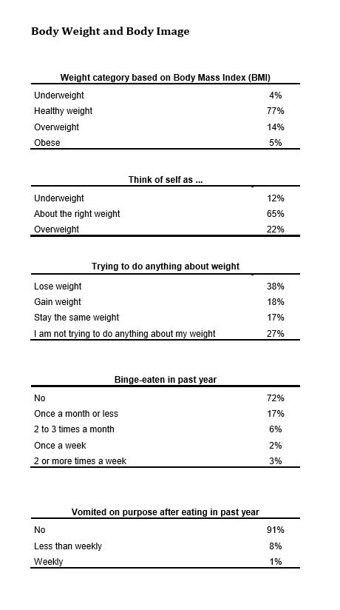
In 2018 grade 10 students participated in McCreary Health Survey Here is what our students told us; 77% identify as being a healthy weight yet 56% are trying to loose or gain weight. Students have disclosed the following unhealthy eating patterns: 11% of youth are binge-eating 9% of youth are vomiting on purpose Discuss what you think these discrepancies are about ?
Body Image and Self-esteem

Slide 4
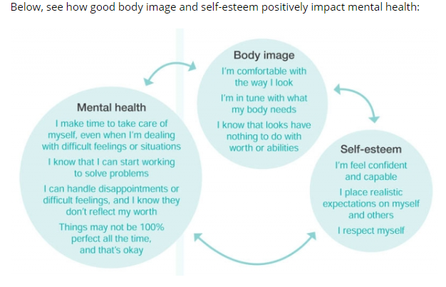
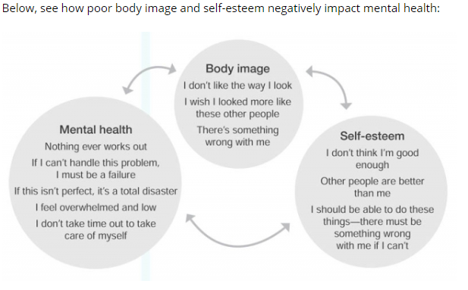
Connecting Mental Health, Body
Image and Self-esteem
Focus on health promotion. How do we connect our discussions around nutrition, exercise & health habits to our attitudes towards our bodies and our minds?

Slide 5
Discussing Health & Wellbeing in the Classroom…more than nutrition facts and healthy habits…
The relationship between food and feelings
Mindful eating practices
Self esteem, healthy attitudes and our relationship to eating
Social Media and impact on body Image
Canada Health Guide
Movement and Exercise
Getting Outside
Holistic approach to talking about health and wellbeing.

Slide 6
Classroom Resources…..
Nutrition and Healthy Eating:
https://bcdairy.ca/nutritioneducation/workshops
https://farmtoschoolbc.ca/curriculum-resources/
https://sipsmart.ca/
https://www.healthyfamiliesbc.ca/
https://digem.med.ubc.ca/projects/ubclearningforlife/
https://www.live5210.ca/about-live-5-2-1-0/
Healthy Attitudes and Body Image:
https://freshindependence.com/clips-from-selfless/
https://www.mentallyhealthyschools.org.uk/mental-health-needs/eating-problems/
https://jessieslegacy.com/resources/eating-disorder-prevention-toolkit/
https://keltyeatingdisorders.ca/
https://bcdairy.ca/nutritioneducation/workshops/healthy-attitudes-healthy-bodies-healthy-schools
https://jessieslegacy.com/resources-and-information/

