Slide 1
Grasp Gratitude Increase Wellness

Slide 2
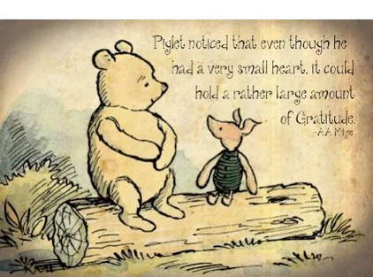

Slide 3
What Is Gratitude?
Gratitude is one of many positive emotions. It's about focusing on what's good in our lives and being thankful for the things we have.
Gratitude is pausing to notice and appreciate the things that we often take for granted, like having a place to live, food, clean water, friends, family, even computer access. It's taking a moment to reflect on how fortunate we are when something good happens — whether it's a small thing or a big thing.
We can use lots of words to describe feelings of gratitude: We might say we feel thankful, lucky, fortunate, humbled, or blessed.
Notes:
Note: All information on TeensHealth® is for educational purposes only. For specific medical advice, diagnoses, and treatment, consult your doctor.
© 1995-2020 The Nemours Foundation. All rights reserved.
Images provided by The Nemours Foundation, iStock, Getty Images, Veer, Shutterstock, and Clipart.com.

Slide 4
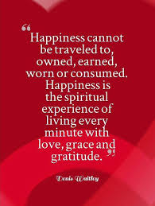

Slide 6
Why Gratitude Matters Gratitude doesn't just feel good. Making a habit of gratitude can also be good for us. Brain research shows that positive emotions are good for our bodies, minds, and brains.
Positive emotions open us up to more possibilities. They boost our ability to learn and make good decisions.
Positive emotions balance out negative emotions. People who often feel grateful and appreciative are happier, less stressed, and less depressed. Gratitude is like a U-turn on complaining or thinking about what we don't have.
One positive emotion often leads to another. When we feel grateful, we might also feel happy, calm, joyful, or loving.
Gratitude can lead to positive actions. Your gratitude also can have a positive effect on someone else's actions. Thanking people can make it more likely they'll do a kindness again.
Gratitude helps us build better relationships. When we feel and express heartfelt gratitude and appreciation to people in our lives, it creates loving bonds, builds trust, and helps you feel closer.
Notes:
Note: All information on TeensHealth® is for educational purposes only. For specific medical advice, diagnoses, and treatment, consult your doctor.
© 1995-2020 The Nemours Foundation. All rights reserved.
Images provided by The Nemours Foundation, iStock, Getty Images, Veer, Shutterstock, and Clipart.com.

Slide 7
Effects of Gratitude in the classroom
…researchers assigned young adults to keep a daily journal of things they were grateful for. They assigned other groups to journal about things that annoyed them, or why they were better off than others. The young adults assigned to keep gratitude journals showed greater increases in determination, attention, enthusiasm and energy compared to the other groups.
PowerofPositivity. (2018, September 22). Scientific Proof: Practicing Gratitude Every Day Can Change Your Life. Retrieved October 06, 2020, from https://www.powerofpositivity.com/gratitude-change-your-life/

Slide 9
Videos
Elementary
https://www.youtube.com/watch?v=T5Umo80x9og
https://www.youtube.com/watch?v=yA5Qpt1JRE4
https://www.youtube.com/watch?v=YeSdQmO51Ps
Secondary
https://www.youtube.com/watch?v=yBsPJJxOwmU
https://www.youtube.com/watch?v=U5lZBjWDR_c
https://www.youtube.com/watch?v=GXy__kBVq1M
Science of Gratitude
https://www.youtube.com/watch?v=oHv6vTKD6lg
https://www.youtube.com/watch?v=JMd1CcGZYwU

Slide 11
Boost Your Optimism
Seligman Survey
A – Adversity: Describe the event that happened. Leave out evaluations and judgements
B – Belief: Explain how adversity was interpreted. Not how you think it ought to be, but what your default belief/interpretation was.
C - Consequences: Think about the feelings and actions that result from these beliefs.
D - Disputation: Do you have any grounds to dispute these automatic reactions?
E - Energization: This is the last step that's done when successful disputation occurs.
Dr. Albert Ellis and Dr. Martin Seligman

Slide 12
Are You Optimistic or Pessimistic?
https://www.seemypersonality.com/Optimism-Test#q1

