Slide 1
Number Talks
BURNABY SCHOOLS
Donna Morgan, Math/Science Consultant

Slide 2
We acknowledge the Coast Salish nations (Musqueam, Squamish and Tsleil-Waututh) on WHOSE unceded traditional territories WE TEACH, LEARN AND PLAY
Mathematics is not acultural.

Slide 3
Agenda
Acknowledgement
Number Talks
Introduction/Videos/make and take anchor chart
Books and Resources
Feedback/Date/For Next Time

Slide 4
Number Talks
Videos
https://players.brightcove.net/5387496875001/default_default/index.html?videoId=5441080655001
https://players.brightcove.net/5387496875001/default_default/index.html?videoId=5441100552001

Slide 5
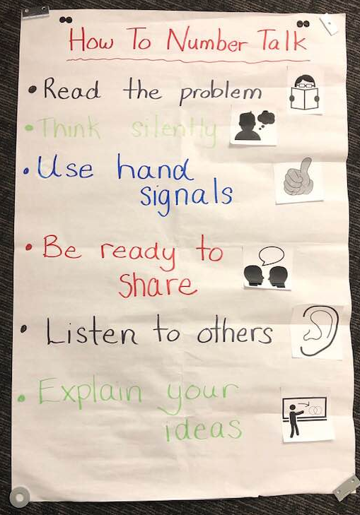
Anchor Charts to Introduce Number Talks

Slide 6
Tips
Be comfortable with plenty of WAIT TIME
Practice GRADUATED PRESSING to get students to explain their thinking.
THINKING TOGETHER…model and encourage, especially when just starting out.
LEARN TO LISTEN so you can unpack student thinking (and misconceptions)
Do them REGULARLY…when starting, try one every math period. You can space them out later.
Encourage CLARITY OF MATHEMATICAL LANGUAGE…get students to rephrase.
RECORD student thinking on the whiteboard or smartboard
Promote STUDENT INTERACTIONS by putting yourself to the side and encourage them to question and answer each other.
Have BACK UP QUESTIONS in place, in case your choice is too easy or too hard.
NUDGE students to go beyond the rote algorithms.

Slide 7
Make and Take
Take a look at the number talk books.
How might you use your Carole Fullerton Resource to run Number Talks?
Make your own anchor charts, and find a number string to start you off with number talks.

Slide 8
Resources
Number Talks
Books by Sherry Parrish
My Math Blog:
https://blogs.sd41.bc.ca/math

