Slide 1
Number Talks
BURNABY SCHOOLS
Donna Morgan, Math/Science Consultant

Slide 2
We acknowledge the Coast Salish nations (Musqueam, Squamish and Tsleil-Waututh) on WHOSE unceded traditional territories WE TEACH, LEARN AND PLAY
Mathematics is not acultural.

Slide 3
Agenda
Number Talks
Introduction
Sample Videos
Anchor charts
Books and Resources
Questions

Slide 4
Using the Rekenrek

Slide 5
Number Talks
https://www.youtube.com/watch?v=pk9TbuAPQ7E
https://players.brightcove.net/5387496875001/default_default/index.html?videoId=5441100552001

Slide 6
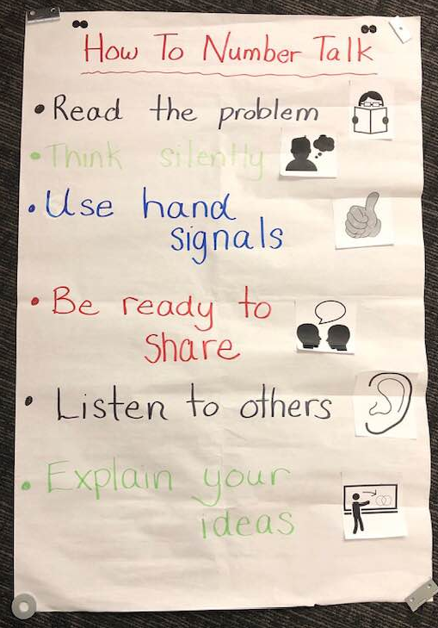
Anchor Charts to Introduce Number Talks

Slide 7
Tips for the Classroom—Dan Meyer
Start with easy questions that are accessible to everyone.
Students will be looking to see if you indicate what the right answer is. Don’t favor right answers over wrong ones. Make sure that the explanations are what matters.
Taking a few minutes ahead of time to plan out a sequence of questions can be helpful. (i.e., I’ll start with 9 + 7, since everyone can do that, then we’ll do 9 + 17, then 19 + 17.)
Make sure you emphasize the Number Talk protocol—hands at chests rather than waving in the air, for example. This will pay off, and you can use it in other places.

Slide 8
Give students constructive language to use in the discussion, like, “I respectfully disagree, because…” and “I agree with _____, because…”
Always keep the environment safe and positive.
Don’t worry if you don’t reach total consensus on every problem. Sometimes a student will need more time to process. You can move on when it feels like it is time.
Number Talks can sprawl if you’re not careful. Doing short (5 minute) Number Talks regularly is more powerful than long ones infrequently.
https://mathforlove.com/lesson/number-talks/

Slide 9
Sample Number Talk
160÷8
16÷8
400÷8
80÷8
496÷8

Slide 10
Resources
Number Talks
Books by Sherry Parrish
https://brownbagteacher.com/number-talks-how-and-why/
My Math Blog:
https://blogs.sd41.bc.ca/math

