Slide 1
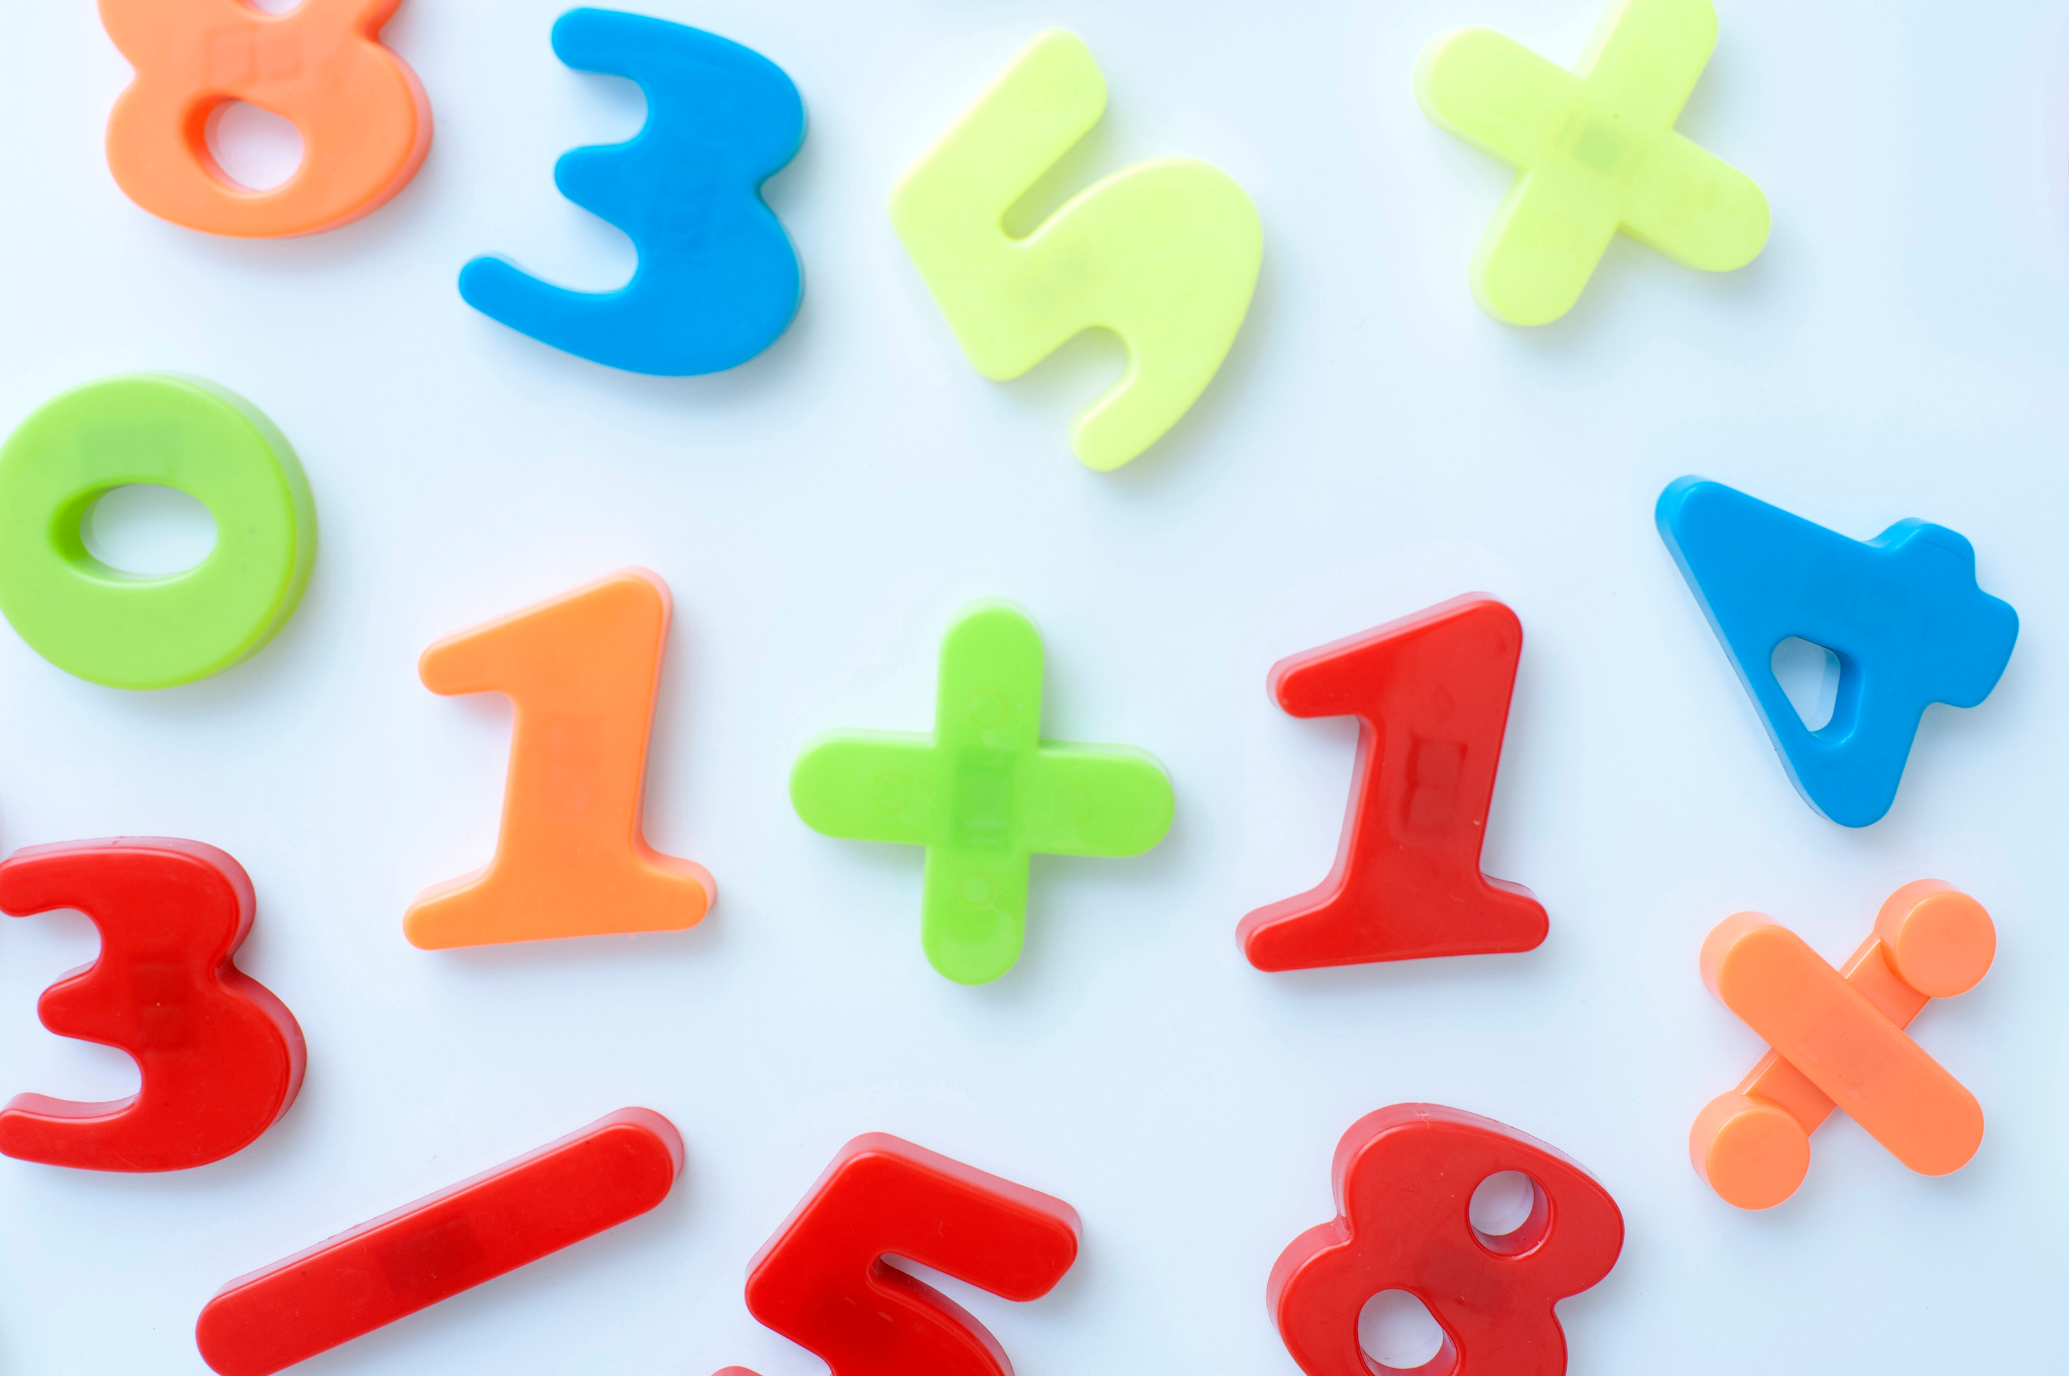
MATH 101-Primary
BURNABY SCHOOLS
Donna Morgan, Math/Science Consultant

Slide 2
Soft start
Play the domino game and try out the Halloween shapes for the pattern blocks!

Slide 3
We acknowledge the Coast Salish nations (Musqueam, Squamish and Tsleil-Waututh) on WHOSE unceded traditional territories WE TEACH, LEARN AND PLAY
Mathematics is not acultural.

Slide 4
Agenda
Soft start…dominoes and halloween pattern blocks
Acknowledgement
Numberline warm up
Today’s Focus: Numberlines leading to multiplication
-clotheslines
-Kim Sutton’s placemat numberline
-Addition games and skip counting
SUPPER (5 pm)
Numberline Make and Take and Ideas
Great Resource: BC Numeracy network
Feedback/For Next Time

Slide 5
Group Up/Line Up

Slide 6
Using the Rekenrek

Slide 7
Rekenrek Sample Lessons
It takes 2 to build a number
Count and Compare

Slide 8
The importance of the numberline

Slide 9
Numberline Activities

Slide 10
Numberline Activities
Questions for numberline

Slide 11
Preparing for Multiplying
CHIPS AHOY
IN BETWEENS

Slide 12
Connect to Literature
The King’s Commissioners

Slide 13
A great resource

Slide 14
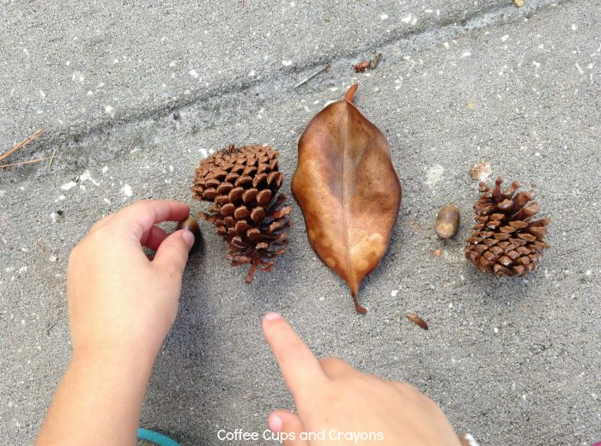
Progression of MATH 101
Oct 29—Building Fluency, Building towards multiplication*
Nov 19—Spatial relationships, shapes, data*
Nov 23—am session with Carole Fullerton (Financial Literacy or YOUR choice?)
Please commit to all 4 sessions

Slide 15
Resources
For the rekenrek:
On-line rekenrek for teacher demo:
https://apps.mathlearningcenter.org/number-rack/
Rekenrek info and suggested lessons:
https://bridges1.mathlearningcenter.org/files/media/Rekenrek_0308.pdf
https://www.mathlearningcenter.org/sites/default/files/pdfs/LTM_Rekenrek.pdf
Clothesline Numberlines (and the PDF’s of the cards we made in the session):
https://mathwithmeaning.wordpress.com/tag/clothesline/
BC Numeracy Network
https://sites.google.com/view/bc-numeracy-network/home?authuser=0

