Slide 1
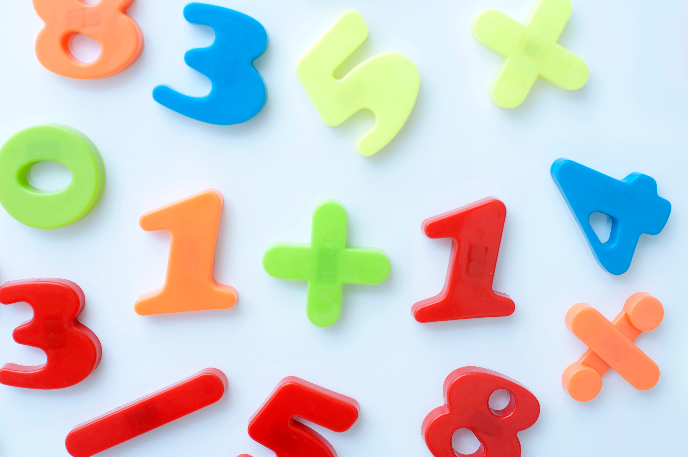
MATH 101-Primary
BURNABY SCHOOLS
Donna Morgan, Math/Science Consultant

Slide 2
We acknowledge the Coast Salish nations (Musqueam, Squamish and Tsleil-Waututh) on WHOSE unceded traditional territories WE TEACH, LEARN AND PLAY
Mathematics is not acultural.

Slide 3
Agenda
Acknowledgement
Series Overview
Give one/Get one &Introductions
Math Autobiography
Curriculum Overview—read, prioritize via Human Histogram
Today’s Focus: Number
Benchmark Triage
Number Routines Review
SUPPER (5 pm)
Rekenrek Make and Take and Ideas
Book
Feedback/For Next Time

Slide 4
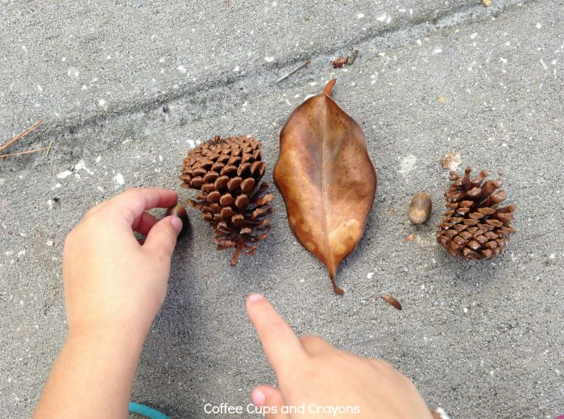
Progression of MATH 101
Oct 15—Intro, Math Mindset, Curriculum Overview, Number Sense Routines, Rekenrek, Fullerton Book
Oct 29—Building Fluency, Building towards multiplication*
Nov 19—Spatial relationships, shapes, data*
Nov 23—am session with Carole Fullerton (Financial Literacy or YOUR choice?)
Please commit to all 4 sessions

Slide 5
GIVE ONE/GET ONE
Take your quote, read it and think about how you relate to it.
Mingle, share your perspective with one other person, trade cards.
Repeat!

Slide 6
Introductions
Who are we?
Why are we here?

Slide 8
What is your math autobiography?
Take a few minutes and write about your experiences as a math learner
It can be positive or negative. Include some of your early experiences, include some experiences with teachers (in any grade), both good and bad ones, how your attitude towards mathematics has changed over the years (if it did), why you like it or don't like it, what feels good about doing math or learning math or teaching math, what is scary for you, what is exciting for you, …

Slide 9
Curriculum Overview

Slide 10
Human Histogram

Slide 11
Benchmarks for Number
Read through the benchmarks column for the grade(s) you teach.
Read through a second time, using a “stop-light” highlighting—green for things you feel you do very well with your students; yellow for things that need some improvement; and pink (red) for things that you feel need more work or attention in your class.
Let’s share…first at your table, then in to the group.

Slide 12
Why Number Sense Routines?
Allow for a focus on learning
Design and flow of the learning experience more predictable
Provide for a wide range of learners to access and use math practices
Support making sense of numbers
Support mental math calculations/fact fluency
Help to build critical math thinking habits
Support reasoning and explaining thinking
Support students learning from each other

Slide 13
Visual Routines
Subitizing/Quick Images Using
Dot Cards (Regular and Irregular)
Five and Ten Frames
Rekenreks (bead rack—after supper)

Slide 14
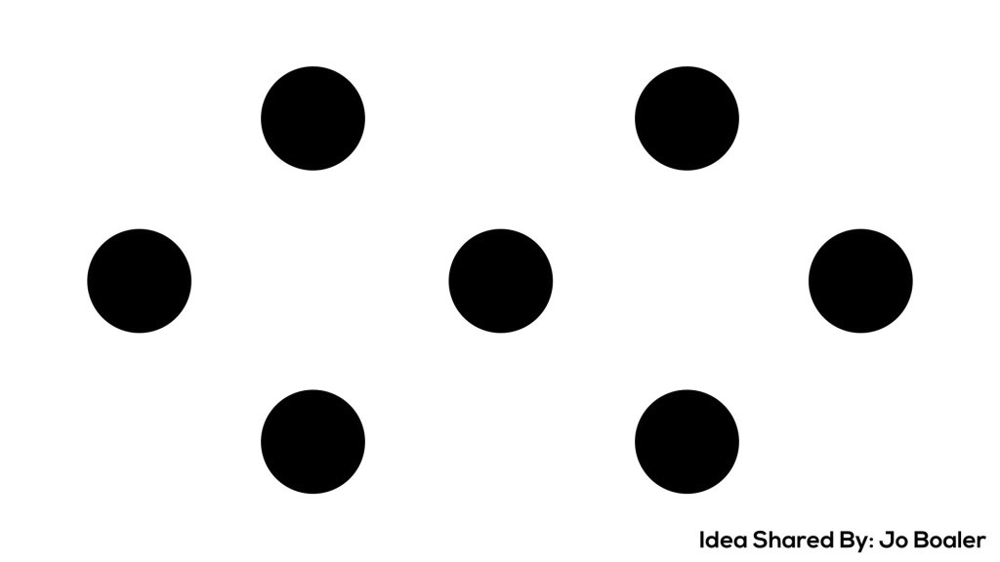

Slide 15
How did you see and count the dots?
Notes:
So many ways to see the dots…go back and try a few of the ways, write on screen with pen.

Slide 16
10 Frames are great tools from K – Gr 3 and beyond—here is an example of using them to develop multiplicative thinking in Gr 3

Slide 17
Counting Routines
Comfort with counting, then add skip counting
Count Around
Establish classroom comfort with MISTAKES.
Everyone needs to listen to each other and count in their heads.
Provide wait-time for students.
Students develop fluency with counting and place value.
Teachers can record the numbers on the board to help with the noticing of patterns.
VARIATIONS: Count forward and backwards; count by 2’s, 3’s, etc.; ask questions
Bizz-Buzz
Determine number to focus on (ie. 3)
Students count around the circle counting by 1s.
When the count has the number 3 in it, say “Bizz”.
Do a second number (ie. 6) and say “Buzz”
When the count has 3 and 6, instead of saying the number, you say “Bizz Buzz”.
Let’s Try!
Notes:
Ask “What number will Jane say?” or “Will we reach 20 by the time we go around the circle once?” or “If we start at 52 and count backwards, how many times will we go around the circle to reach zero?”
Each student picks a coin and keeps it visible. Count around adding the value of the coin. . Use coins appropriate to your grade level. Ex.: 1, 26, 31, 41, 42, 67...

Slide 18
Numbers and Relationships
Thinking about number in many different ways
Target Number
Provide students with a target number.
Students think of as many ways as they can to represent the number.
Share out their thinking while teacher records.
Guess My Number
Give or select three clues about the number.
Between 70 and 120
An even number
Has 3 digits
Students think through possible numbers for a moment
Share with a partner
Share with whole group
Variation: have students create clues to share

Slide 19
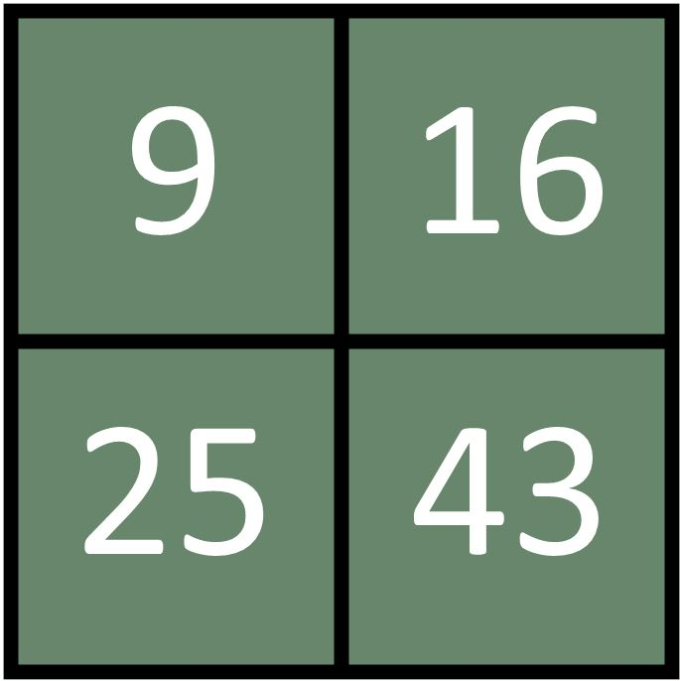
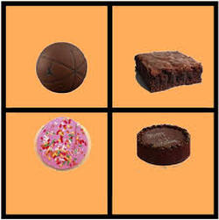
Numbers and Relationships
Which one’s not like the others?
Operation Estimation
Use your own objects to estimate,
or find interesting ones here:

Slide 20
Using the Rekenrek

Slide 21
Resources
For the rekenrek:
On-line rekenrek for teacher demo:
https://apps.mathlearningcenter.org/number-rack/
Rekenrek info and suggested lessons:
https://bridges1.mathlearningcenter.org/files/media/Rekenrek_0308.pdf
https://www.mathlearningcenter.org/sites/default/files/pdfs/LTM_Rekenrek.pdf
Subitizing Dots/Dot cards:
http://mathisvisual.com/subitizing-dot-cards/
10 Frames
https://nrich.maths.org/10742
From Carole Fullerton:
https://mindfull.files.wordpress.com/2013/08/screen-shot-2013-08-10-at-12-24-36-pm.png
Which one Doesn’t Belong:
http://www.meaningfulmathmoments.com/which-one-doesnt-belong-wodb.html
Operation Estimation
http://www.estimation180.com
Some material in this workshop is from: http://www.wismath.org/resources/Pictures/Session%20177%20Slides.pdf

