Slide 1
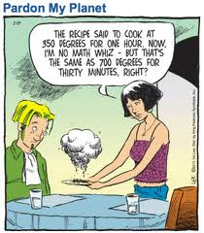
SUPPORTING ALL LEARNERS (ESP ELL) IN NUMERACY TASKS
Sept 21, 2018
Donna Morgan, Ma/Sc Consultant

Slide 2
Agenda
Acknowledgement
Math Biography/Math Mindset
ELL Learners in Math
How does it feel
Defining the Possible Learning Opportunities
A few specific strategies
Authentic Tasks
Video about word problems
Some tasks
Where to find good tasks
Planning Time

Slide 3
We acknowledge the Coast Salish nations (Musqueam, Squamish and Tsleil-Waututh) on WHOSE unceded traditional territories WE TEACH, LEARN AND PLAY
Mathematics is not acultural.

Slide 4
6 Dimensions of Encultured Math
AJ Bishop says that all cultures use math for the following 6 purpose:
measuring
locating
playing
counting
designing
explaining

Slide 5
What is math?

Slide 6
What is your math autobiography?
Take a moment to think about your own experiences of math and numeracy, whether in formal mathematical teaching and learning or in informal situations. Write down your feelings.
How do you feel about math?
Let’s make a U….

Slide 7
Equity needed
Fear of looking stupid by making mistakes can play an outsized role for students of colour and emergent bilingual students.

Slide 8
Math is important to educational equity
Math is a “gatekeeper” to certain STEM fields and even to many business fields
Equity issues in math apply to students from lower socio-economic status homes; immigrants; Indigenous students and sometimes women.
How can we close gaps and ensure that ALL students can achieve success in math?

Slide 9
How would we feel?
Dans la salle de classe de M. Pratt, il y a 25 élèves. Les pupitres de sa classe sont organisés dans des rangées de 5. Combien de pupitres sont dans chaque rangée?

Slide 10
How would we feel?

Slide 11
How would we feel?
Ar ddydd llun mae'r clwb pel-droed yn ail ddechrau. Mae pawb sydd yn ymuno a'r clwb angen pel ei hun. Mae'r peli yn cael ei chadw mewn bag mawr o ddeg. Mae 45 o blant wedi ymuno a'r clwb. Faint o fagiau mawr mae Mr Owen angen, a faint o beli ar wahan?

Slide 12
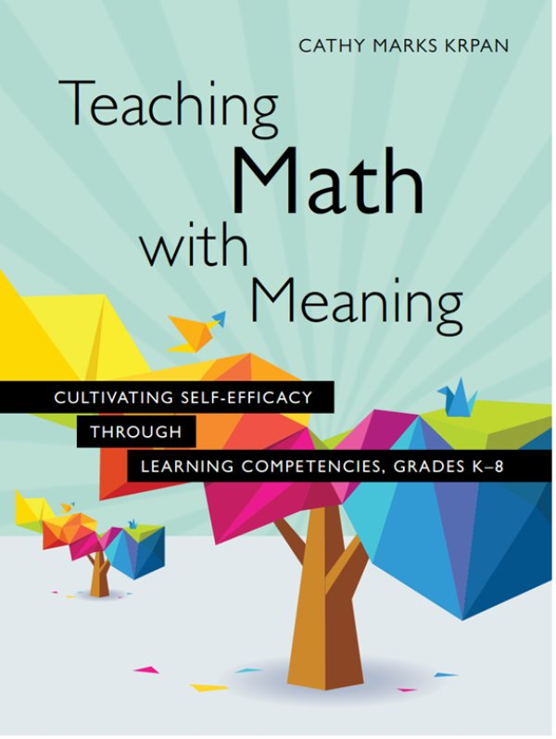
What struggles do English Language Learners face in Math?
Let’s take a look at part of Cathy Krpan’s book. You will see that I have highlighted a section for you to think about. Find the others also looking at that section. Take a look at what Krpan calls “possible learning opportunities”, examine the proposed strategies, and consider how it would work in your classroom.
We will share out…

Slide 13
Some strategies
Setting specific language goals for our lessons
Primary example:
When learning to describe 3-D shapes: Students will discuss characteristics of 2 and 3 dimensional shapes by explaining, both orally and in writing, the characteristics of a square, triangle, rhombus and hexagon using a sentence frame.
Intermediate Example:
When learning equivalent fractions/decimals/percents: Students will be able to use the words greater than, less than or equal to to compare fractions/decimals/percents
Now consider some specific language goals that you might set for an upcoming lesson.

Slide 14
Use sentence frames and “4 Corners” vocabulary to reinforce key math-specific language.
Take a look at the sample sentence frames and the 4 corners outline…discuss with a neighbour. Would these work for you?

Slide 15
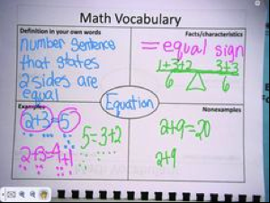
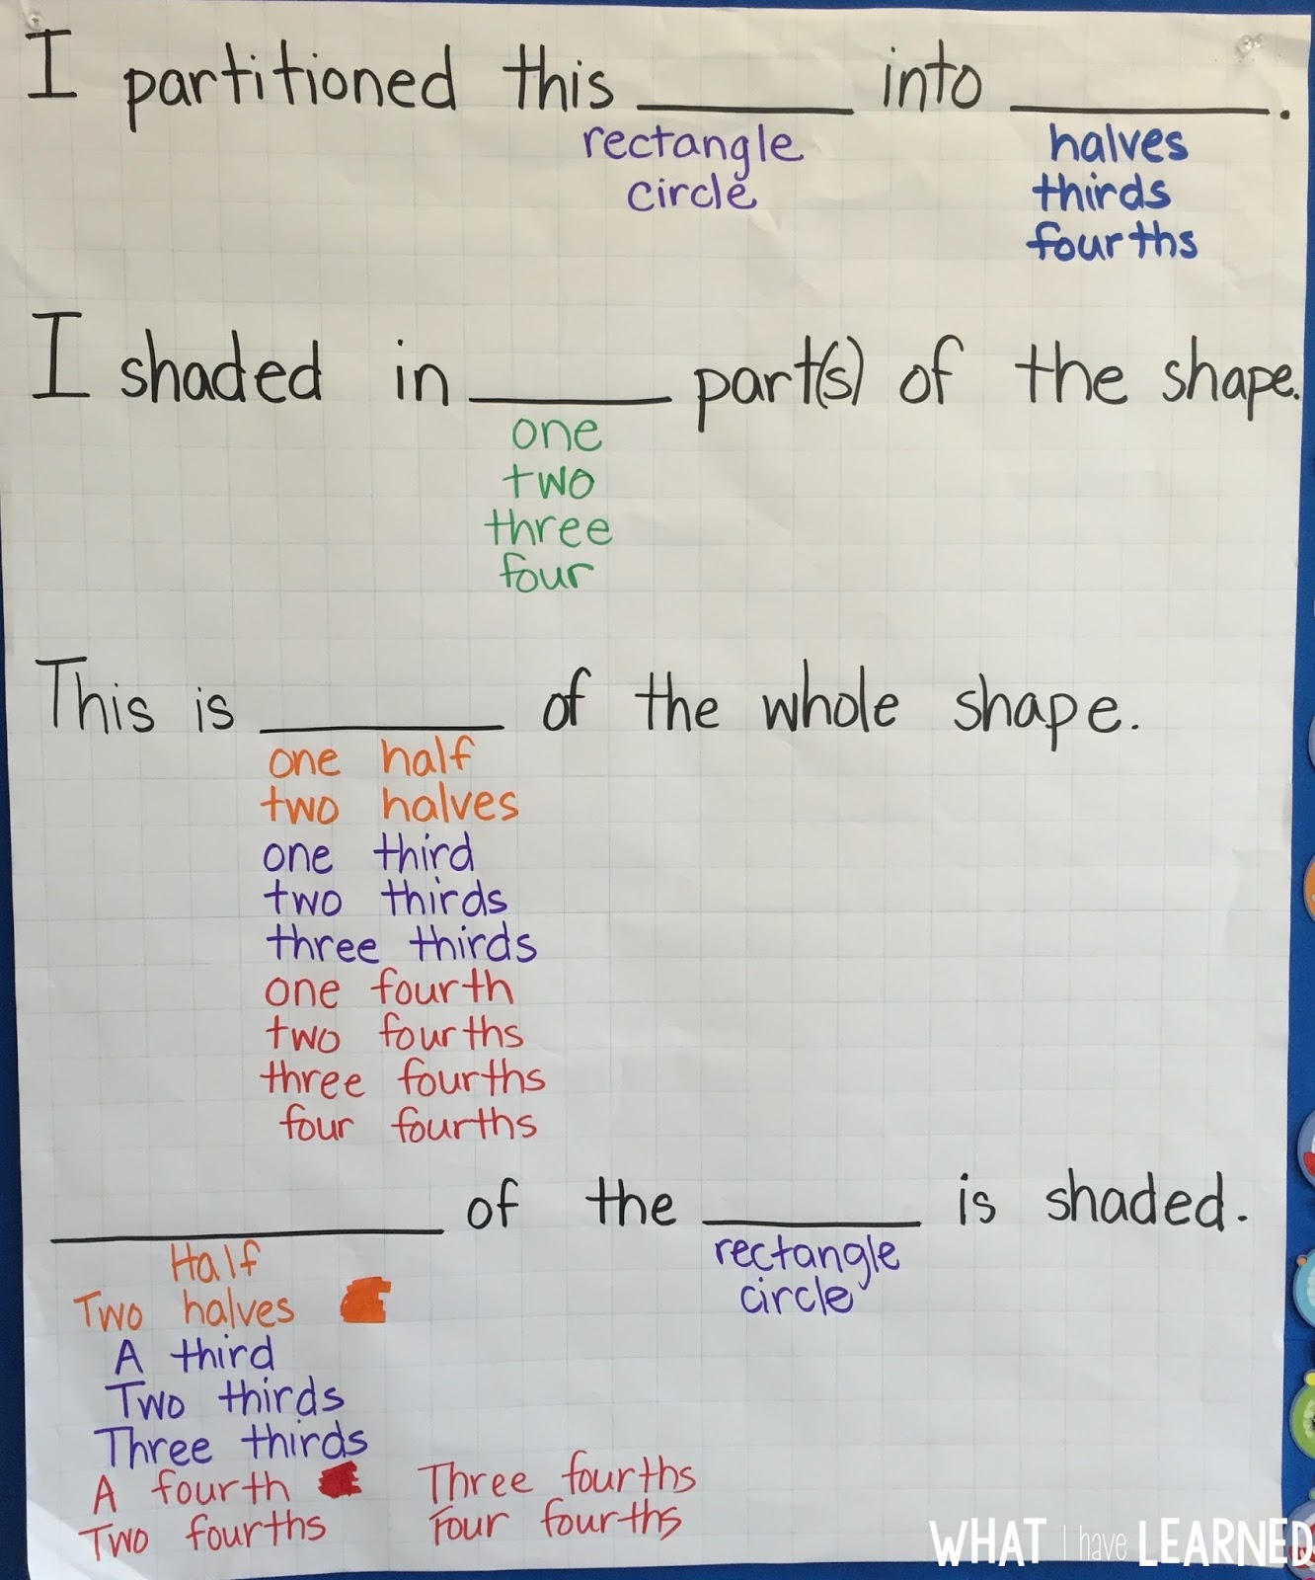

Slide 16
These vocabulary strategies will help ALL learners too!

Slide 17
Activate their math understandings from their first language.
Use these glossaries
https://steinhardt.nyu.edu/metrocenter/resources/glossaries
Allow them to write their definition in their first language on the 4 corners sheet.

Slide 18
Going beyond the word problem
https://robertkaplinsky.com/webinar-es

Slide 19
Some Tasks
As we go through the tasks, discuss in your groups:
What about this task would be hard for an English Language Learner?
What academic Language is necessary for this task?
What tools (from today or from your own experience) would be useful to an ELL student doing this task?

Slide 20
Ice Cream Scoops
From Jo Boaler’s website at: https://www.youcubed.org/tasks/

Slide 21
Some Tasks
As we go through the tasks, discuss in your groups:
What about this task would be hard for an English Language Learner?
What academic Language is necessary for this task?
What tools (from today or from your own experience) would be useful to an ELL student doing this task?

Slide 22
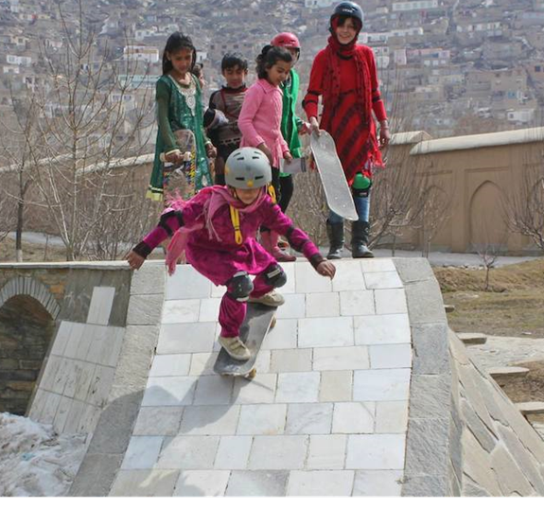
Steepness
From Fawn Nguyen’s website at: http://fawnnguyen.com/staircase-steepness/

Slide 23
Some Tasks
As we go through the tasks, discuss in your groups:
What about this task would be hard for an English Language Learner?
What academic Language is necessary for this task?
What tools (from today or from your own experience) would be useful to an ELL student doing this task?

Slide 24
Coke Freestyle Machine --using Robert Kaplinsky’s model

Slide 25
Coke machine

Slide 26
Diamond Paper Assessment

Slide 27
Places to Find Tasks
Peter Liljedahl:
http://www.peterliljedahl.com/teachers/numeracy-tasks
BCAMT Weekly Tasks:
http://www.bcamt.ca/weeklymathtasks/
NRICH Maths
https://nrich.maths.org/frontpage
YouCubed
https://www.youcubed.org/tasks/
Robert Kaplinsky
https://robertkaplinsky.com/lessons/

