Slide 1
Unit Planning
NEW BC CURRICULUM

Slide 2
Brainteaser: Can you answer these questions?

Slide 3
Take a moment to think about a powerful learning moment from your own elementary or secondary school experience. Write it down and make a snowball.

Slide 6
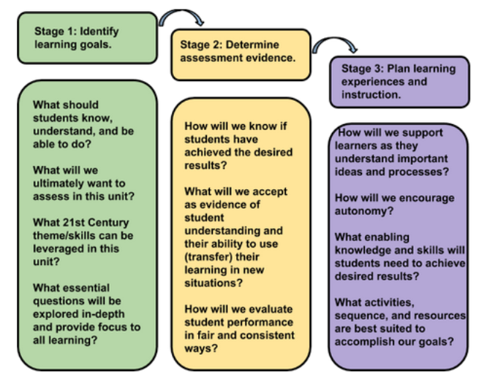

Slide 7
Competencies are the goals, content is the vehicle.

Slide 8
UNIVERSAL THEMES AND GENERALIZATIONS
1. Change
2. Conflict
3. Exploration
4. Force or Influence
5. Patterns
6. Order vs Chaos
7. Power
8. Structure
9. Relationships
10. Systems
11. Adaptation

Slide 9
Interdisciplinary Planning
Start with a theme
Group the BIG IDEAS from the curriculum around the themes and concepts
Add in the learning standards and curricular competencies
Choose one of these groupings to build a unit around
Consider the UDL principles
From DeTerra and Carson, 2016

Slide 10
From S. Moore https://blogsomemoore.files.wordpress.com/2015/02/burnaby.pdf

Slide 12
Things to consider
Differentiated Planning
Formative Assessment
Developing Inquiry Questions with Students

Slide 13
Links for the New Curriculum
BCEd curriculum
https://curriculum.gov.bc.ca/curriculum
Detailed Planning Documents by grade and subject area (thanks to Janet Chow from SD41): http://blogs.sd41.bc.ca/learningtech/new-curriculum/
SD41 Indigenous Education Blog: https://burnabyschools.ca/indigenouseducation/
SD41 Literacy Blog: http://blogs.sd41.bc.ca/literacy/
SD41 Math Blog (Find this PPT there): https://blogs.sd41.bc.ca/math
SD41 Science Blog: http://blogs.sd41.bc.ca/science

Slide 14
Even More Links….
Resources from SD71: http://www.learn71.ca/new-curriculum-draft/
Teach BC BCTF: https://teachbc.bctf.ca/
Social Studies Resources: http://www.thielmann.ca/new-bc-curriculum.html
Shelley Moore Templates: https://blogsomemoore.com/shout-outs/templates/
Understanding BY Design Resources
Grant Wiggins Videos: https://www.youtube.com/v/4isSHf3SBuQ
UBD resources: http://www.ascd.org/research-a-topic/understanding-by-design-resources.aspx
OISE lesson planning link: http://supo.oise.utoronto.ca/Forms_Resources/Lesson_Plan_Templates/index.html

