Slide 1
Daily 5/Daily 3
Cari Derbitsky
Donna Morgan
Tanis Anderson
Debbie Lirenman

Slide 3
What the research says…
Research shows that nothing is more highly correlated to reading achievement than volume.
We are simply not giving our students enough time to read each day- especially our kids that need it the most.
Giving kids choice in what they read is critical in increasing volume of reading. Volume of reading is predictive of reading achievement.

Slide 4
What the research says…
Increasing the amount of time DOING math positively affects understanding
Engagement in problem solving increases both CONCEPTS and SKILLS
Opportunities to INTERACT and DISCUSS math content greatly increases student learning
Source: http://www.iaoed.org/downloads/prac04e.pdf

Slide 5
For Students to Progress:
Students’ voices must be included.
It must be strength based.
Students must have choice.
Sharon Jeroski

Slide 6
What is Daily 5?
Students select from five authentic reading and writing choices, working independently toward personalized goals, while the teacher meets individual needs through whole-group and small-group instruction, as well as one-on-one conferring.

Slide 7
Components of Daily 5
Read to Self

Slide 8
Read With Someone

Slide 9
Work on Writing

Slide 10
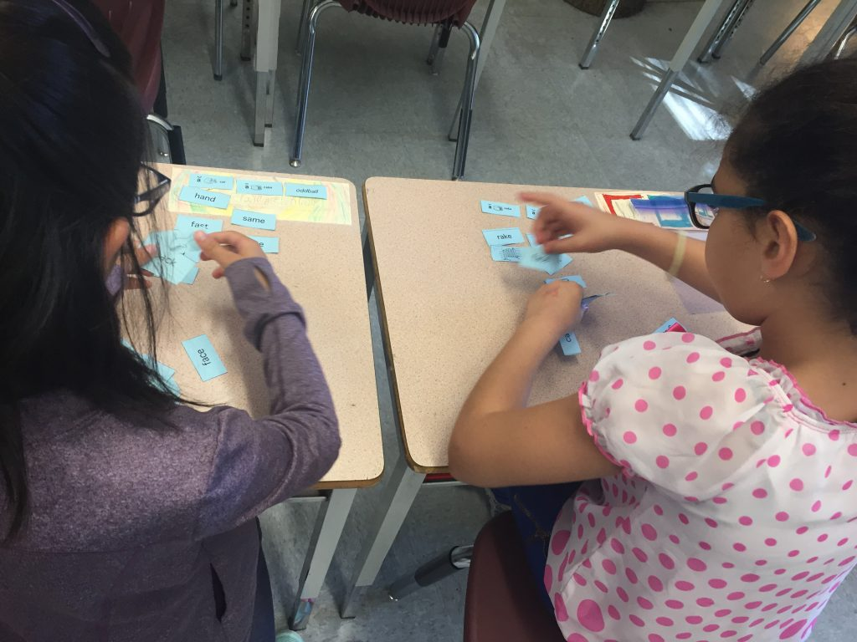
Word Work

Slide 11
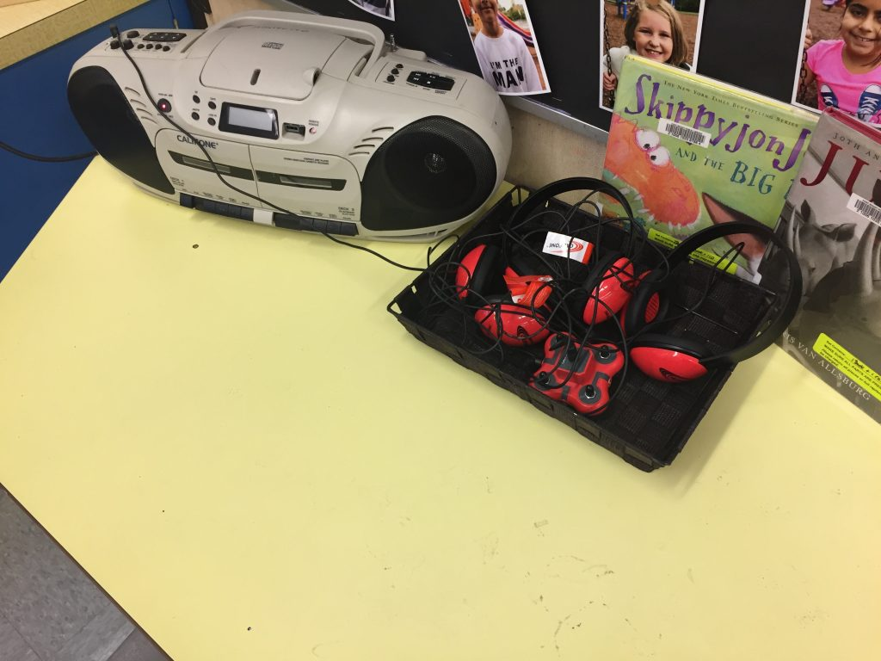
Listen To Reading

Slide 12
See it in Action
In Grade 4
In Grade K-2

Slide 13
What is Math Daily 3?
The Math Daily 3 is a method for structuring math time so students practice different ways of applying and learning math every day, fostering independent learning and success. It has 3 components: Math By Myself; Math Writing; and Math With Someone. These are interspersed with concise, focussed lessons either delivered to the whole group or to small groups.

Slide 14
Components of Math Daily 3

Slide 15
Math By Myself
Math by Myself provides time for kinesthetic practice of math concepts that are primarily activity based. At the beginning of a new math unit, the activities are mostly review and practice from prior units of study. Then, as the new unit goes on, more of the Math Daily 3 activities become practice and reinforcement related to the current unit of study.

Slide 16
Math Writing
During Math Writing, students express and articulate their thinking and understanding by working on a math problem or math concept using pictures, numbers, and words, and occasionally by creating problems of their own.

Slide 17
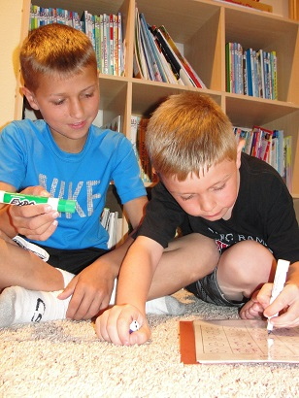
Math With Someone
This task allows students to have experience with talking and writing about mathematics as they describe and explain their thinking to peers.

Slide 18
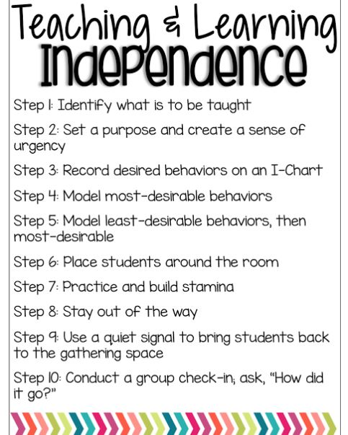
The 10 Steps to Teaching and Learning Independence Chapter 3 Page 36

Slide 19
Every Day, Every Child

Slide 20
A growth mindset in math…
Teachers and students BELIEVE that every student can do it
Math is VISUAL
COMMUNICATION and connection are valued
MISTAKES are welcomed as learning opportunities
-From Jo Boaler: https://bhi61nm2cr3mkdgk1dtaov18-wpengine.netdna-ssl.com/wp-content/uploads/2017/03/Mindset-card-with-logo.pdf

Slide 21
http://blogs.sd41.bc.ca/literacy/

Slide 22
Math Blog: http://blogs.sd41.bc.ca/math/

Slide 23
Before we finish up
My Thoughts:
Something I’m thinking about or wondering:
My Commitment to Action:
Something I will try in my class before next book club meeting is:

Slide 24
For next time (January 15th):
Read Ch 1-3
Be prepared to share your take on the book…what things are you confident about, what things are you concerned about?

