Slide 1
Multiplicative Thinking
From Skip Counting to Algebra
Carole Fullerton
mindfull.wordpress.com
Notes:
Prince George Math Academy October 16th

Slide 2
What’s important to know?
multiplicative thinking
proportional thinking
algebraic thinking
Notes:
the grown up version

Slide 3
the multiples

Slide 4
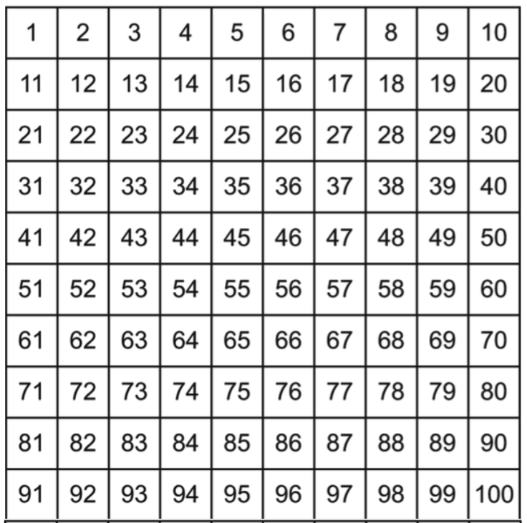
What do you notice?
What patterns can you find?
Notes:
What patterns do you notice?
into patterns AAB then x’n by 3, then divisibility …

Slide 5
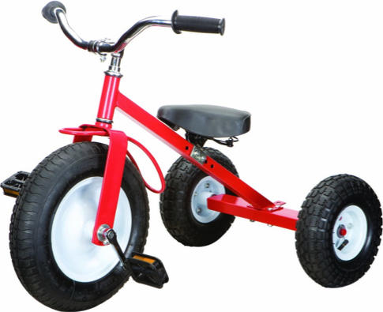
What could we be counting?
What always comes in 3’s?
Notes:
Use the chart
make problems to match it.

Slide 6
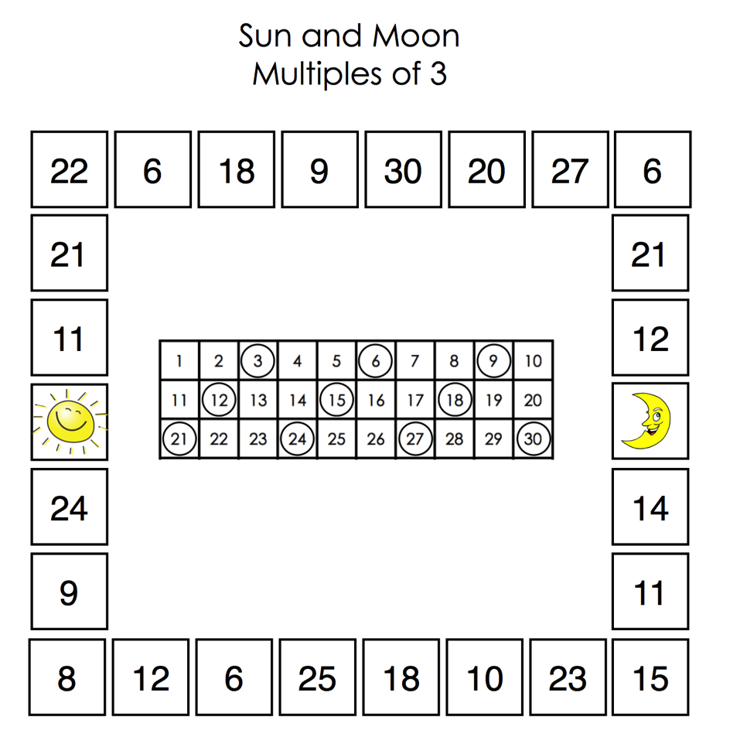

Slide 7
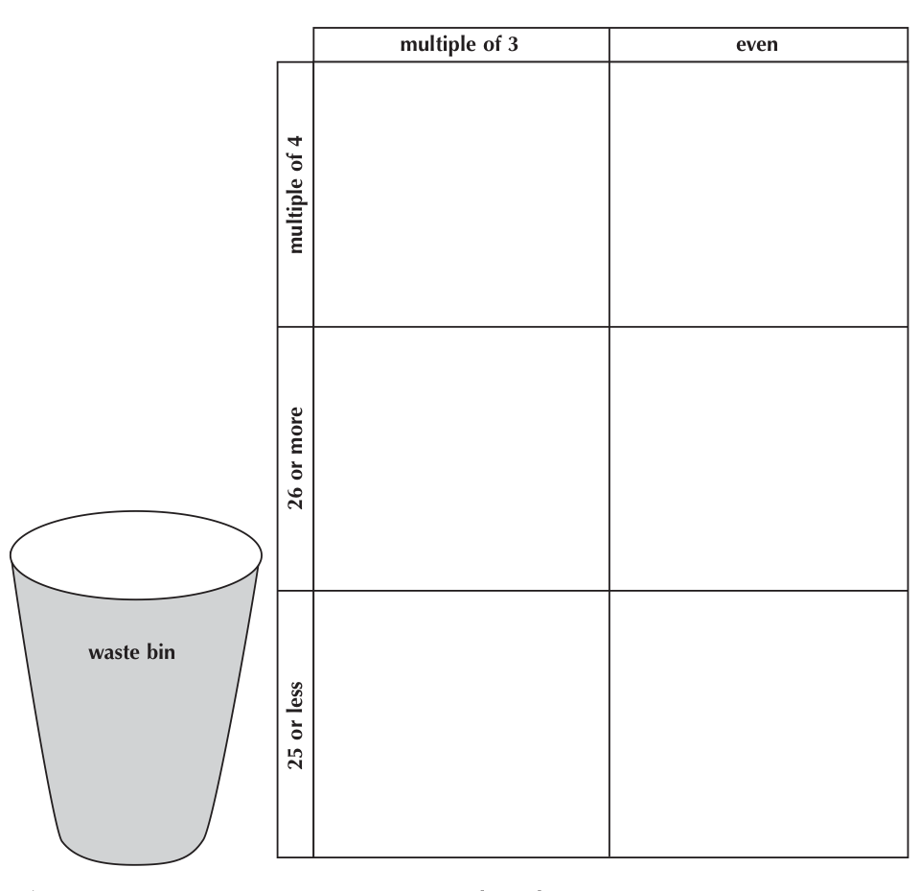
18
20

Slide 8
multiplication…
unravelled

Slide 9
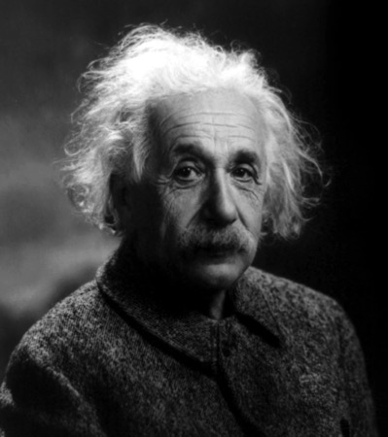
So?
What is multiplication, anyway?

Slide 10
Laying the foundations
What do you see?
What would a mathematician write?
3 groups of 2
3 x 2 = 6

Slide 11
Laying the foundations
What do you see?
What would a mathematician write?

Slide 12
Laying the foundations
What do you see now?
What would a mathematician write?
Notes:
groups of, rows of… where does groups of come from??

Slide 14
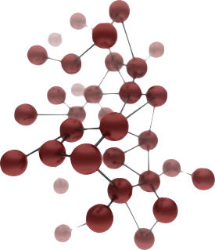
Make connections
Multiplication is:
Groups of...
Rows of...
Rates ($, speed, etc)
Combinations

Slide 15
Make connections
How are these problems the same?

Slide 16
Make connections
Change problem 2 just a little so that you cannot solve it using multiplication any more...
Why doesn’t multiplication work now?

Slide 17
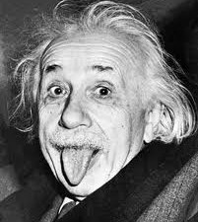
Apply your learning
The equation is:
4 x 3
What multiplication problems can you write?
How many different kinds can you show?

Slide 18
Make connections
Multiplication is:
Groups of...
Rows of...
Rates ($, speed, etc)
Combinations

Slide 19
An Area Model for Multiplication
3
How many tiles?
What’s the area?
2
2 x 3 = 6

Slide 20
3
30
12
10
14
4
14
x 3
10 + 4
x 3
30
12
42
Notes:
WHAT’S THE AREA?

Slide 21
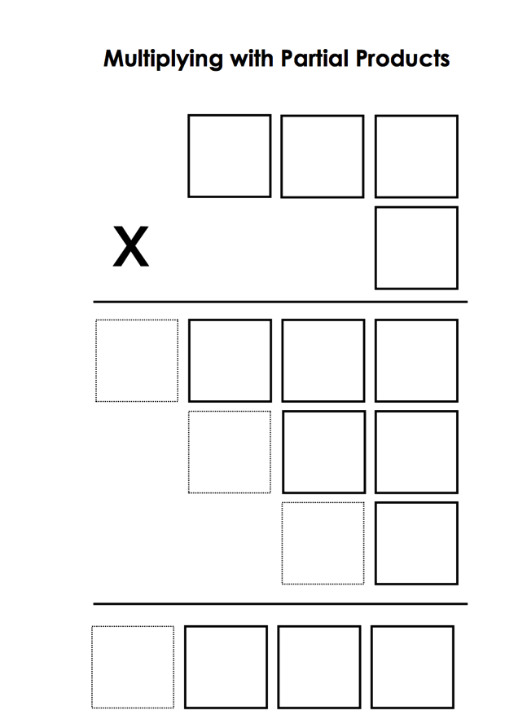
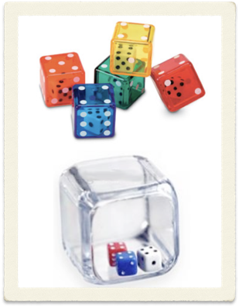

Slide 22
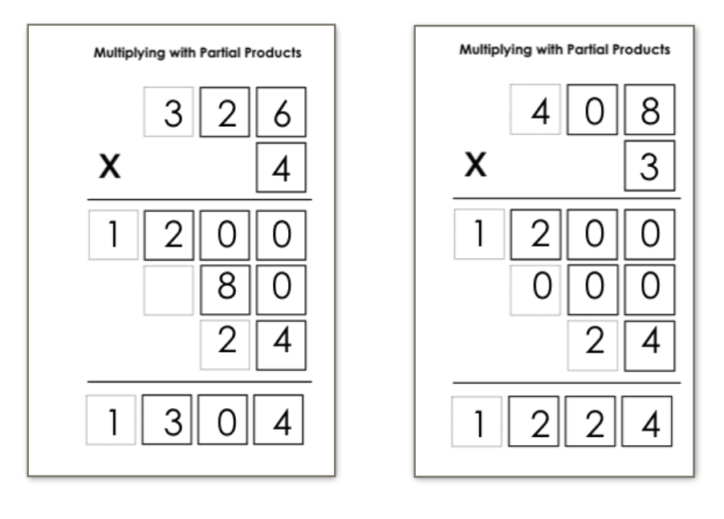

Slide 23
280
10
4
23
x 14
200
80
280
20
+ 42
322
3
30
12

Slide 24
20 + 3
x 10 + 4
200
30
80
+ 12
322
23
x 14
..2
20
200
80
23
3
30
12
10
4
14

Slide 25
(2x + 3)(x + 4)
(20 + 3)(10 + 4)
2x² + 8x + 3x +12

Slide 26
the facts

Slide 27
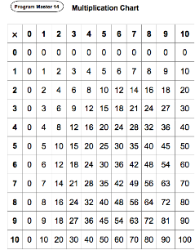
the 3’s
the 4’s
the ugly ones
Notes:
teach a lesson sequence
explore connectedness
talk algebra...

Slide 28
4 x 45
associative
distributive
4 x 45
2 x (2 x 45)
2 x 90
180
4 x 45
(4 x 40) + (4 x 5)
160 + 20
180

Slide 29
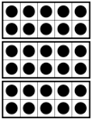
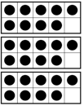
Making connections
6 groups of 10
6 groups of 9
6 x 9 = (6 x 10) - (6 x 1)
6 x 9 = 60 - 6
6 x 9 = 54
Notes:
model all...

Slide 30
Number Talks
2 x 15 x 6
3 x 5 x 12
3 x 15 x 4
4 x 5 x 3 x 3
12 x 15
Notes:
breaking it into smaller factors

Slide 31
Now what...?
What’s one thing you’ll try...
one new question you have...

Slide 32
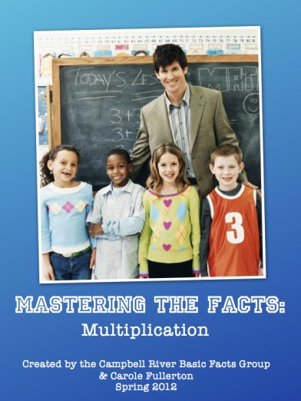
Carole Fullerton
mindfull.wordpress.com
Booth 326

