Slide 1
Focusing on the Curricular Competencies in Math
Strategies and Resources

Slide 2
Acknowledgement
Try First Peoples Principles of Mathematical Teaching: http://blogs.sd41.bc.ca/math/curriculum/aboriginal-education/

Slide 3
Shape of the Day
AGENDA
Introductions-Math Mindset Video and Discussion (10 minutes)
Goals and Challenges (10 minutes)
Low floor high ceiling open-ended tasks
Games for Fluency
Using Number Talks

Slide 4
Mathematical Mindsets

Slide 5
Goals and Challenges
What is your GOAL for math in your class? (on pink)
What CHALLENGES do you face? (on orange)

Slide 6
Do your goals include?
Growth mindset in math?
Engaging lessons?
Everyone can do math?
Students doing math at ZPD during the whole class?
Do your challenges include?
Students lacking numeracy?
Daunting curriculum?
Lack of resources?
Kids at too wide a range of knowledge and skills? abilities

Slide 7
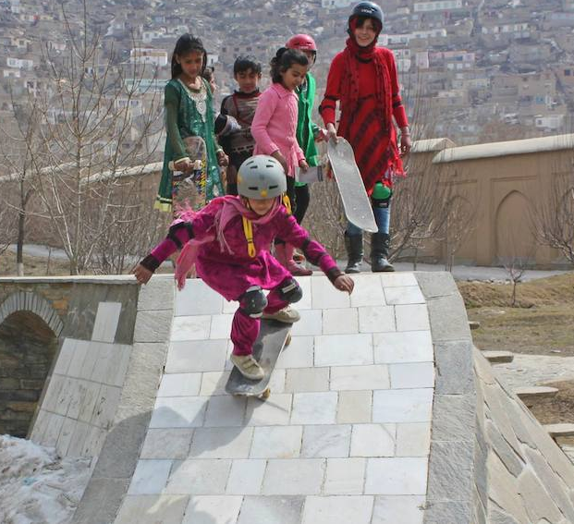
Let’s try a “Low floor high ceiling” task...
http://fawnnguyen.com/staircase-steepness/

Slide 8
Let’s play a numeracy game
How might we differentiate it?
How can we adapt for different curricular areas?

Slide 9
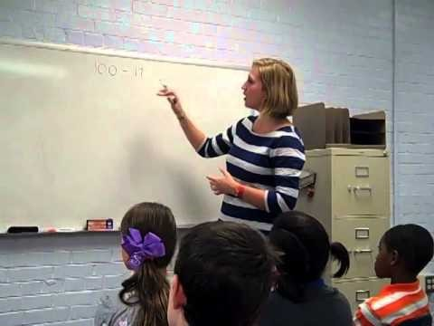
Intro to Number Talks

Slide 10
How can we close gaps?
What about students who are 2 or more years behind their grade level?
Diagnose (use WDTK—from Carole Fullerton’s website, Leaps and Bounds, or Van Is assessment)
Target whole number sense and understanding K-5, go into fractions/decimals late Gr 5-7
Do at least 10 minutes a day of fluency practice AT THEIR LEVEL

Slide 11
Assessing with the Curricular Competencies
Look at the Curricular Competencies bookmarks.
Discuss how you might use each of the 3 strategies we have looked at to assessthe skills….

Slide 12
Resources
RESOURCES
Check out Math Blog (http://blogs.sd41.bc.ca) for a list of resources
Consider forming a learning team to develop Math Workshop for your school (I can help).
Call me in to your classroom! Please! Donna.morgan@sd41.bc.ca

Slide 13
Resources from the web
Sources for Games
Here is a link to the Office 365 files shared by Burnaby Math/Science Program Consultant Donna Morgan:
http://bit.ly/2EHgiXl
If you have resources to share, please send to Donna.Morgan@sd41.bc.ca and I will upload them to this O365 folder
Carole Fullerton https://mindfull.wordpress.com/
Sources for Rich Tasks
Numeracy tasks (K-12) from Dr. Peter Liljedahl at SFU
http://www.peterliljedahl.com/teachers/numeracy-tasks
NRICH math tasks K-12
https://nrich.maths.org/frontpage
YOUCUBED—tasks sorted by topic and level
https://www.youcubed.org/tasks/
Sources for Number Talks
Mollie Hall’s collection of resources
https://elementarynumbertalks.wordpress.com/
Fawn Nguyen’s site Between two Numbers has some great conversation starters (and also available in FRENCH!):
http://www.between2numbers.com/

