Slide 1
Differentiation in Math
Two possible strategies (and some resources)

Slide 2
Acknowledgement
Try First Peoples Principles of Mathematical Teaching: http://blogs.sd41.bc.ca/math/curriculum/aboriginal-education/

Slide 3
Shape of the Day
AGENDA
Introductions
Goals and Challenges
Low floor high ceiling open-ended tasks
Math stations or Math workshop (video)
Fluency with Facts (activity)
Resources

Slide 4
Goals and Challenges
What is your GOAL for your math lessons? (on pink)
What CHALLENGES do you face? (on orange)

Slide 5
Do your goals include?
Growth mindset in math?
Engaging lessons?
Everyone can do math?
Students doing math at ZPD during the whole class?
Do your challenges include?
Students lacking numeracy?
Daunting curriculum?
Lack of resources?
Kids at too wide a range of knowledge and skills? abilities

Slide 6
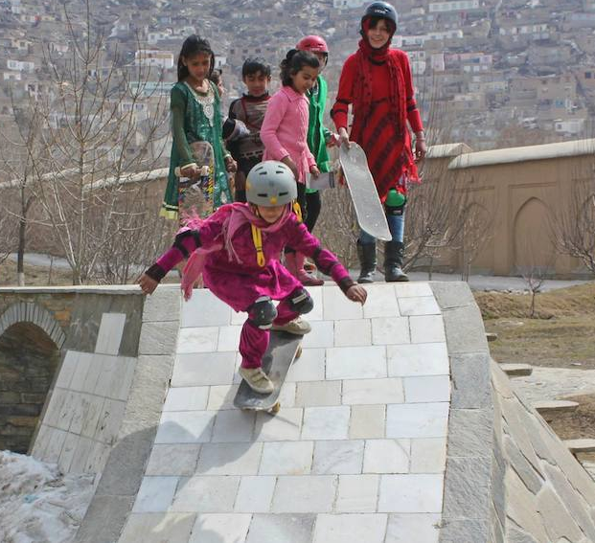
Let’s try a “Low floor high ceiling” task...
http://fawnnguyen.com/staircase-steepness/

Slide 7
Math workshop/stations

Slide 8
Let’s play a numeracy game
How might we differentiate it?

Slide 9
How can we close gaps?
What about students who are 2 or more years behind their grade level?
Diagnose (use WDTK, Leaps and Bounds, or Van Is assessment)
Target whole number sense and understanding K-5, go into fractions/decimals late Gr 5-7
Do at least 10 minutes a day of fluency practice AT THEIR LEVEL

Slide 10
Resources
See handout on Math Workshop, plus list of resources
Check out Math Blog (http://blogs.sd41.bc.ca) for a list of resources
Check the link on the hand-out to have access to a variety of games for “math with a partner” to practice fluency, facts, etc. (this will be growing as time goes on).
Consider forming a learning team to develop Math Workshop for your school (I can help).
Call me in to your classroom! Please! Donna.morgan@sd41.bc.ca

