Slide 1
Curriculum Implementation:
Competencies and Rich Tasks in Math

Slide 2
Assessment of Curricular Competencies
Understanding and Solving
Reasoning and Analyzing
Communicating and Representing
Reflecting and Connecting

Slide 3
Examples of Assessment
Checkpoints and self-assessments
Tests
Rich tasks
Summative Assessment

Slide 4
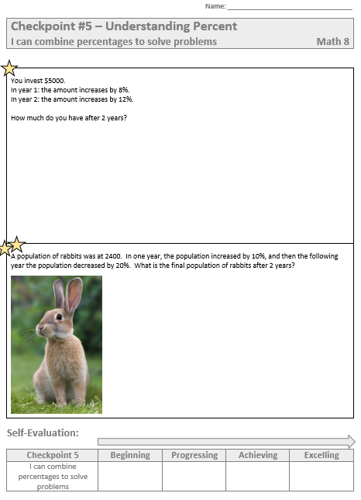
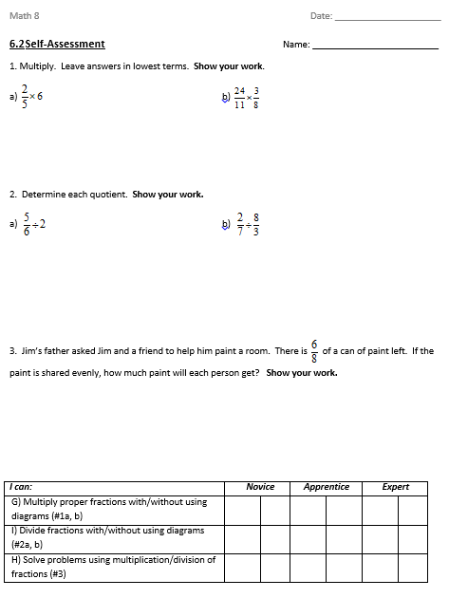
Daily Checkpoints with Self-Assessment

Slide 5
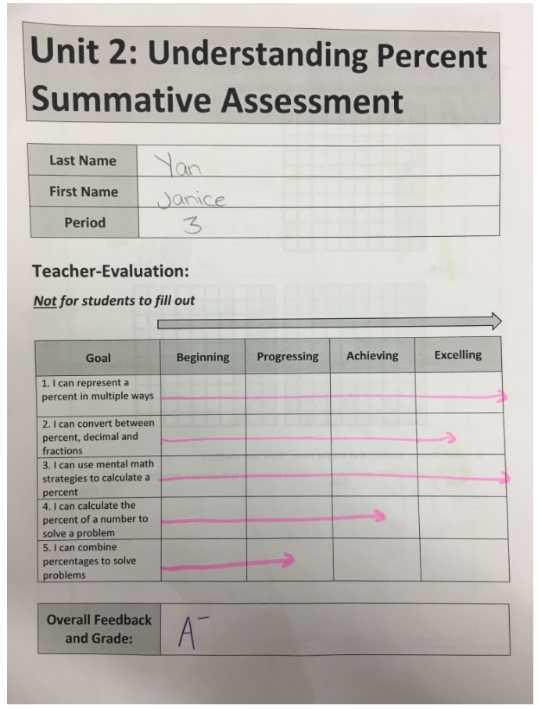
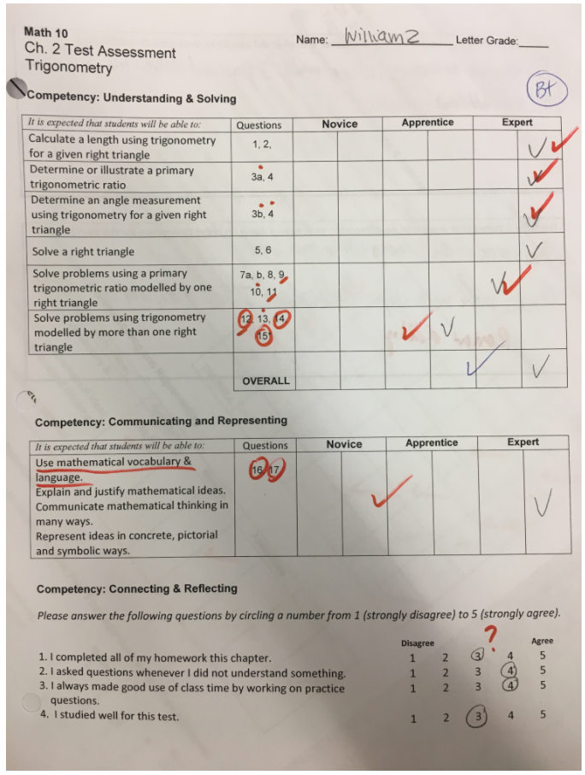
Tests

Slide 6
Rich Tasks
Route to a solution is initially unclear
Accessible to pupils of wide ranging abilities (low floor – high ceiling)
Extend knowledge or apply knowledge in new contexts
Different methods to solve
Make connections between different areas of mathematics
Encourage collaboration with peers
https://nrich.maths.org/6299

Slide 7
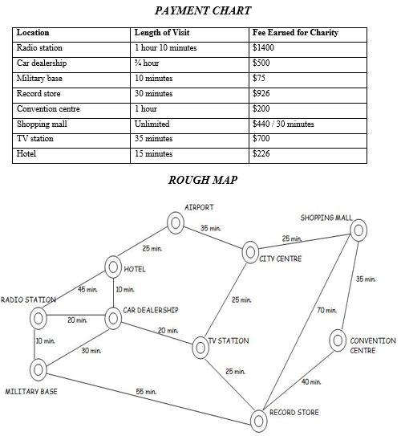
Rich Tasks

Slide 8
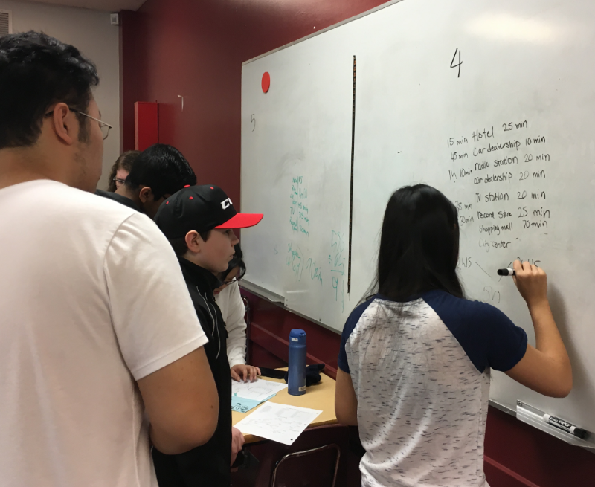
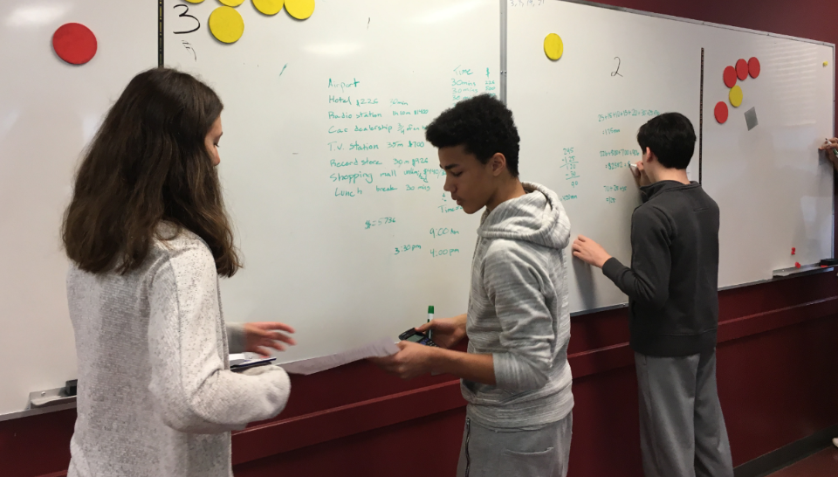
Rich Tasks
Collaboration
Vertical non-permanent surfaces
Visibly random groups

Slide 9
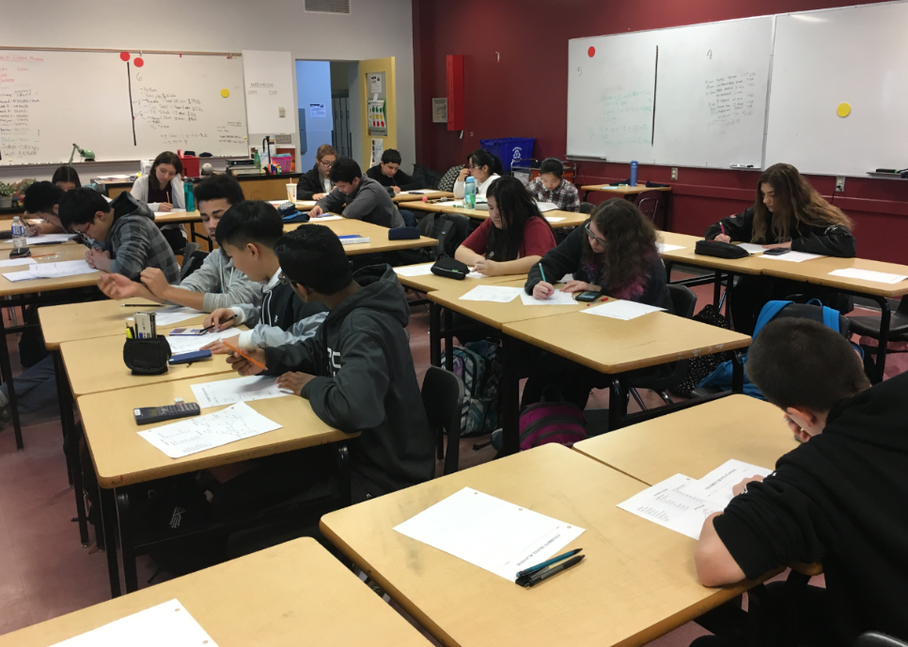
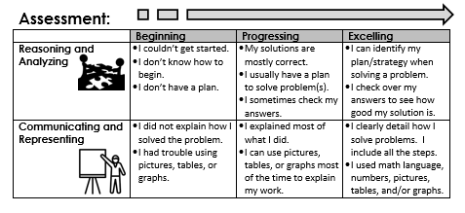
Rich Tasks
Students assessed on communication and reasoning competencies

Slide 10
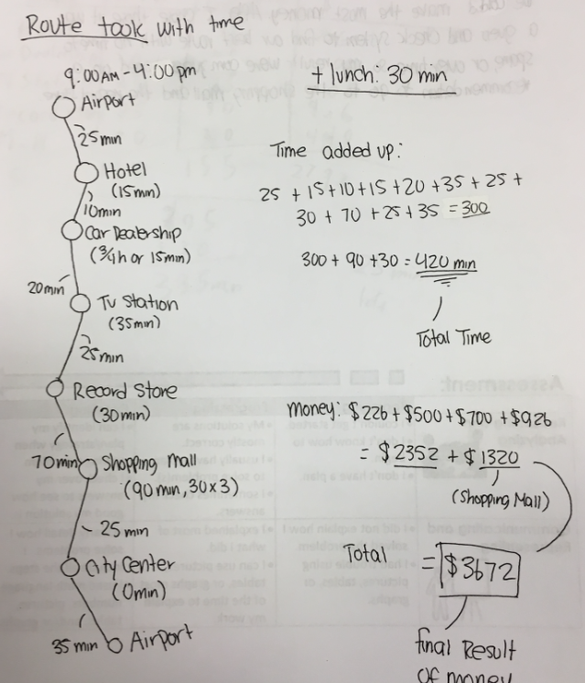
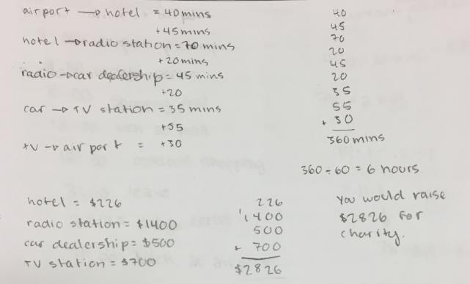
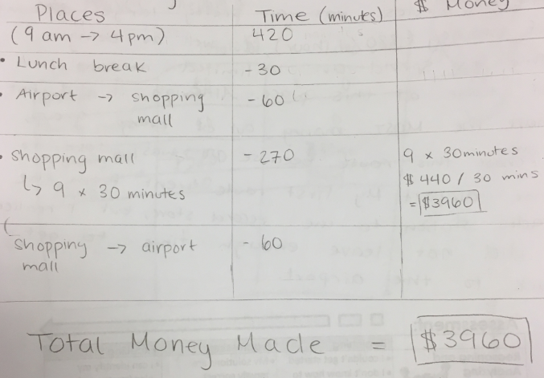
Rich Tasks

Slide 11
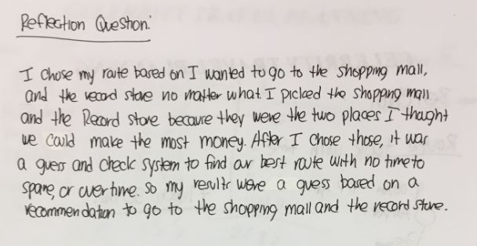
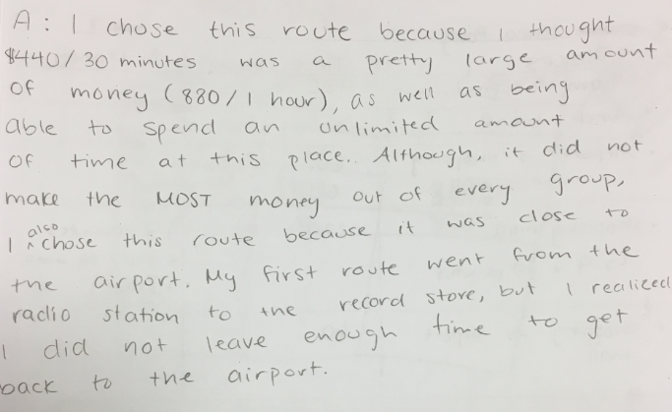
Rich Tasks
Students reflect on their solutions and problem solving process

Slide 12
Rich Tasks Successes and Struggles with this problem:
To start, the students were just shown the map and discussed what the question could be (like a 3-act activity). This had them engaged in the problem from the beginning.
Students were engaged during the first part of the group stage. Most groups found a unique way to approach the problem and organize their work.
Students enjoyed the competitive aspect of the problem – many were motivated to find the path worth the most money.
Once they had found one solution, many students were not motivated to continue searching for the ‘best’ solution.
Some students struggled to explain why or how they chose their particular solution
Students found it challenging to work with time (converting hours to minutes) and how to organize their work.

Slide 13
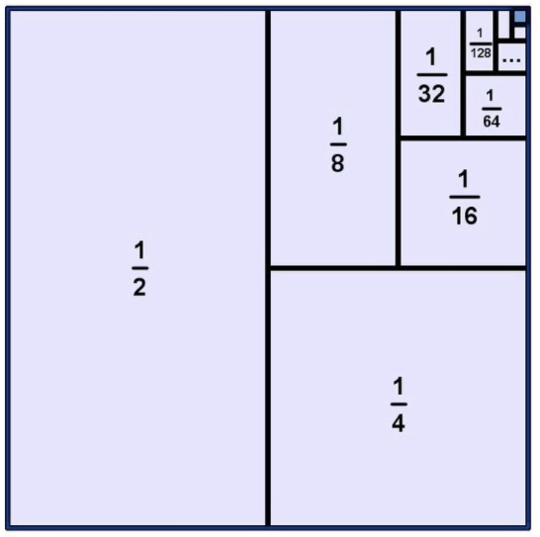
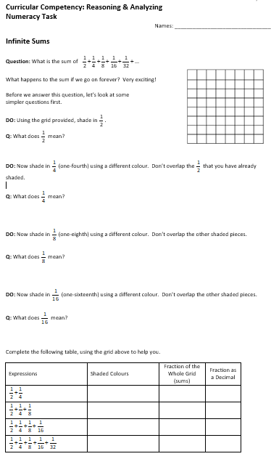
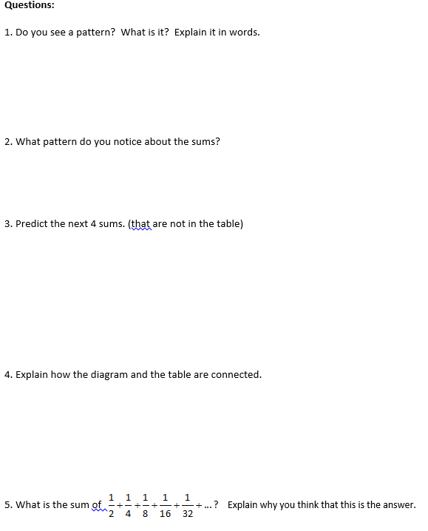
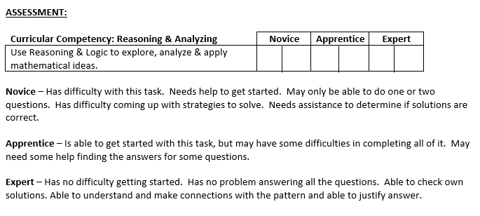
Rich Tasks

Slide 14
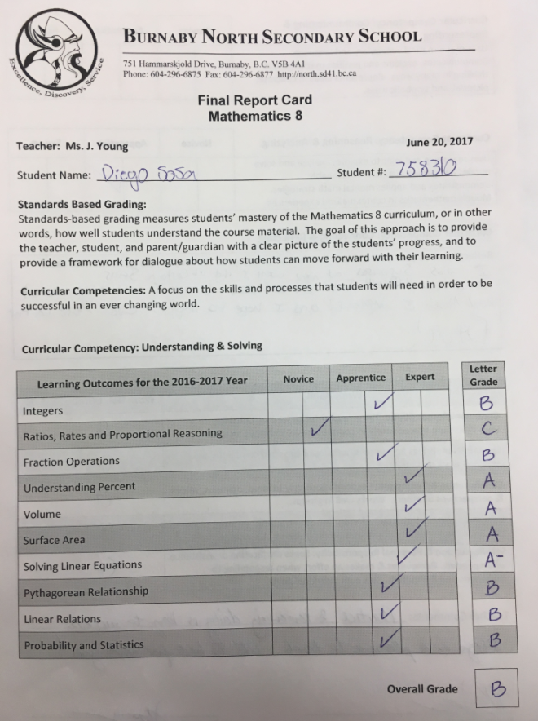
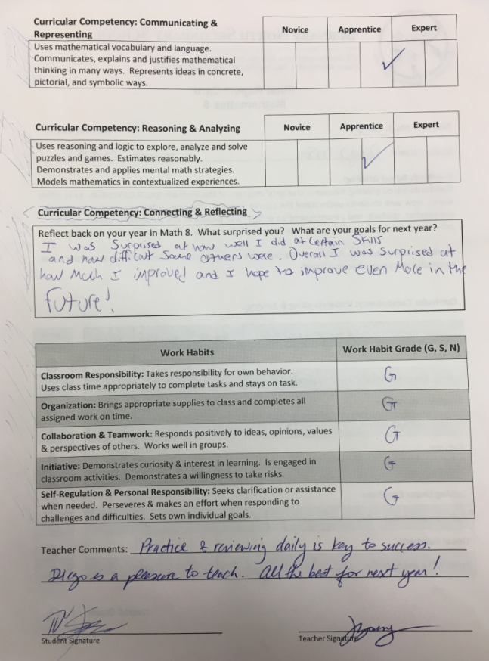
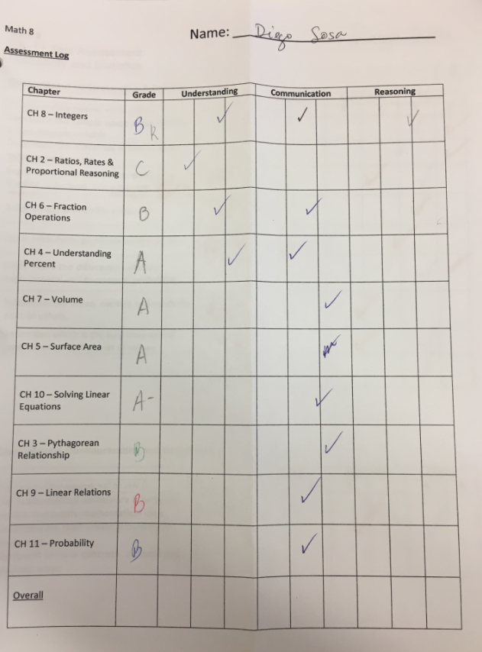
Summative Assessment

Slide 15
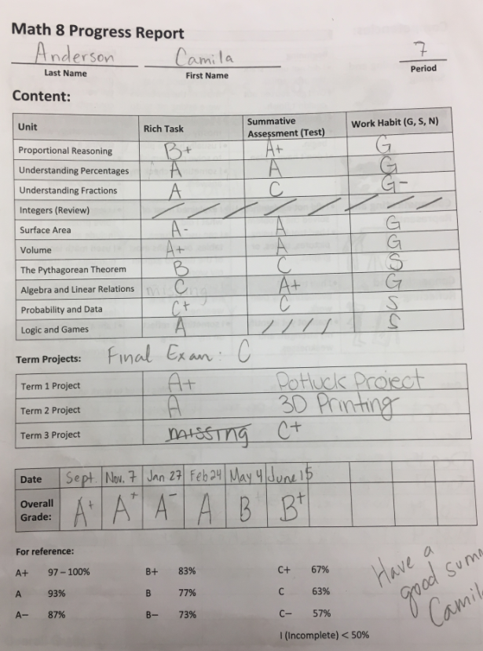
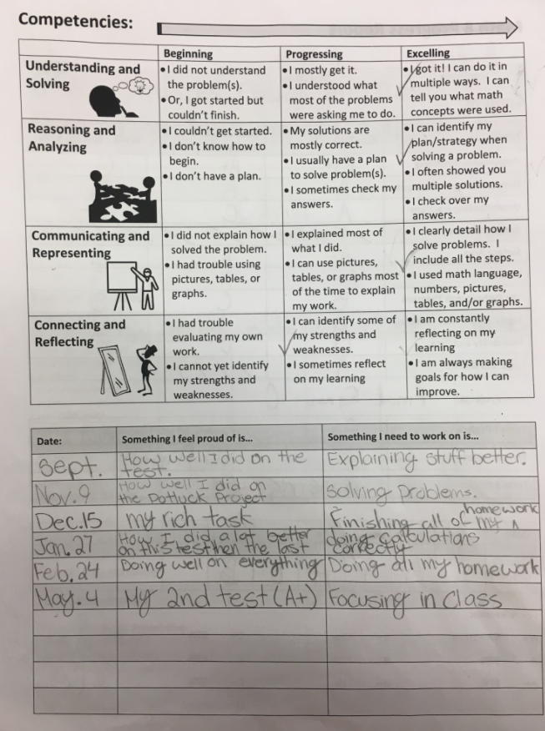
Summative Assessment

Slide 16
Resources:
http://blogs.sd41.bc.ca/math/ to access any of our templates
Email: Jennifer.Morrison@sd41.bc.ca
Email: Donna.Morgan@sd41.bc.ca
Email: Jenny.Young@sd41.bc.ca
Youcubed
Nrich
3 Act videos
Peter Liljedahl

