Slide 1
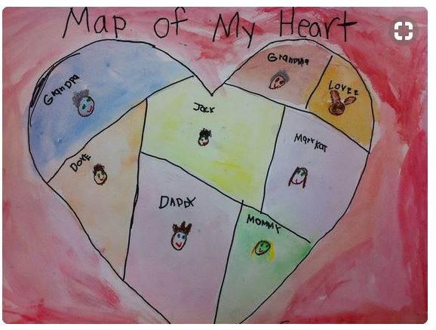
Heart Maps

Slide 2
What is a heart map?
A heart map is a visual reminder of all a student loves and cares about. It expands students’ minds and helps them think broadly about what really matters. In doing so, students move away from writing about superficial topics, and travel to a deeper place inside themselves. You'll find your students express themselves more authentically and honestly when they write about what they love and value.
https://www.scholastic.com/teachers/blog-posts/ruth-manna/heart-maps-and-writing/

Slide 3
Making our Heart Maps
Use the questions below to help you organize your thoughts:
What has really affected your heart?
What people have been important to you?
What are some experiences or central events you'll never forget?
What happy or sad memories do you have?
What secrets have you kept in your heart? (Don’t share the secret, but find a metaphor for it.)
What small things or objects are important to you? A tree in the backyard, a stuffed animal, etc.?

Slide 5
