Slide 1



Collaborative Inquiry for SRL:
Launching the Year
With
With
Miriam Miller
Burnaby School District
Deborah Butler
UBC-V
Leyton Schnellert
UBC-O
October 10, 2017
Notes:
Title this time?

Slide 2

Questions for Today
Why Engage in Collaborative Inquiry?
Why Focus on SRL?
What Connects SEL and SRL?
What Will You Do This Year?

Slide 3

Why Engage in Collaborative Inquiry?
Notes:
Deb

Slide 4

Why Engage in Inquiry?
To support you in taking up questions you are wrestling with
To help you in making meaning of ideas in relation to your particular context

Slide 5

Why Collaborative Inquiry?
Learning from and working with peers is what collaborative inquiry is all about
Cole, Knowles, De Sousa, Huebel, & Prendergast (2000, p. 144)

Slide 6
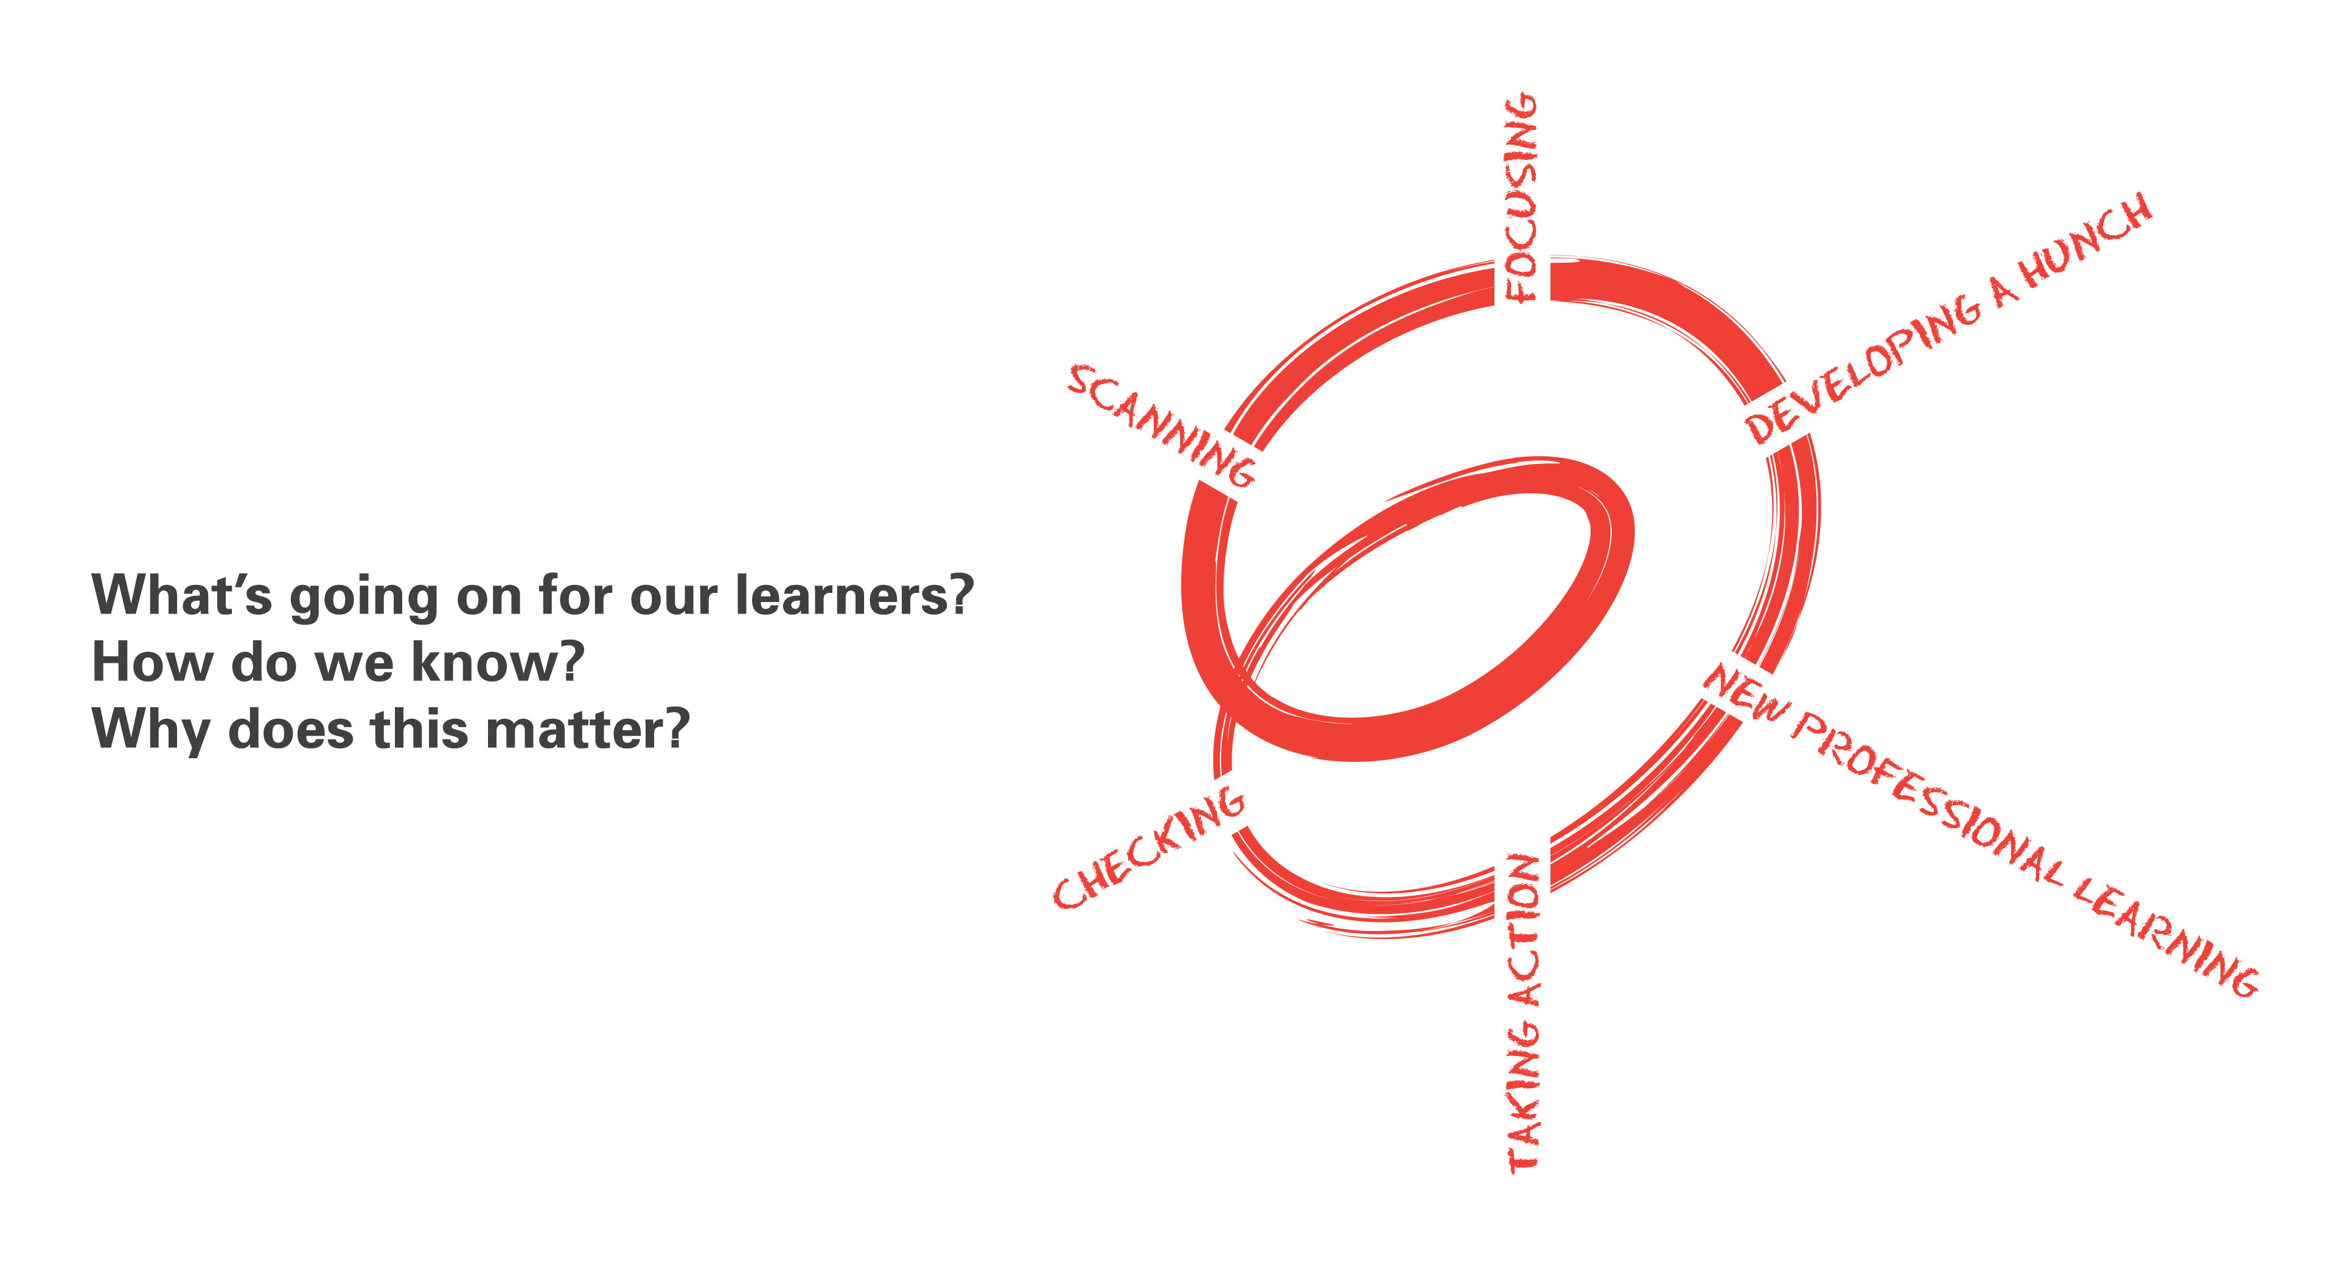
Spirals of Inquiry
(Halbert & Kaser, 2013)
What is happening in your context?
What do you need to focus on?
What do you think is going on?
How is it going? What’s next?
What do you need to learn about?
What will you do?
Notes:
An inquiry cycle- Halbert & Kaser

Slide 7

Inquiry for SRL
This year we invite you to engage in inquiry for SRL
  As a stance for thinking about and advancing your practice
  And/or more formally, by taking up inquiry processes on your own or with others

Slide 8

Where Might You Focus?
What have you noticed about self-regulation in the context where you are working?
Is there a focus you have in mind that might benefit your students?
What do you think might be happening?
What more do you want to know?
Notes:
What about a modified “what do you know, what do you wonder”? Something that starts them thinking along the spirals of inquiry?

Slide 9
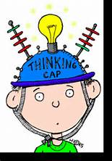
Why Focus on SRL?
Notes:
Deb

Slide 10
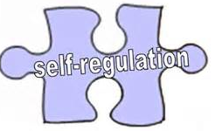
Why is Self-Regulation Important?
Self-regulation predicts early school achievement more powerfully than IQ scores and knowledge of reading and math
Successful self-regulation in kindergarten predicts achievement through grade 6
Self-regulating learners are successful in and beyond school
  Higher motivation and confidence
  More productive thinking skills and strategies
  More task relevant behaviour
  Higher achievement

Slide 11
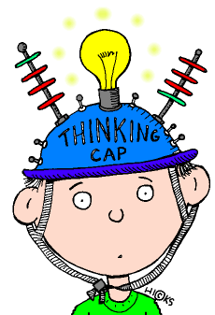
Personalized Learning
Self-Determination
Inquiry Based Learning
21st-Century Learning
Self Regulated Learning
Assessment for Learning
Critical Thinking/ Higher order thinking
Life Long Learning
Social-Emotional Learning
Universal Design for
Learning

Slide 12
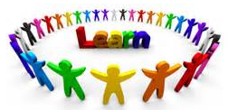
What is SRL in the Context of Learning?
Notes:
Deb

Slide 13
How much of what you learned in school is still current?
Half of what you'll learn in medical school will be shown to be either dead wrong or out of date within five years of your graduation; the trouble is that nobody can tell you which half— so the most important thing to learn is how to learn on your own.
  Dr. Dave Sackett, pioneer in evidence-based medicine, speaking to medical students
Notes:
Challenge to education systems:
Exposing learners to knowledge is important; There are things we want physicians to know
But we also need to develop lifelong learners, who seek out, work with, even generate new knowledge, not only during school, for in the next 70 years of their lives
How do we do that?
Barry Zimmerman describes lifelong learners as "self-regulated learners"
Today I'm going to talk about what that means.
-> AGENDA

Slide 14
The Nature of Learning
(Dumont et al., 2012)
… the ultimate goal of learning and associated teaching … is to acquire adaptive expertise—the ability to apply meaningfully learned knowledge and skills flexibly and creatively in different situations.
The capacity to continuously learn and apply/integrate new knowledge and skills has never been more essential.
Students should become … life-long learners, especially as they prepare for jobs that do not yet exist, to use technologies that have not yet been invented, and to solve problems not yet recognized as problems.
(see http://www.oecd.org/edu/ceri/thenatureoflearningusingresearchtoinspirepractice.htm)

Slide 15
What is Self-Regulated Learning?
Lifelong learners are self-regulating learners (alone & with others!)
Self-regulating learners know how to control their thoughts, feelings, and actions to achieve personal goals and respond to environmental demands (Zimmerman, 2008)
Self-regulation describes "active," strategic learning
Individuals can take, and feel in control, over learning by deliberately and reflectively “self-regulating” their engagement in activities
Notes:
Deb

Slide 16

Imagining Self-Regulation
Students are self-regulating all the time in the context of all sorts of activities in schools
The problem is that they may be doing so more or less effectively
Our job is to support students to take up effective forms of self-regulation

Slide 17
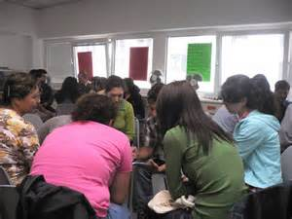
Imagining SRL
Start by reading the two case studies
  What do you notice?
Then discuss at your table:
  Can you “see” self-regulation in the examples?
  Where are the two students engaged in “goal-directed” activity?
  How are their ways of engaging “effective”? From whose point of view?

Slide 18

Stretch Break
(10 minutes)

Slide 19
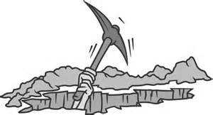
Digging Deeper

Slide 20

Imagining Self-Regulation
You will work with a partner to choose and read an article finding important information about viruses. After reading and discussing what you learned, you will write a 60 second news article to be shared with the class to help them choose their next article.

Slide 21
Probing Deeper:
What is SRL?
Awareness of personal strengths and
limitations; Using that self-awareness
to solve problems and cope
with challenges
Choosing from a repertoire of strategies those best suited to the situation and applying them effectively and efficiently
Metacognition
Strategic Action
Motivation & Emotion
SRL
Affective responses;
Beliefs about ability;
Willingness to try;
Expectations for success

Slide 22
Question One
What dimensions of SRL would be involved or needed for students working through this task?
Where and how could engagement break down?
Metacognition
Strategic Action
Motivation & Emotion
SRL

Slide 23
Question Two
What do students need to "regulate" to successfully navigate a learning activity?
What would that look like in this example?
Body
?
Emotions
?
?
Motivation
Navigating a Task
Environment
?
?
Social Interactions
?
Learning (Cognition)
Strategic Action
(Metacognition)
?

Slide 24
An Integrative Model of Self-Regulation
(Butler, Schnellert, & Perry, 2016)
Overall Classroom Environment
Activities ... Supports ... Assessment/Feedback
Interpreting Tasks
History,
Strengths,
Challenges,
Metacognition,
Knowledge,
Beliefs,
Agency
Adjusting
Cycles of Self-Regulated Activity
Planning
Monitoring
Enacting Strategies
Emotions & Motivation
Butler, 2002; Butler et al., 2011

Slide 25
What Are YOUR Questions?
What do you know and what do you wonder about self-regulation and/or self-regulated learning (SRL)?
Revisit what you imagined as a potential focus
Is there anything you’d add or refine?

Slide 26

SRL and SEL Connections

Slide 27
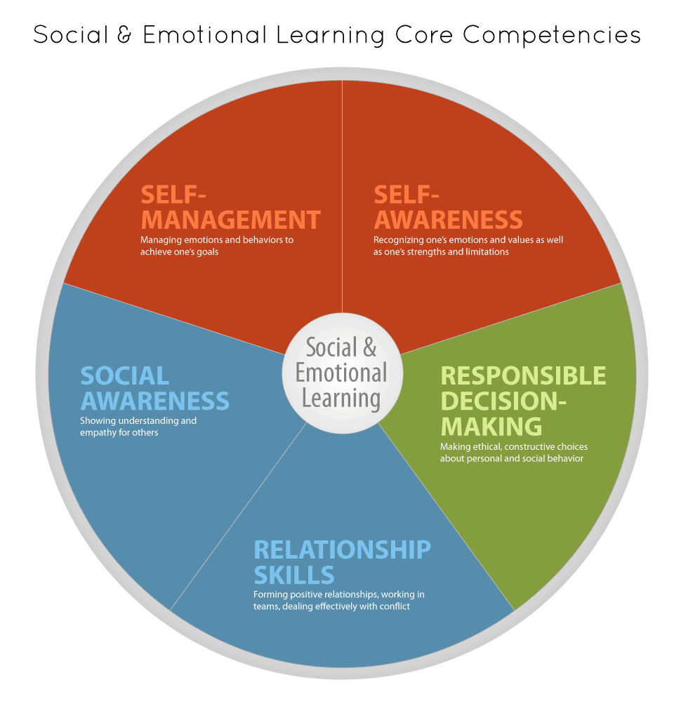

Notes:
What is SEL? According to CASEL, SEL includes the teaching of skills in the following five areas:
Self-awareness: accurately assessing one’s feelings, interests, values, and strengths; maintaining a well-grounded sense of self-confidence;
Self-management: regulating one’s emotions to handle stress, controlling impulses, and persevering in addressing challenges; expressing emotions appropriately; and setting and monitoring progress toward personal and academic goals;
Social awareness: being able to take the perspective of and empathize with others; recognizing and appreciating individual and group similarities and differences; and recognizing and making best use of family, school, and community resources;
Relationship skills: establishing and maintaining healthy and rewarding relation- ships based on cooperation; resisting inappropriate social pressure; preventing, managing, and resolving interpersonal conflict; and seeking help when needed; and
Responsible decision making: making decisions based on consideration of ethical standards, safety concerns, appropriate social norms, respect for others, and likely consequences of various actions; applying decision-making skills to academic and social situations; and contributing to the well-being of one’s school and community.
(CASEL.org)
Questions for consideration:
When you see these core competencies, do any stand out as “more important” for you? In which areas do you feel your students need the most support? How do these competencies work together (can they operate in isolation)?

Slide 28
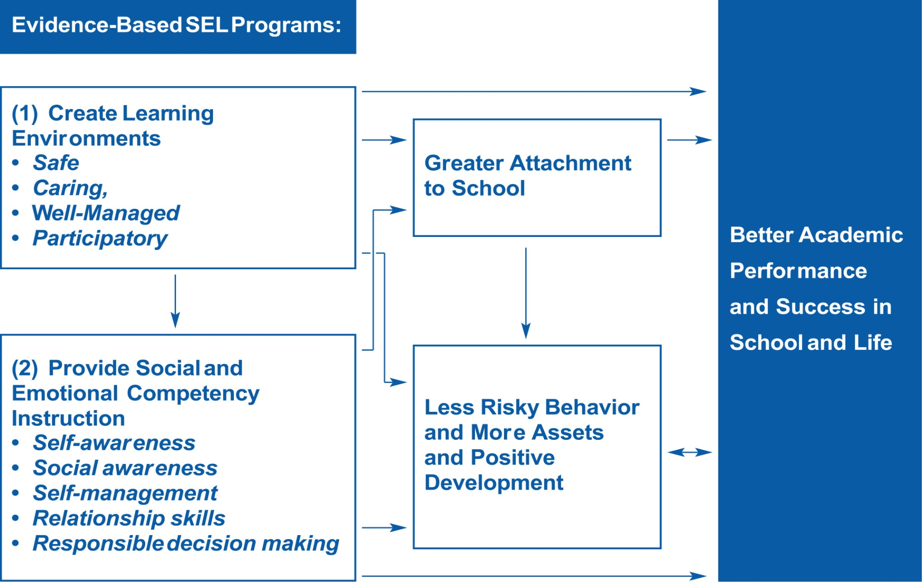
The Process of SEL
Notes:
There is extensive evidence that the two key elements, or approaches, of evidence-based SEL programs (1) creating positive school learning environments and (2) providing social and emotional skills instruction—result in greater academic performance and better long-term life outcomes.
These two key elements of SEL programs are mutually reinforcing. Classrooms filled with socially and emotionally skilled students are more caring and safe, and positive learning environments provide opportunities for students to use and further develop SE competencies.
As you can see, by focusing on skills instruction and creating effective learning environments, students are more attached to school, are less likely to be engaged in risky behavior, are developing more positive assets, and as a result, students are more ready and able to learn. This increases their success in school and beyond. Let’s see how…
Positive Learning Environments:
have caring teacher-student relationships at their center.
are well-managed, participatory, and hold high expectations for all students.
use instructional and classroom management strategies that address students’ social and emotional needs.
are motivating and psychologically and physically safe.
As a result, students in these environments:
feel more connected to peers, teachers, and their school, and they are more likely to adopt the prosocial and proacademic norms promoted by these individuals and settings.
have better academic performance and attendance, as well as significantly lower rates of emotional distress, violence, delinquency, substance abuse, and sexual activity.
In order to participate fully and respectfully in a relationship-centered environment, however, students need basic social and emotional skills. They need to manage themselves appropriately and interact positively with others.
SE Skills Instruction:
Teaching the five core social and emotional competencies in an explicit, systematic and sequenced manner helps students:
Engage in prosocial behaviors (e.g. follow classroom rules)
Avoid risky or problem behaviors, (e.g. delinquency and drug and alcohol use)
Improve their understanding of subject matter when teachers integrate it with other academic content.

Slide 29
What Are YOUR Questions?
What do you know and what do you wonder about SEL and/or SRL?
Revisit what you imagined as a potential focus
Is there anything you’d add or refine?

Slide 30
An Integrative Model of Self-Regulation
(Butler, Schnellert, & Perry, 2016)
How can we design activities, supports, and assessment to foster rich forms of learning?
How can we create inclusive environments in which students feel they belong, are engaged, and know how to learn?
Overall Classroom Environment
Activities ... Supports ... Assessment/Feedback
Interpreting Tasks
How can we support students to learn how to engage in intentional, strategic action?
History,
Strengths,
Challenges,
Metacognition,
Knowledge,
Beliefs,
Agency
What do students bring to contexts that influences learning?
Adjusting
Cycles of Self-Regulated Activity
Planning
Monitoring
Enacting Strategies
How can we help students understand and navigate their emotions and motivation in the service of learning?
Emotions & Motivation
Butler, 2002; Butler et al., 2011

Slide 31

What Can You Do Tomorrow?
Shifting Day-to-Day Language to Foster SRL
Notes:
Deb

Slide 32


Day-to-Day Language in Classrooms
What we say matters.

Slide 33
Strategic Questioning
Notes:
Deb

Slide 34
Using Strategic Questioning by Amy Semple (Delta School District)
It is recess time. The children are asked to put their coats on and line up. This routine has been the same since September. Every single day, Alex (pseudonym) does not do this. He wanders around the classroom and rarely even has his coat in his hands.
In the past, I would always ask him to put his coat on. Since all I have learned, I decided to change my language; I now ask him what his job is. He always knows the correct answer. For this example, his answer would be, “I should put on my coat and line up.” Once he offers that information, he will go, get his coat, and ask for help to put it on.
I have found that this slight change in my language has created a powerful shift! The children (including Alex) are starting to take ownership over what they are supposed to be doing (rather than relying on having the information repeated over and over again). Alex is very capable of following the directions but constantly relies on adults to help him
From Butler, Schnellert, & Perry (2016), Chapter 8
Notes:
Deb

Slide 35
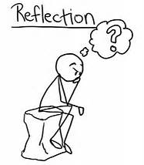
Reflection
How could you use strategic questions to foster metacognition and SRL?

Slide 36
Where Might You Focus?
As we close today, think about where you might want to focus in the coming year
    What have you been seeing in practice?
    What have you tried or are you thinking of trying?
    What will you do between now and our next meeting?
Notes:
Deb, I’m imagining you will orchestrate this activity.
Nancy... I like the idea of including Leyton a bit more in the afternoon. But we can talk about it with him too.
Also imagining that these first discussions will focus on the first question from the “Beginning Reflections” slide; then Leyton might take up the other two questions in introducing the “Wonder Book” activity.

Slide 37

Plan for Our November Meeting
Sharing
    What are you trying?
    How is it going?
Resources (Next Time)
    Inspirational Examples
    Chapter Discussions
Work Time
    What will you do?

Slide 38
Inquiring into SRL
Context: Where might you focus your efforts with SRL-related practices based on what you know about the strengths and stretches of your class? | Refining your focus: What is your goal? What do you plan to try?
Observation. What happened? What did you notice about the students’ reactions and learning? | Reflect and Plan: What more do you need to know? What will you try next?
You can use this tool to record your thinking when you want to try something and reflect on what happens
Notes:
Work time… plan for quadrant one and two... What will you look for? What might you try?
Bridge to idea of reading collaboratively

Slide 39
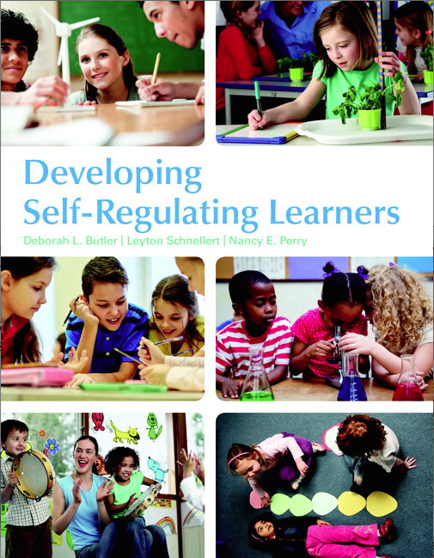
Recommended Resource
Butler, D. L., Schnellert, L., & Perry, N. E. (2017). Developing self-regulating learners. Don Mills, ON: Pearson.
We'll read some of this together this year!

Slide 40
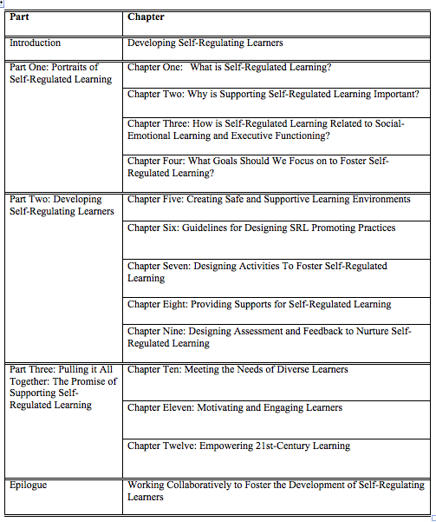
Shared Readings
All Read:
Chapter Five
Choose One of: Chapter Six
Chapter Seven
Chapter Eight
Chapter Nine
For more on today's topics, you can check out Chapters 1-4
(as you wish!)

Slide 41
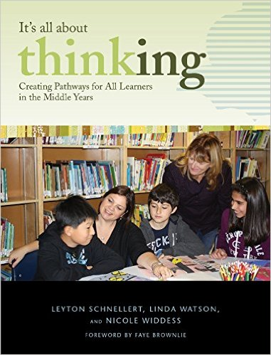
Other Helpful Resources
Schnellert, L., Watson, L., & N. Widdess (2015). It’s all about thinking: Building pathways for all learners in the middle years. Portage and Main. Chapter One.
Brownlie, F., Fullerton, C., & Schnellert, L. (2011). It’s all about thinking: Collaborating to support all learners in mathematics and science. Portage and Main. Chapter One.
Brownlie, F., & Schnellert, L. (2009). It’s all about thinking: Collaborating to support all learners in social studies, English, & humanities. Portage and Main. Chapter One.
Schnellert, L., Datoo, M., Ediger, K., & Panas, J. (2009). Pulling together: Integrating inquiry, assessment, & instruction in today’s English classroom. Pembroke. Chapter One.

Slide 42

Have a Wonderful Evening!

