Slide 1
Dracula Doesn’t reflect – But We Do!
Sharon Jeroski
February 2017
sjeroski@shaw.ca

Slide 2
Self-assessment: Overview
Research suggests that reflection/self-assessment is the most powerful instructional strategy.
The purpose of self-assessment/reflection is to enable students to understand the processes and products of their learning.
This understanding is the foundation of new learning.
The process of self-assessment is what matters; the form/record is less important
Student self-assessment is not a “substitute” for teacher assessment – it is not about matching the teacher’s thinking unless you are only interested in fixed content.

Slide 3
Some forms we can use for self-assessment ...
Photographs (incl selfies)
Lists
Stories
Poems and acrostics
Spoken reflections
Illustrations
Graphic stories (e.g., Comic Life)
Symbols (personal)
Equations (personal)
Collages
Videos (incl selfies)
Body language
Collections
Questions
“The story behind the ...”
Dramatization
“I can” statements
Photos (and photo essays)
Charts made from sorting
Constructions
Found poem
Word cloud
Advertisement/commercial
Reference letter or bio
Interview (written or oral)
Mind map
Other graphic organizers (e.g., Frayer Model; Story Map)

Slide 4
Response mode
Oral interview partner conference | Written Journal - post-it notes “Please notice”
Kinesthetic thumbs up/down 4 corners | Visual/ Symbolic thought bubble choose/match a face (“I feel”)

Slide 5
Notes about self-assessment
Everyone doesn’t have to provide the same evidence
Because ”how” doesn’t matter as much as “why”, we don’t have to do the same thing with everyone
The standardization is in our inquiry and our purpose, not our methods
There has to be action on the results!
We assess because we/students NEED to know
Something should happen/change (even if it is reducing uncertainty)

Slide 6
Developing processes of reflection and self-assessment
Clear learning intentions and criteria
Safe environment
Students believe they can learn and that teachers know how to help them
Differentiation: diverse learning styles, preferences, strengths, needs
Focused instruction

Slide 7
A process for reviewing progress
Getting started. Can be done in group. Let’s talk about some of the work you’ve done (lately, this week, this winter ...). Tell me about something you really liked. What made it special for you?
Teacher makes list of work/activities
Records key words about what made it special
Gathering evidence of strengths. Individual. Tell me about a piece of work or an activity that you are especially proud of. Can you show me your work? (option: Could you make a picture showing what you did?)
Prompt for the story ... (Tell me about ....)
Ask: What makes you proud about this? (What would you like other people to notice?)
Anything else?

Slide 8
Conference. Connecting to core competencies
I notice you are proud of having a new idea and working on it … that is what creative thinking is all about.
Do you think you are getting to be more of a creative thinker or have you always been able to do this?
You also talked about how you worked hard to finish this on your own. That’s one of the things people who have personal responsibility do.
What helped you stick to your work and get it done? What advice could you give younger students about sticking to their work until they finish?
Option: teacher records Core competencies: Creative thinking and personal responsibility”

Slide 9
A process for reflecting on growth
Based on Critical Thinking activity from SD 67 (Okanagan Skaha.) contact Judith King jking@summer.com)
Prepare materials
Prepare a page of words and phrases that relate to the topic/aspect students will self-assess, spaced out for easy cutting.
Sources:
Looks like/sounds like charts and discussions with students with teacher support
Curriculum resources
Classroom/school resources (e.g., Minds Up)
Include some blank spaces
Make sure you have descriptions that show a wide range
Strength-based – all phrased in positive terms

Slide 10
Duplicate the page of words and phrases
Cut them apart and make a set for each student (students can do this.)
Have ongoing large and small group discussions
Start with exploration and discussion, e.g.: find ...
A word or phrase that is sometimes hard to understand
one that your class frequently talks about
Focus on growth mindset: How does anyone get better at [your topic] What does it take to improve? If you were coaching younger students on [topic] what advice would you give them?

Slide 11
Self-assessment options: Getting started
Use the words and phrases for ongoing self-assessment activities and discussions. For example:
Choose two words and phrases that are a lot like you. Give evidence.
Choose one word or phrase you would like to understand more about. Get ideas from at least two classmates about what someone might say, do, and think if they were a lot like this word or phrase.
Give students three cards:
A bit like me Quite Like me Very much like me
-Note; these are from IB self-assessment categories
Have students choose one or two words/phrases that fit each category for themselves and share with a partner or the teacher.

Slide 12
More Options
Several times during the year, have students work with the words and phrases. For example:
Look for opportunities to add new words and phrases as students engage in activities and discussions
Provide some blank cards so students can add words and phrases of their own that are not on the chart
Try options: e.g., start with JUST finding words that are “very much like me,” or choosing/creating just 10 word/phrases to work with.
Take photos of their sorted sets so they can compare from one time to another

Slide 13
More Options
Focus discussions and planning activities on growth
At some point, have students
make a summary statement or represent their growth in some way (make the form accessible for all – does not have to be a written response)
OR
Use the final sort of the words as their self-assessment and give some evidence for a few of the words/phrases
The process of self-assessment is ALWAYS more important than the record

Slide 14
Examples: “I CAN ...”
Celebrate my efforts and my work | Set goals that match my skills
Make healthy choices | Make and carry out a plan
Tell other people about what I am good at | Use strategies that help keep me calm
Be focused and determined | Show what I want and need
Stick with tasks that are hard for me | Stand up for myself and my ideas
Take responsibility for my learning | Keep my personal information private when I am online
Recognize the consequences my actions have on others | Recognize my emotions

Slide 15
Questioning to Prompt Reflection
Generally, questions most effectively stimulate thinking (including reflective thinking) when they are:
Engaging – interesting to think about answer
Authentic – reflecting genuine curiosity about the student’s thinking and ideas
Open-ended – no predetermined or limiting answer
Accessible to students with a range of experiences and abilities
Strength-based – focused on what the student is able to do
Flexible in form of response - open to responses in a variety of forms
Used frequently, and integrated into a variety of activities

Slide 16
Sources of Reflective Questions
Tried and true conference and self-assessment questions that work from your files
Student illustrations on Core Competency website
CAN (Curriculum and Assessment Network) charts
Samples of student work on curriculum website
Teacher professional resources; curriculum resources
Colleagues (e.g., twitter; conferences; professional exchanges)
Students (ask them for questions they would like to answer)
Working together as a department, staff, or group

Slide 17
Sample Questions for Reflecting on Core Competencies
Based on Work from the Curriculum and Assessment Network (CAN) . Note: Many questions touch on more than one competency.
Communication
How did you show you were listening thoughtfully? In what ways did your listening contribute to the group’s understanding?
What are some ways you like to show your learning? What makes [name a form they identified] work for you?
What do you do when you disagree with someone in your group or discussion? How did you learn/develop that strategy?
Critical Thinking
[After some experiences with a topic or question] How has your thinking about .... changed? What made it change?
What strategies do you use to decide whether to believe something you read/on a social media site? How did you develop those strategies? What advice would you give a younger student about figuring out what is true?
[In response to reading/hearing/offering an opinion] Who might have the same opinion about [this issue]? Who can you think of that might disagree? What reasons might they have for seeing things differently?
Creative thinking
How do you come with ideas when you want to make something new – at school or at home? Tell me about a time when you felt really good about a new idea you had?
What helps you get new ideas?
What makes you want to think of new ideas or try something new?

Slide 18
Sample questions (continued)
Social Responsibility
How do you use words and actions to encourage other students who might be feeling a bit sad or discouraged? (What are some words and phrases you use?)
What contribution to our school do you feel good about? How did you get started doing that?
What are some ways you are a good friend? What strategies are you good at for making and keeping friends?
PPC Identity
What are your strengths as a learner?
How do your learn best?
What's most important to you? (Can be anything at school, home, community ...)
Tell me about one or two people or groups that influence your thinking and your actions. Why are they important to you? How do they influence you? How do you influence them?
Personal Awareness and Responsibility
Tell me about one your learning goals. [prompt: Something you want to get better at or learn how to do.] How did you come to choose that goal? Tell me about something you are doing to help you work on that goal.
What do you do to help yourself when you are feeling a bit discouraged about your work?
Think of times when you have to wait. What strategies do you use when you are feeling impatient? How did you develop that strategy? (Prompt: When did you start? How does it work?)

Slide 19
Place in the learning cycle: Before
Parallels diagnostic assessment.
What do you already know?
How can that help you?
What has worked best for you in similar situations?
What will you need help with?
What should I know?
Goalsetting

Slide 20
Place in the learning cycle: During
Key aspect of assessment for learning
Part of all activities:
What are you learning?
How does that match the learning goals or objectives? (or criteria/samples)

Slide 21
Example: Reading Assessment
Good readers know how to solve problems and
understand what they read. Here are some
strategies they use:
❑ reread  ask questions
make predictions  read more slowly
think about what they already know
make pictures in their minds
Look back at the selection. Find
a place where you used a reading
strategy. Tell how it helped you.

Slide 22
Example: Reading Assessment
“The first paragraph confused me because it talked about building extra rail lines and housing for soldiers. I didn’t understand what this had to do with the Halifax Explosion. I read the paragraph over a few times and noticed that it was talking about WWI, so I thought Halifax must be a place where soldiers and war materials were delivered so they could be sent to
the war in Europe. That’s why the
Mont Blanc was carrying 3000
tonnes of explosives. (Gr. 7)

Slide 23
Example: Reading Assessment
Part of assessment rubric:
Metacognition | Not yet within expectations | Meets Expectations (minimal-moderate) | Fully meets expectations | Exceeds expectations
Reflects on own reading processes. Describes a strategy and how it worked | Limited: lacks awareness of own reading processes and Comprehension strategies; does not describe or explain thinking | Somewhat effective: has some basic awareness of own reading processes and comprehension strategies; attempts to describe thinking (basic) | Considerably effective: shows awareness of own reading processes and comprehension strategies; explains thinking | Highly effective: shows insight into own reading processes and comprehension strategies; clearly articulates thinking

Slide 24
Place in the learning cycle: After
Focus still on improving learning, but becoming more summative
Often involves reviewing collections or demonstrations of learning:
Choose work that demonstrates something important about your learning (or that shows how you met your goal or the
objectives.)
Explain your choice.
Includes reflecting on processes:
What worked best for you?
How can use what you learned to
help you with new topics/units?
What was most challenging?
What did you learn about
overcoming challenges?

Slide 25
Gr 3 Science Challenge…
Strength and stability of structures
Design a bridge using one piece of paper and two books that will support the weight of a Hot Wheels car.

Slide 26
Gr 3 Science Challenge…
Would you say your experiment was successful? YES NO Why?
Yes because it was 84 mm far
Yes because it stayed on very good
Yes cause when we moved the desk more and more it never fell
Yes because it wasn’t falling much only when we moved it crookid
Yes because it was 84 mm far. And because we tried it 4 times

Slide 27
Gr 3 Science Challenge…
What would you do to make it better
A bit more stedyer because it will stay
Put two more books on it
I will put thing under the bridge
Just a bit stadyer because I want more books
To just make it more far and steader If I had tape it would be better
Move it a little bit closer or heavier books
Use tape or make it shorter or use more books

Slide 28
Gr 3 Science Challenge…
How do you feel being a scientist?
I feel like a scientist and fun
I fell very, very, very smart
I feel helpful smart nice and very fun
I feel smart and like I can figer out anything
I feel happy cause I get to learn more interesting things and be more smarter.
Smart, helpful, learning more things and teaching others. It’s fun.

Slide 29
Sample: Literature Conversations Courtesy Kathleen Gregory <kathleengregory@shaw.ca>
Criteria: the 4 B's
Bring the book (and have read the part)
Bring questions
Bring notes and ideas
Bring yourself (be part of conversation)
- stay on topic
- give opinions with support from book
- ask questions
- give responses to questions
- be respectful
Next time, I Plan to....

Slide 30
Place in the learning cycle: During
What can we see in your learning?
What should I notice?
What is working best for you?
What would you like to improve?
How can someone help you?
How could you help others?

Slide 31
Examples: Reading
Write about how the story map helped you understand the story.
“The story map helped me understand because it made me think of the details in the story.” (gr. 4)
“The story map helped me because it is sorted with subjects, so it was easier for me to understand the story and that you can write the beginning, middle, and the end.”
“Doing the story map made me understand the story clearly because we had to look in the book for the details. When I read the story I had never thought about the setting.” (gr. 5)
“I think it helped me by leaving out the not
important part and help me understand the
important part.” (gr. 6 ELL)

Slide 32
Examples: Reading
What would you like people to notice about your understanding of this story?
“I want people to know that I understand the story because I know what the little owlets are thinking because they can not speak so I show what they are thinking so whoever has never read this story will sort of have an idea of what this story is like. And I know a lot of people who like comics so they can read this.” (gr. 5 after drawing cartoon panels)

Slide 33
Place in the learning cycle: After
Focus still on improving learning, but becomes more summative
Often involves reviewing collections or demonstrations of learning:
Choose work that demonstrates something important about your learning (or that shows how you met your goal or the
objectives.)
Explain your choice.

Slide 34
Example: Math Journal
What I learned in math
“In math, I learned about graphs, broken line graphs and bar graphs. We also learned about coordinate, frequency tables and line plots. I had a fun time guessing what the coordinates would turn into. I had a hard time understanding sample questions and population questions,
The most easiest thing was
frequency tables & line plots …”

Slide 35
Example: Math Journal (1)
What I learned in math
“In math this year I have learnd about a hole tone of stuff I never knew. I learnt that the population is the age of the group you are surveying. I was really fascenated to learn how to find the rang of data and to find out what a scale is. I allso liked the fact that when you are doing a frequency table you can split the data in to more than 2 equal groups. I
was fasenated with the fact that
line plots and broken line graphs
showed the exact amount of data.

Slide 36
Example: Math Journal (2)
I liked the fact that you can draw a picter by graphing couwordets. Whith the bare graph, I liked that you can draw one vertical or horizontal and you sould title everything with any tipe of interpreting data even a line plot. I also learnt that when drawing a frequency table you all ways need to make the colums all equal. I am looking forward to the test like the
review we did today with are
groups. I am looking forwart to
yousing my nolige with my test.”

Slide 37
Example: Reviewing Progress
Improvement
“This work shows I’ve improved in making polygons. I used to no nothing about polygons but now I know polygons have to have straight lines.”

Slide 38
Example: Reviewing Progress
Best partner work
“This is my best because I worked with my best friend and we helped each other but we gotta lot of questions right. We learned what we did wrong so we’d know what to do nextime.”

Slide 39
Descriptive feedback and self-assessment
Descriptive feedback …
Clarifies objectives, intentions, criteria
Helps students decide what is important
Creates a “tape” that can be replayed
Shows that continuous assessment is part of learning
Develops language

Slide 40
Super Seven
Focus on what students are learning
Be relentlessly strength-based
Engage students in describing criteria (e.g., What will it look like? Sound like?) in student-friendly language
Offer choice in how students respond; find ways to include everyone
Integrate not laminate – part of every lesson, but not always the same
Be purposeful; use what you find out and
help students use what they find out
Be genuinely curious!

Slide 41
Place in the learning cycle: During
Key aspect of assessment for learning
Part of all activities:
What are you learning?
How does that match the learning goals or objectives? (or criteria/samples)

Slide 42
Example: End of Year
Dear Wireless Writing Project,
In the project I have been lucky enough to participate in, wireless writing, I have learned many valuable skills and have seen much improvement in my writing and organization. I have found this to be a very good school year and have seen the quantity of my writing increase drastically. From this experience I have gained many new skills and
have found life much less stressing
as my work is in a tidy environment.

Slide 43
Example: End of term
Give an example that shows your …
Pride
Improvement
Successful collaboration
Originality
Perseverance
Other

Slide 44
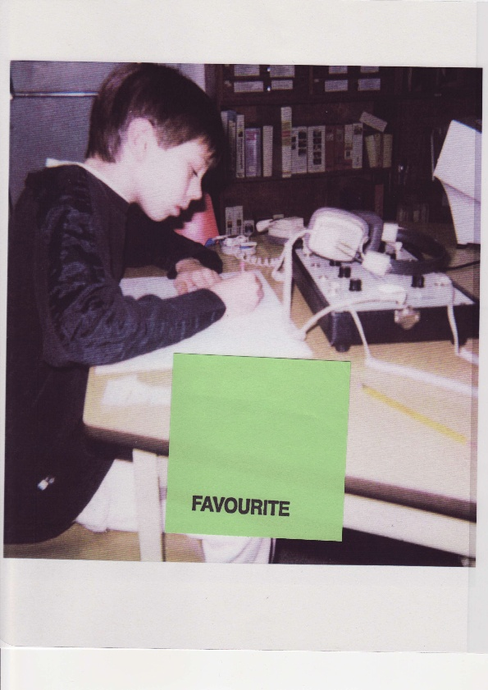

Slide 45
Focus of self-assessment
General to specific
General; reflective – e.g., describe your best learning; draw your ideal classroom and tell why it help your
Specific: concrete – e.g., in your work today, show me a place where …
In between – this class,
today, this week

Slide 46
Example: General
Thinking like a mathematician.
“When I’m working on a problem and I’m stuck I look back on my math book to see if I can find a question like the one I’m working on. Then I follow what I did before.”

Slide 47
Example: General
I know I’m a reader because
I find books interesting
I can read a book in a week
I’m a Fraser
I have a big book at home
I can read books

Slide 48
Example: Acronym Criteria Courtesy of Kathleen Gregory

Slide 49
Example: Daily Self-Assessment
TALK
Tell your ideas
Ask one important question
Listen carefully
Knot the ideas together
Next time, I will try to …

Slide 50
See My Thinking
Think about the math you did today. Use pictures, words, and numbers to show what you were thinking while you worked.

Slide 51
See My Thinking
Draw two thought bubbles, showing how you were using the strategies of a good reader to understand and remember what you read.

Slide 52
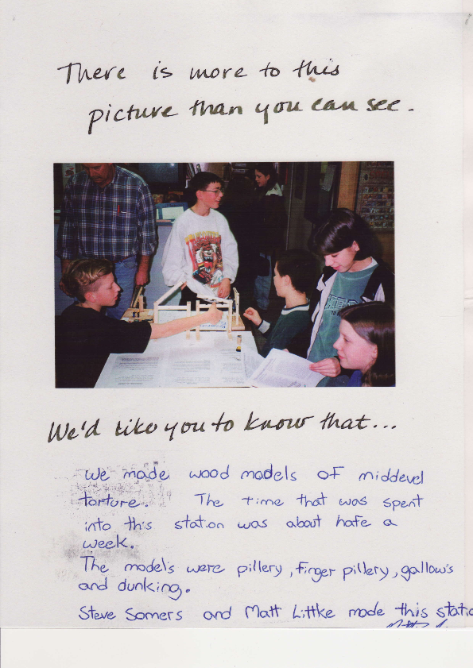

Slide 53
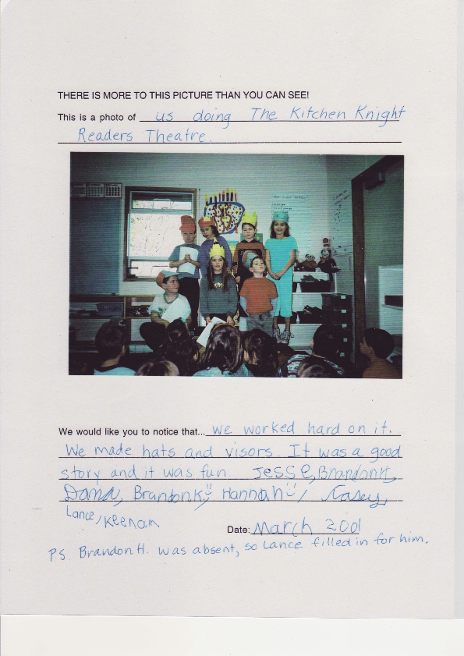

Slide 54
Example: Picture This!
There is more to this photo than you can see.
This is a photo of me "in character" in my first stage role.
I want you to notice that putting on the makeup took about three hours -- and that is all my own hair! I learned how much of yourself you have to put into your character to make it really believeable

Slide 55
Example: Homework
Explain two things you learned today.
Make sure your parents understand.
Ask them to write a note telling what you learned.
Bring it back to school.
Variation: something you
are trying to learn

Slide 56
Sample: Reading Strategies
Ask: When you are making connections, what do you think you should look for? What criteria would tell me that you were using this strategy?
Record and clarify students’ suggestions on a chart. Ask students to reflect on and record or tell about one important thing they learned about being a good reader.
Post the chart for future reference.

Slide 57
Continuing
I need to know how your thinking about connections is going so I can plan the best work for you, so I’m going to do some research. In research, it’s important that I get exactly the right information -- not what you think you should say. So, I need you to close your eyes so my information isn’t biased.
Options include:
thumbs up/down
five-finger survey
use your expression

Slide 58
Next lesson …
Ask students to think about the selection and how they made connections.
Have them create a thought bubble, using pitctures or words, to show connections they made before, during, or after reading.
Share with a partner or group.
Post examples.

Slide 59
Next lesson …
Model writing a journal or Reader’s Notebook reflection about making connections. Be as specific as possible (“I thought about other brave people, and which one was like …”)
Invite students to contribute ideas for a shared reflection about how they made connections, and how the connections helped them to read and understand the selection.
Start a list of words and frames

Slide 60
Next lesson
Have students reflect on how they made connections, and and tell a partner about how their connections helped them read and understand the selection.
Make a shared of list of language that helps you talk about connections.

Slide 61
Next lesson
Ask students to write a short entry in their journals or Reader’s Notebooks about how they made connections. Ask them to include how their connections them read and understand the selection. Some may prefer to show this by drawing thought bubbles.
Scaffold as needed. Review word lists, frames as needed.
Provide feedback (peer/ teacher)

Slide 62
More lessons ..
Have students write about how they made connections as they were reading. Ask: What did you do to make sure your connections helps you understand and remember.
Vary response format; continue feedback

Slide 63
End of sequence
Write about when making connections helps with your reading. Explain if there are times when it is more/less helpful.
What tips would you give other students about making connections?
Did writing and drawing about your thinking help? Tell why or
why not.

