Slide 1
Neuroimaging of Reading
Dr. Tony Herdman
Michael Smith Scholar
Assistant Professor
Department of Psychology, SFU
Supported by:
Michael Smith Foundation for
Health Research

Slide 2
Overview
Brain Networks
Models of Reading and Language
Orthographic Processing
Letter-Speech Integration

Slide 3
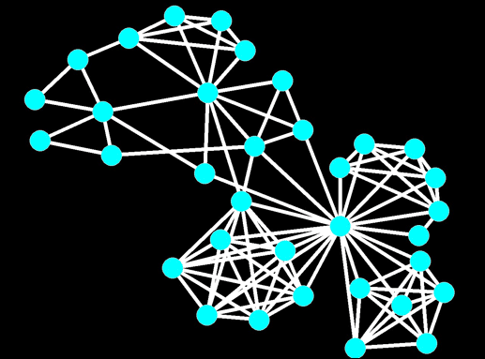
Networks
Motor Plan
Semantics
Speech
Generation
Orthography
Phonology

Slide 4
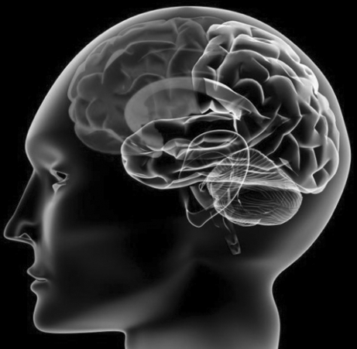
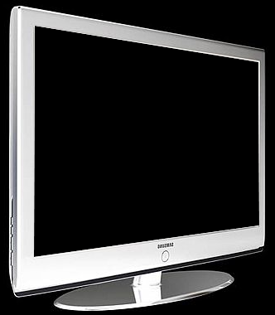
Classical Reading & Language Model
Motor
Semantics
Speech
Generation
cheese
Phonology
Orthography

Slide 5
Classical Reading & Language Model
Motor
cheese

Slide 6
MEG
Brain Reponses ~ 100-300 femtoTesla (10⁻¹⁵)
Earths magnetic field ~ 30-60 microTesla (10⁻³)

Slide 7
Word Reading
SOUP
SHOE
BALL
CAR
PEN
KEY

Slide 8
Word Reading
Sight
(orthography)
Repeat
Generate
MEG
Speech
(Generation)
(Herdman et al., Cerebral Cortex, 2007)

Slide 9
Speech Processing
Sight
(orthography)
Repeat
Generate
MEG
Sound
(phonology)
Speech
(Generation)
(Herdman et al., Cerebral Cortex, 2007)

Slide 10
Classical Reading & Language Model
Motor
Semantics
Speech
Generation
cheese
Phonology
Orthography

Slide 11
Orthography
cheese
Orthography

Slide 12
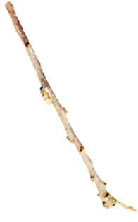
Orthography
“To the uneducated, an ‘A’ is just three sticks.”
Winnie the Pooh

Slide 13
Orthography
“To the uneducated, an ‘A’ is just three sticks.”
Winnie the Pooh

Slide 14
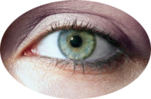
Model of Reading
(Dehaene, et al., TICS, 2005)

Slide 15
Model of Reading
Letter: A
Pseudoletter ?
A
A
Z
K
input

Slide 16
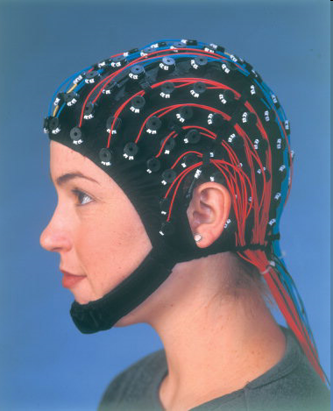
Letter Perception Study
Children (12-13 years old)
EEG
P1
Letter
Psuedoletter
N1
7 ms
(Herdman et al., submitted)

Slide 17
Neural Networks

Slide 18
Neural Networks
Letter
Pesudo
letter

Slide 19
Model of Reading
Letter: A
Pseudoletter ?
A
A
Z
K
input

Slide 20
Letter-Sound Pair Learning

Slide 21
Letter-Sound Pair Learning

Slide 22
Letter-Sound Pair Learning
Phonology
Orthography

Slide 23
Reading Impaired Brain
Motor
Semantics
Speech
Generation
cheese
Phonology
Orthography

Slide 24
Reading Impaired Brain
MEG
(Herdman et al., submitted)

Slide 25
Summary
Brain performs complex functions in many different regions
Learning modifies brain to make it more efficient
Reading impairment can be caused by one or more disruptions in the reading network
Findings support a holistic approach to learning and intervention

Slide 26
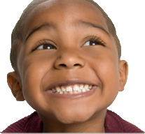
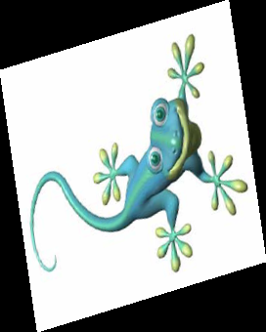
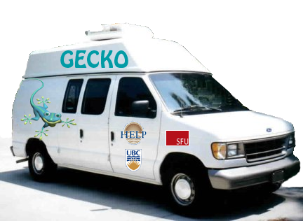
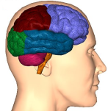
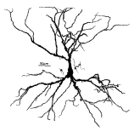
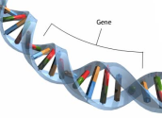
Experience &
Behaviour
Neural
System
GECKO
Project
GECKO
Project
Gene Expression
Collaborative
for Kids Only
Cell &
Synapse
Gene Expression
Collaborative
for Kids Only
Gecko.Project@ubc.ca
Gene &
Transcription
Gecko.Project@ubc.ca

Slide 27
GECKO
Project
Gene Expression
Collaborative
for Kids Only
Gecko.Project@ubc.ca

Slide 28
Thank You for Your Attention
Supported by:
Michael Smith Foundation for
Health Research

Slide 29
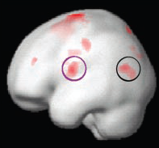
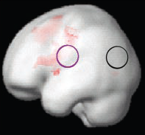
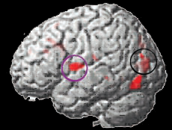
Reading Impaired Brain
Fast ForWord
Normal Reading Children
Rhyming
Dyslexic Reading Children
Rhyming – Before Intervention
Dyslexic Reading Children
Increase After Intervention
(Temple et al., PNAS, 2003)

