Slide 1
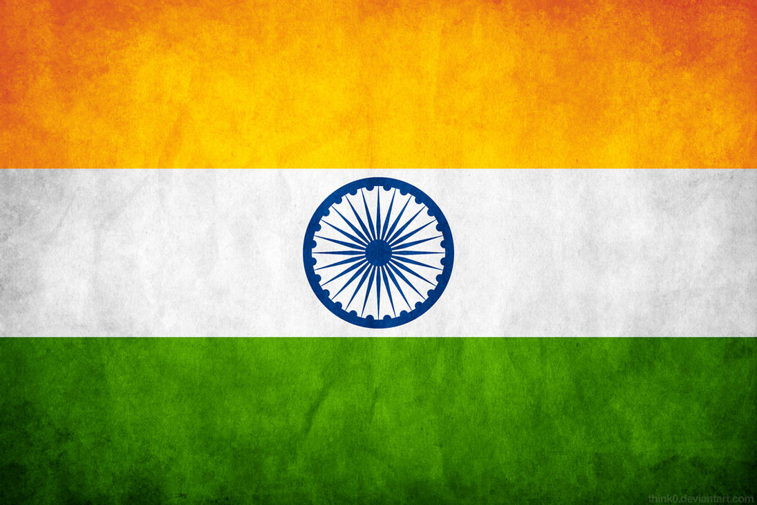
Vaisakhi celebration
Visākhī
dā jaśana

Slide 2
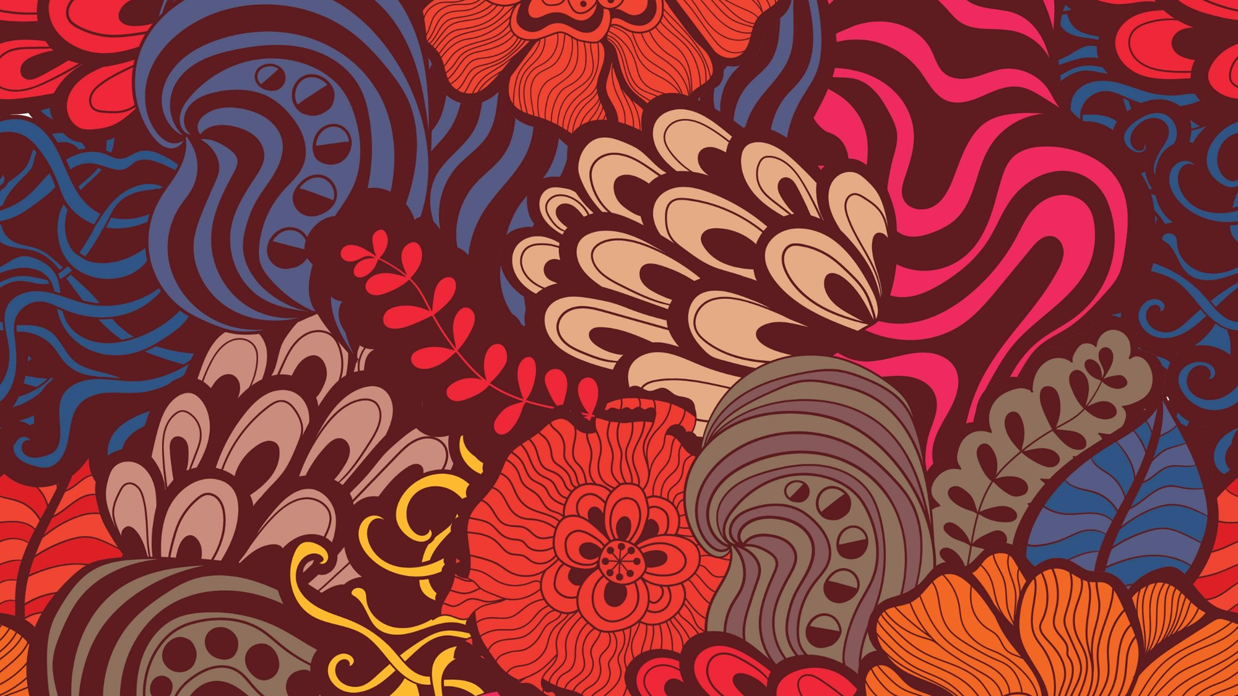
Date of Celebration
Tuesday, April 13, 2021

Slide 3
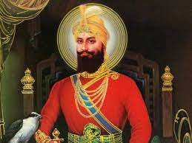
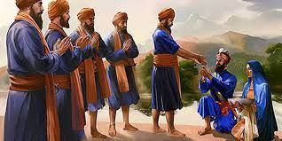
• It is the Sikh New Year's Festival and is one of the most important dates in a Sikh calendar • Vaisakhi, is also known and pronounced as Baisakhi • Vaisakhi originated as a harvest festival, but it is so much more than that • It serves as a reminder to the Sikh community of the Khalsa (Sikh faith) order, which promotes justice & equality for the creation of a more equal and just society. • It originated in the Punjab region (the northern part) of India, but celebrated in Sikh communities around the world. • Celebrating is held on April 13th or 14th every year.
What is Vaisakhi

Slide 4
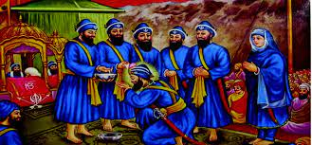
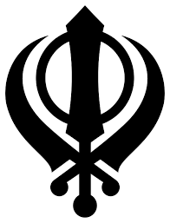
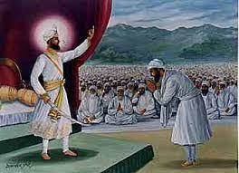
• It commemorates the formation of Khalsa in 1699, the year Sikhism was born as a faith. • During Vaisakhi in 1699, the tenth Guru of the Sikhs, Guru Gobind Singh Ji, chose Vaisakhi as the occasion to test the courage and faith of his followers • During the original Vaisakhi festival in 1699, Guru Gobind Singh challenged any Sikh ready to give their lives for their religion • 5 men came forward, the Guru called these men “the beloved 5”, for their courage and bravery, he baptized these 5 men and declared them the first members of Khalsa
What are the origins of Vaisakhi?

Slide 5
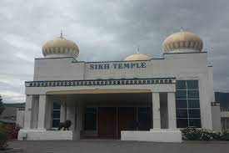
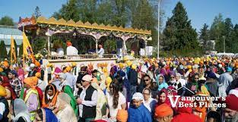
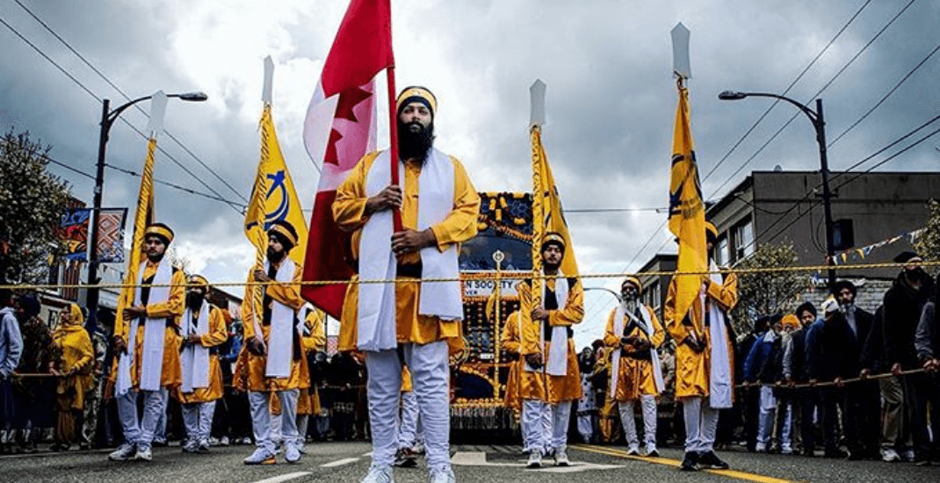
• There are many parades across BC that celebrate Vaisakhi, two of the biggest are in Surrey and Vancouver. • These parades allow Sikhs and others to celebrate and honor Vaisakhi. • Sikhs begin Vaisakhi with a visit and religious service at the Sikh Temple (Gurdwara). Following the services begins a day of celebration. • The Gurdwaras allow people of all ethnicities to come together, pray and celebrate.
Vaisakhi Celebration

Slide 6
• People wear colorful, traditional clothing as they take part in parades through out the streets. People celebrate with singing, dancing and chanting of hymns. • During the festival, many people perform a traditional folk dance known as the Bhangra. • During the parades there are many activities, such as getting a turban tied, watching folk dances, honoring old battle weapons in how Khalsa members showed courage and bravery • In honor of Vaisakhi, enjoying a wide variety of Indian sweets and Indian dishes is also an integral part of the celebration every year.
Vaisakhi Celebration con’t
Play short video

Slide 7
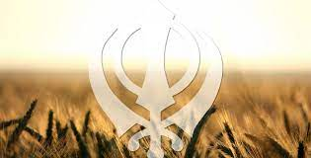
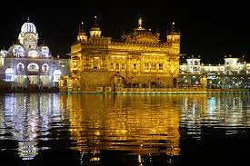
• Vaisakhi is honored and celebrated with lots of Indian sweets and Indian dishes. All of this food is given away for free. Sharing and giving of food, this tradition is called “Langar”, where everyone in the community, no matter how rich or poor they are, would come together, share a meal and celebrate Vaisakhi • Vaisakhi is celebrated in many different countries
Con’t Vaisahki Celebration

Slide 8
Activity time!

Slide 9
Fun Facts/Interesting Facts about Vaisakhi
Instructions:
True or False Questions to share with students

Slide 10
1. Are Sikhs the only people who celebrate Vaisakhi?
Yes
No

Slide 11
Answer: NO
- Hindus and Buddhists also celebrate Vaishaki.
- Hindus celebrate it quite similarly and for them Vaishaki is Hindu Solar New Year Harvest festival.
- Buddhists celebrate Vaishaki by going to a local temple and staying there through-out the day and doing many good deeds.

Slide 12
2. Are India and Canada the only countries to celebrate Vaisakhi?
Yes
No

Slide 13
Answer: NO
- Many other countries also celebrate Vaishaki
- Pakistan, Malaysia, Afghanistan, Africa, United States, and United Kingdom

Slide 14
3. Is Vaisakhi inclusive to all different people from all different cultures?
Yes
No

Slide 15
Answer: YES
- Vaisakhi although celebrated by primarily Sikhs does not discriminate if people from other cultures take part in the activities. It is encouraged to do so.

Slide 16
4. Is Vaisakhi observed by farmers who pay their tribute by thanking God for abundant harvest?
True
False

Slide 17
Answer: TRUE
- Farmers see Vaisakhi as a thanksgiving day in which they do indeed pay tribute to the gods and pray.

Slide 18
5. Were Sikhs given the middle names Singh (for men) and Kaur (for women)?
True
False

Slide 19
Answer: TRUE
- Most if not all Sikhs either have Singh as a middle name if male and Kaur as a middle name if female.

Slide 20
Thank you Burnaby Central!!! Happy Vaisakhi!

